Slide 1
Compensable Hours Worked by FLSA Nonexempt Employees
University of Wisconsin-Madison
Office of Human Resources

Slide 2
Table of Contents
What is the Fair Labor Standards Act (FLSA)?
What is the difference between exempt and nonexempt?
Exemption tests
Compensatory time
What constitutes “hours worked”?
Summary
University of Wisconsin-Madison \\ Office of Human Resources

Slide 3
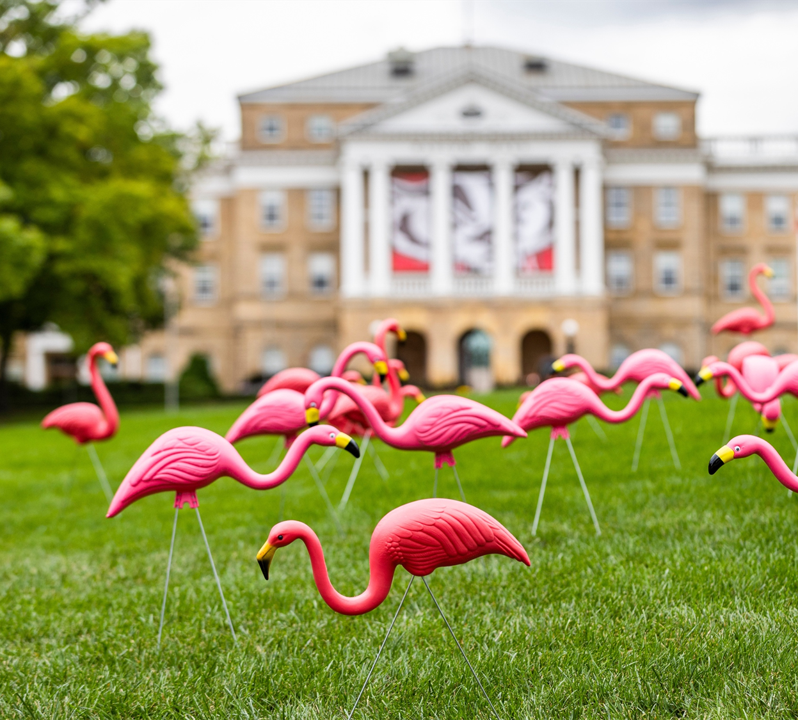
What is the Fair Labor Standards Act?
A brief review of relevant impacts to compensable hours worked
University of Wisconsin-Madison \\ Office of Human Resources

Slide 4
What is the FLSA?
The Federal Labor Standards Act (FLSA) is a US federal wage and hour law. UW-Madison is considered “covered” because it provides an activity of a public agency.
Minimum wage and overtime pay requirements are determined by this law.
All employees at covered employers are considered by the Act, but some employees are exempt from overtime pay provisions (generally salaried) and some are nonexempt (generally hourly).
The FLSA requires that nonexempt employees be paid 1.5 times the regular rate of pay in overtime (OT) or compensatory time for all hours worked over 40 in a workweek.
University of Wisconsin-Madison \\ Office of Human Resources

Slide 5
What is the difference between exempt and nonexempt?
Exempt
  Salaried
  Paid based on an annual salary
  Leave accounted for in half-day increments
  Not eligible for OT/compensatory time
Nonexempt
  Hourly
  Paid based on an hourly rate for time worked
  Leave accounted for in 15 minute increments
  Eligible for OT/compensatory time
University of Wisconsin-Madison \\ Office of Human Resources

Slide 6
Exemption Tests
There are a wide variety of exemptions in the FLSA.
The most common ways to qualify for exemption from FLSA minimum wage and overtime requirements are based on meeting the three following tests:
  Salary Basis Test: Employees must be paid on an annual salary basis; and
  Minimum Salary Test: Currently, employees must be paid above a salary threshold amount of $844 per week or $43,888 annually; and
  Duty and Discretion Test: Employees must qualify as an executive, administrative, professional or computer professional.
University of Wisconsin-Madison \\ Office of Human Resources

Slide 7
Remote Work
The UW-Madison Remote Work policy is located here.
Remote work at UW-Madison is guided by use of Remote Work Agreements (RWAs) which reflect the terms and conditions of the remote work being performed and documents its frequency.
Remote work poses unique challenges for nonexempt employees because of reporting work hours. Reporting compensable hours worked is the same for remote employees.
University of Wisconsin-Madison \\ Office of Human Resources

Slide 8
Compensatory Time
Linked here is the UW-Madison policy for overtime.
  Nonexempt employees may receive compensatory (comp) time, at a rate of 1.5 hours for each overtime worked, instead of cash overtime pay.
  If a division allows employees to receive time, an employee may accumulate up to 80 hours of comp time.
  This division has the discretion to approve scheduled use.
University of Wisconsin-Madison \\ Office of Human Resources

Slide 9
What Constitutes Hours Worked for Nonexempt Employees?
Compensable time under the FLSA is referred to as “hours worked”.
The amount of pay that a nonexempt employee should receive cannot be determined without knowing the number of hours worked.
University of Wisconsin-Madison \\ Office of Human Resources

Slide 10
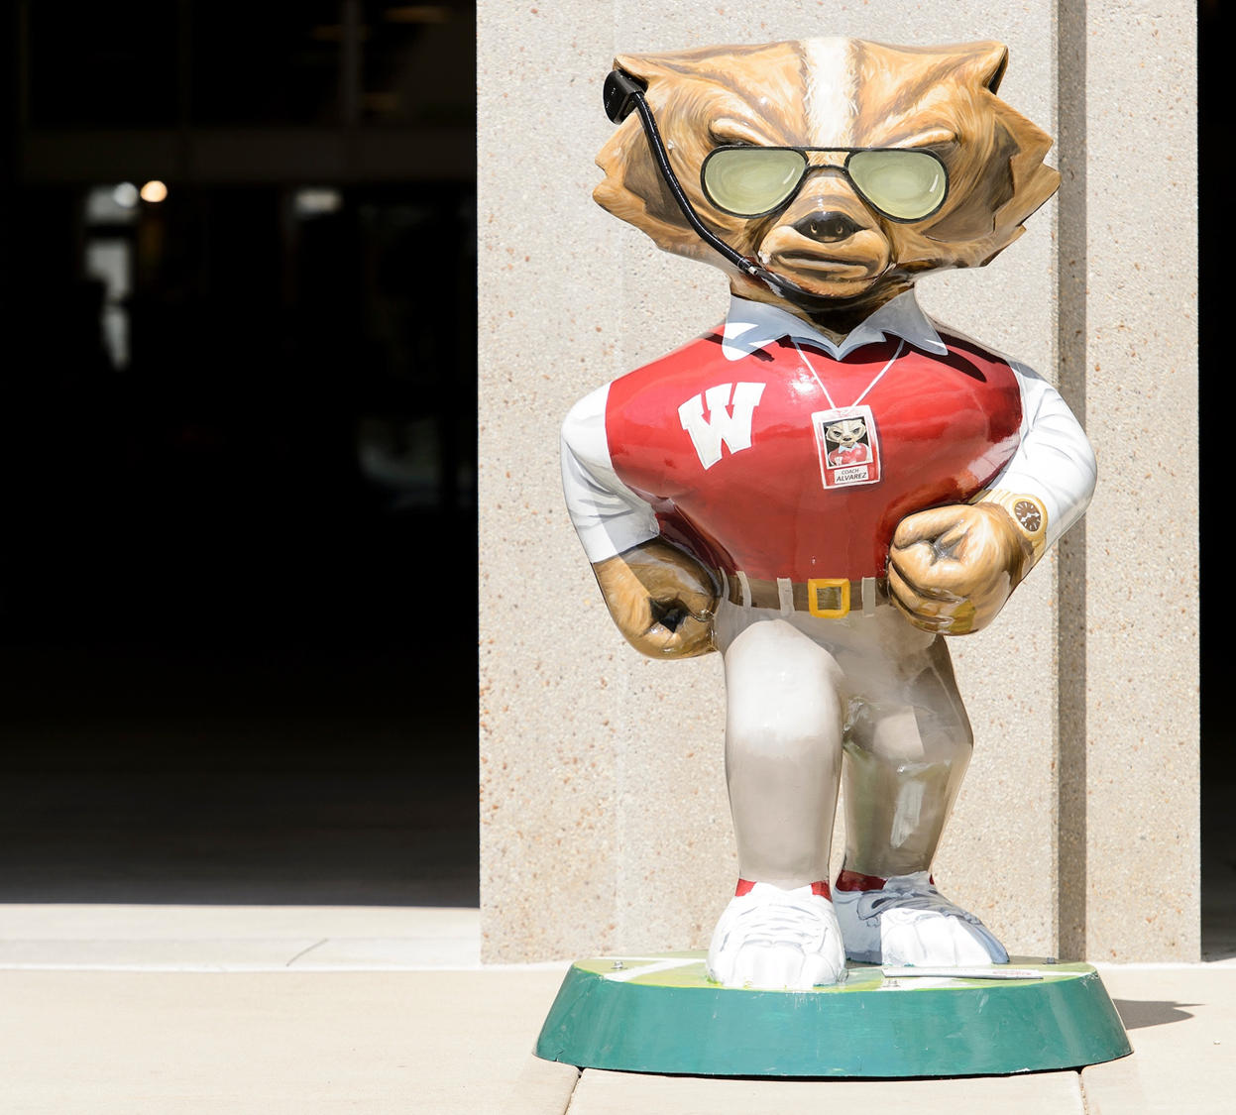
Hours Worked: A breakdown of important categories
This section details examples of when something is considered work time and when it is not
University of Wisconsin-Madison \\ Office of Human Resources

Slide 11
Department of Labor (DOL) Fact Sheets
The DOL provides summaries of important labor and employment laws in the form of fact sheets which explain the most important pieces of the laws it enforces in plain language.
Please refer to the DOL Fact Sheet #22 for additional information related to these slides on Hours Worked. Where a different law applies, a link is provided in that slide.
University of Wisconsin-Madison \\ Office of Human Resources

Slide 12
Overtime
Nonexempt employees must be paid overtime or receive compensatory time credits at a rate of 1.5 for every hour worked over 40 in a workweek.
  The workweek ordinarily includes all time during which an employee is required to be at work.
  This does not include hours of paid leave time
  Compensable hours worked are the same for all nonexempt staff
  Overtime is paid for going over 40 hours in a week and not for going over 8 hours worked in a day
University of Wisconsin-Madison \\ Office of Human Resources

Slide 13
Meal Periods and Breaks
Considered work time:
Rest or meal periods where the employee is not completely relived of duties or where the period is less than 30 minutes in length. For example, if the employee eats at their desk and listens for the phone, it is work time.
Breaks of 20 minutes or less.

Slide 14
Meal Periods and Breaks
Not considered work time:
Bona fide meal periods of 30 minutes or more where the employee is entirely relieved of duties.
Employees should be encouraged to leave their desks or the worksite if the lunch/break period is to be unpaid.

Slide 15
Work Performed Outside of Regularly Scheduled Hours
Please refer to 29 USC §785.11, §785.12 for additional information related to this slide.
Considered work time:
  Work performed outside of regularly scheduled hours which is permitted but not requested by the employer. If the employer knows or has reason to believe work is being performed, it must be counted as hours worked. This includes significant time using the phone or reviewing messages after hours.
Not considered work time:
  Work done at home of which the employer has no knowledge or no means of acquiring knowledge.
University of Wisconsin-Madison \\ Office of Human Resources

Slide 16
Volunteerism
An employee may not volunteer to perform extra duties related to one’s job.
Employees cannot do extra work for the employer and waive payment for hours worked.
University of Wisconsin-Madison \\ Office of Human Resources

Slide 17
Preparatory and Concluding Activities
Please refer to 29 USC §785.24 for additional information related to preparatory and concluding activities.
Considered work time:
  Preparation activities that are integral to principal activities and indispensable to performance of the job.
Not considered work time:
  Changing clothes if for the employee’s convenience and not directly related to principal activities. Waiting in line to punch in or out or waiting to start work at a designated hour.
University of Wisconsin-Madison \\ Office of Human Resources

Slide 18
Training Time
Considered work time:
  Attendance at lectures, meetings, training programs and similar activities outside of regular work hours must be counted as work time if the employee is led to believe that attendance is mandatory or involuntary.
Not considered work time:
  Attendance at lectures, meetings, training programs and similar activities which is voluntary, outside of working hours, not job-related and no other work is performed.
University of Wisconsin-Madison \\ Office of Human Resources

Slide 19
Travel Time
  Considered work time:
    Travel to a meeting place or alternate work location during the normal workday.
    Travel site-to-site as part of the employee’s normal duties.
    Travel after an employee has gone home which requires the employee to go a considerable distance after the workday to respond to an emergency.
    Travel away from the home community overnight.

Slide 20
Travel Time (continued)
  Not considered work time:
    Travel to and from the employee’s home to the work site.
    Travel required to return to the workplace after hours to respond to an emergency.

Slide 21
Travel – Wisconsin Law
Considered work time:
  For additional information related to travel as it relates to Wisconsin Law please refer to (Wis. Adm Code DWD 272.12 (2)(g).
  If an employee is offered public transportation but requests to use a personal vehicle instead, the employer may count as time worked either the time spent driving or the time the employee would have been in the public conveyance.
University of Wisconsin-Madison \\ Office of Human Resources

Slide 22
Waiting Periods
Considered work time:
  Unpredictable short periods of inactivity when the employee is engaged to wait.
Not considered work time:
  Periods of inactivity when the employee is waiting to be engaged or when the length of time is long enough (at least an hour) for the employee to use the time as one pleases without constraints.
University of Wisconsin-Madison \\ Office of Human Resources

Slide 23
Independent Education
Not considered work time:
  Attendance at a college or trade school after hours on the employee’s own initiative, even if the course is related to the employee’s job.
  Attendance outside of working hours at specialized or follow-up training that is required by law for certification.
University of Wisconsin-Madison \\ Office of Human Resources

Slide 24
Summary
The employer must pay for any work done by a nonexempt employee of which the employer had knowledge even if the work was not preapproved.
Any work performed by the nonexempt employee which the employer allows and does not affirmatively stop is paid work time.
This includes work performed after regularly scheduled hours.

Slide 25
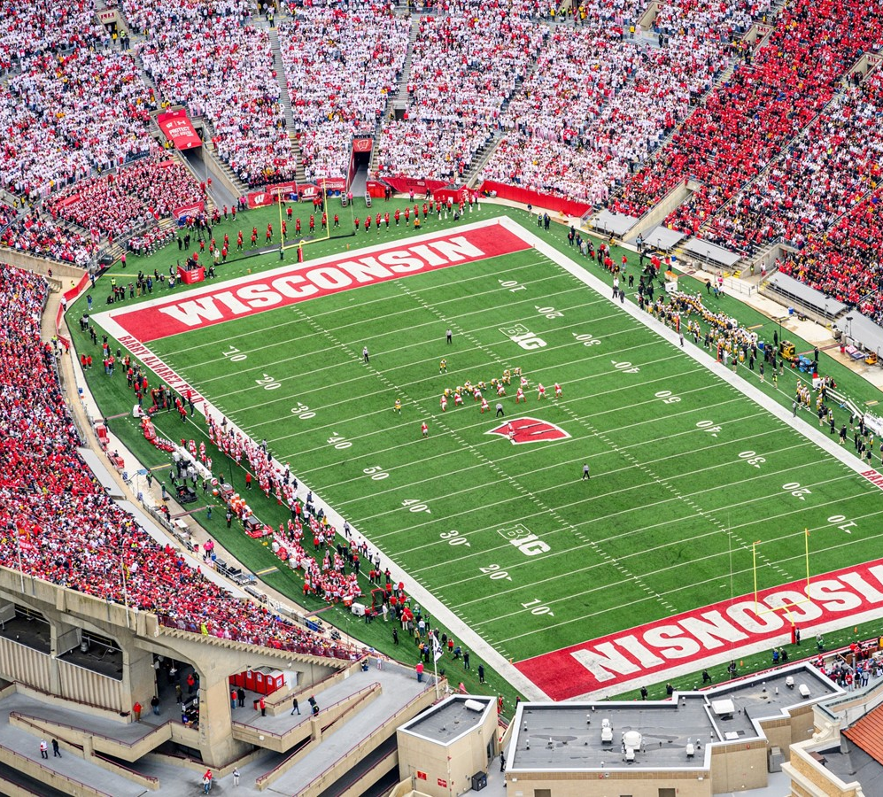
UW-Madison Specific Guidance
Here are some useful guidelines for UW-Madison employees specifically
University of Wisconsin-Madison \\ Office of Human Resources

Slide 26
Helpful Reminders
There is no distinction in timekeeping requirements between nonexempt university staff and nonexempt academic staff.
Overtime or compensatory time is earned after 40 hours worked in a workweek, not 8 hours in a day.
Paid time off does not count toward the 40 hours.
A meal period must be 30 minutes or more to be unpaid.
University of Wisconsin-Madison \\ Office of Human Resources

Slide 27
Questions?
If so, direct them to your divisional human resources office and they will be happy to assist you.
University of Wisconsin-Madison \\ Office of Human Resources

