Slide 1
Instructions for Presenting this Slide Deck
In the facilitator guide, you will find:
A script that you can use to present the information in this slide deck.
Timing estimates for each section,
Timing for the engagement activities
Tips to make the engagement activities run smoothly.
If your room has more than 30 people, some people will not be able to use a computer.
When you give employees time to log into Workday, you can ask people to move around to give access to computers if some people only want to use their phones.

Slide 2
Capacitaciones presenciales de Workday
ESPAÑOL / SPANISH
Semana 1
Regístrese en la lista de asistencia al frente del salón
Siéntese en una computadora disponible
Notes:
Welcome to the Workday In-Person Training Series. My name is [your name] and I'll be facilitating today's training. I work at [your unit] as a [your job title]. With us here today to help are [introduce helpers]. [Allow helpers to introduce themselves – their names, where they work, etc].
If you haven't yet signed in, we will bring the sign-in sheet to you, so you can raise your hand.

Slide 3
Qué esperar
Vamos a…
enseñarle a hacer tareas en Workday
darle tiempo para practicar
No podemos…
responder sus preguntas personales
hablar sobre las políticas de departamentos específicos
Notes:
So, let's talk about what you can expect to do during our time together.
We will...
review how to complete tasks in Workday
give you time to practice completing tasks
You'll see the computers in front of you, and we will walk through using those here in a little bit.
Some things we will not be able to do today...
answer personal employee questions
If you do have questions about your job or any personal details, we cannot answer those today. We would encourage you to talk to your supervisor or your local HR staff to help you with those personal questions.
address department-specific policies or procedures
We know that different departments and units have different policies and procedures, so if you have a question about how something will work in your own department, you should talk to your supervisor.

Slide 4
Visión general de las capacitaciones
Iniciar sesión en Workday
Ver los recibos de pago y los saldos de licencia
Actualizar los formularios de impuestos (W4) y la dirección de residencia
Actualizar el depósito directo
Solicitar tiempo de licencia (time off)
Aplicar a trabajos en UW
Buscar ayuda
Notes:
So let's talk about some things we will review over the next few weeks. We will review how to
Log into Workday
View payslips and leave balances
Update tax forms (W-2, W-4) and address
How to apply for internal positions
How to get help

Slide 5
Objetivos de aprendizaje
Para el final de la sesión de hoy, sabrá cómo:
iniciar sesión en Workday en un teléfono o una computadora
navegar la pantalla principal (home screen)
actualizar su información personal
Notes:
Today, specifically, here are our learning objectives. By the end of today's session, you will know how to:
Log into Workday on a phone or computer
View and print a payslip
Review your time off balance
Request time off

Slide 6
Acuerdos para el día de hoy
Escuche y practique tareas nuevas.
Levante la mano si tiene preguntas o necesita ayuda.
Siga al/a la presentador(a). No se adelante.
Pida permiso antes de mirar la pantalla de alguien.
Notes:
As we present information today and give you time to practice, we’ll ask you to:
Stay engaged – Listen to the presentation and use the time to practice.
Listening to the presentation will help you know what to do during our practice times.
Ask questions – Raise your hand if you have a question or need help during the practice times.
Follow along – Don’t work ahead or do other things. Follow along with the presentation, so you don’t get lost.
Ask before you look at someone’s screen – Sometimes, we will look at personal information, like payslips and benefit choices. Before you look at someone’s screen (even if you are helping them), ask if it’s OK.
Some people may be comfortable with you helping, but others might not. So, always ask first.
If you think you can agree to these, give us a thumbs up.

Slide 7
Conversación en parejas
Preséntese a la persona a su lado
Nombre
Dónde trabaja
Discutan:
¿Qué han escuchado sobre Workday?
¿Cómo creen que usarán Workday?
Notes:
Before we start our overview of Workday, I’m curious to know what you have heard about Workday.
Please talk with someone close to you. Introduce yourself (your name and where you work), and talk about two questions:
What have you heard about Workday?
What do you think you can use Workday for?
*Note to Facilitator: – Give the participants about 5 minutes to chat. When they are done, ask for a few volunteers to share what they have heard, or what their prior knowledge of Workday is.

Slide 8
Visión general de Workday
Notes:
First, we will review what Workday is and what you will use it for.
Facilitator tip:
Try connecting some of the information in this section to what the participants shared from the partner discussion. This will help keep them engaged.

Slide 9
¿Qué es Workday?
Workday es un sistema nuevo que usarán todos los empleados de las Universidades de Wisconsin.
Workday tiene un sitio web y una aplicación móvil (opcional).
Notes:
So What is Workday?
Workday is a new system all Universities of Wisconsin employees will use for employment-related tasks
You can use the Workday website or an optional aplicación móvil

Slide 10
¿Qué puedo hacer en Workday?
Actualizar su información de contacto
Actualizar su depósito directo
Hacer sus elecciones de impuestos federales y estatales
Ver e imprimir sus recibos de pago
Ver su información de beneficios
Notes:
You can do a lot in Workday! You can:
Submit time off
Update your contact information
Update your direct deposit for paychecks
Choose your federal and state tax elections
View and print pay slips
View benefits information
With Workday, you have direct access to important information about your employment.
For example, you might need a payslip if you apply for a loan or are renting an apartment. You can also see the health insurance you chose in the Benefits app. You can find all this information yourself, whenever you need it.
In this training you will learn how to access this information at any time (including on a mobile device).

Slide 11
Workday
Usted puede:
usar la aplicación móvil
encontrar lo que necesita usando la barra de búsqueda
cambiar su información personal
Notes:
There are many advantages of Workday. For an employee, a few key ones are
You can use the aplicación móvil to access your information
The search bar helps you find what you need quickly
You can change your personal information as well
I think a huge benefit of Workday is that all these things are in one spot. Instead of logging into different systems, you will log into Workday and you can see all your employment information.
Throughout today and the next two weeks, we will talk about key features you may use regularly. And we’ll give you time to explore Workday and practice doing specific actions.
So let's get started!

Slide 12
Iniciar sesión en Workday
Aplicación móvil de Workday
Sitio web de Workday
Notes:
First, we are going to look at the ways that you can log into Workday.
You have two options: from your smart phone with the Workday aplicación móvil or online using a computer or web browser.
We are going to review all of the steps to download the aplicación móvil, and then we will look at how you can log into Workday on a computer. After that, we will give you all time to get logged into Workday, and we will walk around and help as needed.

Slide 13
Lo que necesita
Computadora o teléfono inteligente (smartphone)
NetID y contraseña personales
Teléfono inteligente o dispositivo Duo (Duo Device)
Notes:
For today, here are the things you will need.
To get logged into Workday, you will need a computer or smartphone.
You will also need your personal NetID and password.
You will then have to authenticate using Duo, so you’ll either need your smartphone, or your duo device to authenticate.

Slide 14
Instalar la aplicación móvil de Workday
En su teléfono:
Vaya a la Apple App Store o Google Play Store
Busque y seleccione Workday
Seleccione Install (Instalar) o Get (Obtener)
Acepte los permisos de la aplicación, si es necesario
Notes:
Now, we’ll talk about instructions to download the aplicación móvil. This is optional. You do not have to download the aplicación móvil. However, if you use your phone everyday, it might be easier than logging into a computer.
If you want to download the aplicación móvil now, you can pull out your phone and follow the instructions. You can let the app download while we look at other instructions in Workday.
First, go to the Apple App Store or Google Play Store
Search for Workday in the search field.
Look for the W logo to know that you have the right app.
Select Install or Get and accept application permissions, if necessary

Slide 15
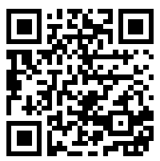
Iniciar sesión en la aplicación móvil de Workday
Abra la aplicación móvil de Workday
Toque Log in (Iniciar sesión)
Ingrese el ID de organización (Your Organization ID) o escanee el código QR
ID de organización: wisconsin
Notes:
First, Open the Workday aplicación móvil
Then, tap Log in
Enter the organization ID in the Your Organization ID field, or scan the QR code
Organization ID: XXXXXXXXX

Slide 16
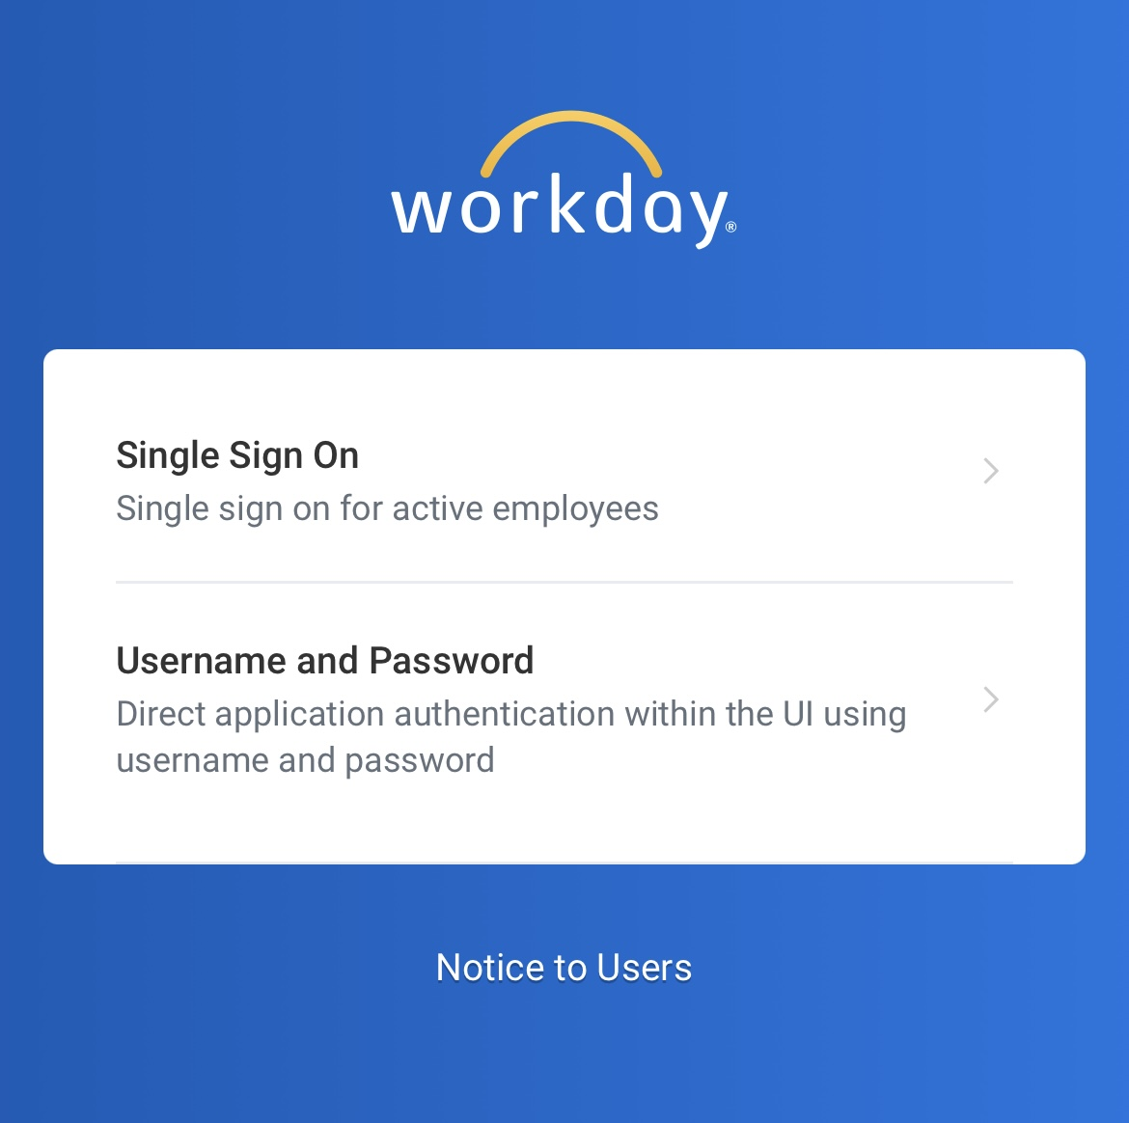
Iniciar sesión en la aplicación móvil de Workday
4. Toque Single Sign On (Inicio de sesión único) en la aplicación
Notes:
Next, you will tap Single Sign On

Slide 17
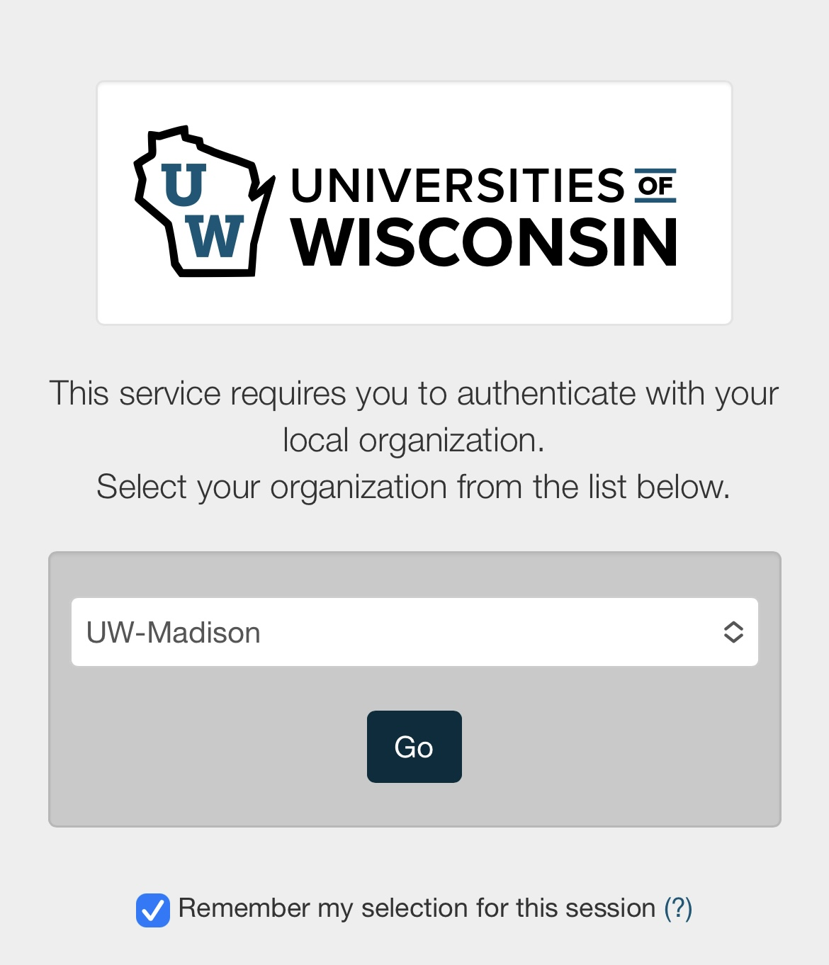
Iniciar sesión en la aplicación móvil de Workday
5. Seleccione UW-Madison
6. Toque Go (Ir)
Notes:
That will take you to this screen, where you need to select UW-Madison from the dropdown menu
Then tap Go

Slide 18
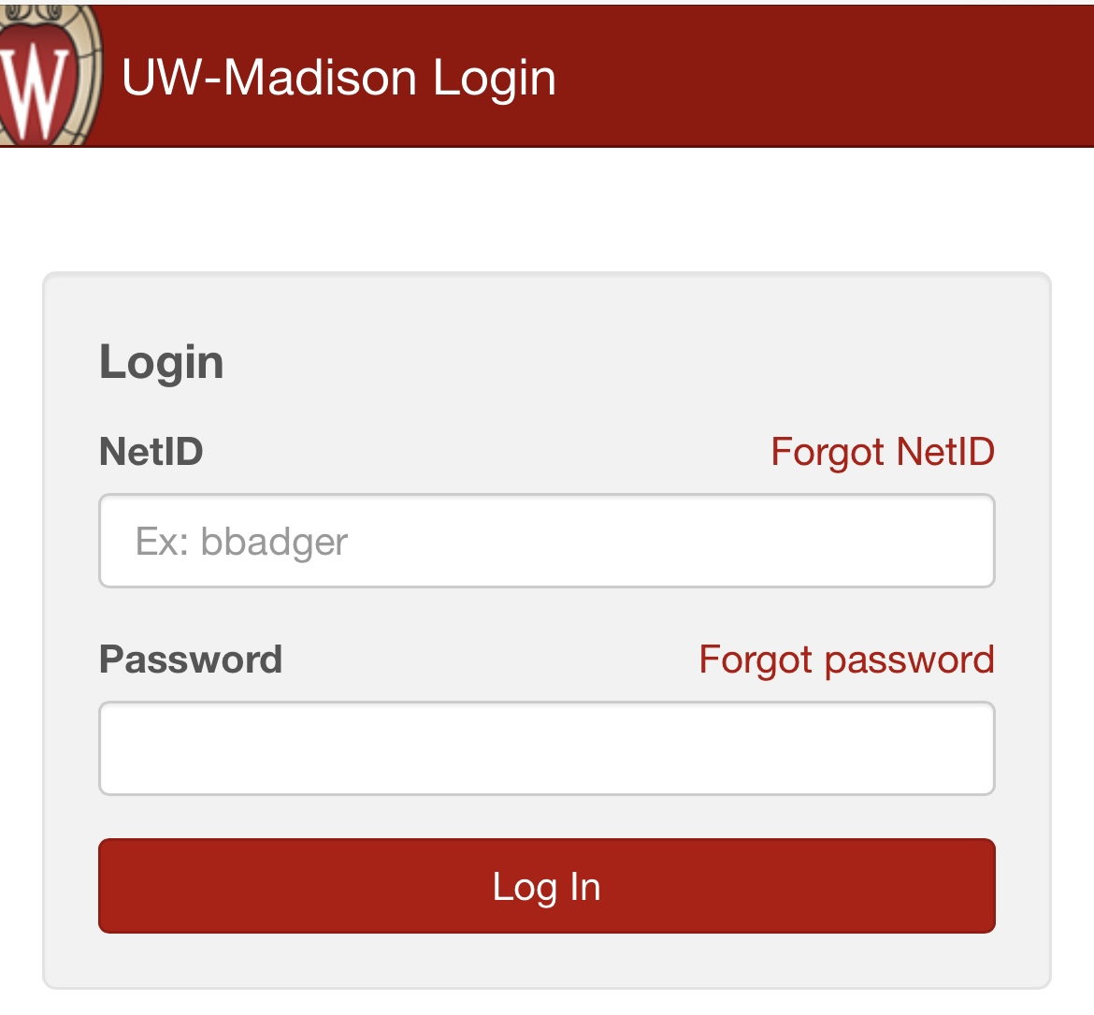
Ingresar sus credenciales de UW
7. Ingrese su NetID y contraseña (password)
8. Toque Log In (Iniciar sesión)
Notes:
Here is where you will need to enter your NetID and password.​
Type in your NetID and Password​
Then tap Log In

Slide 19
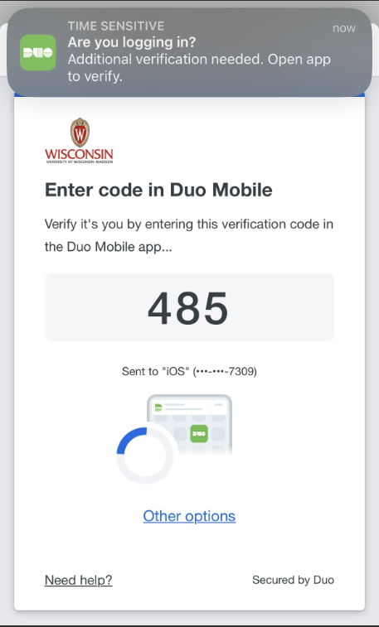
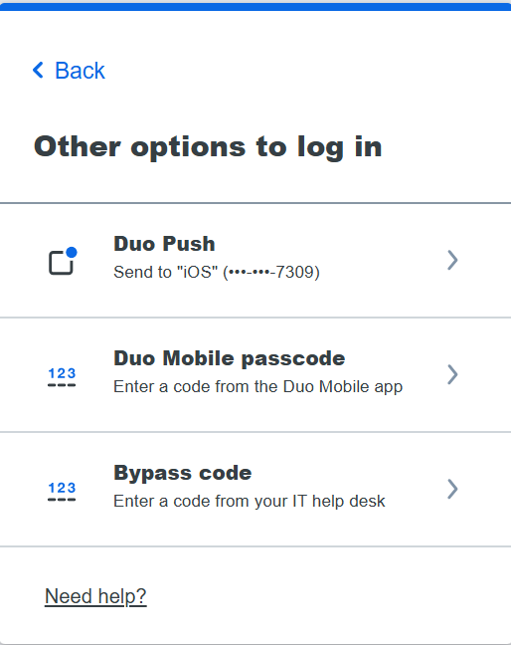
Verificar su cuenta
9. Verifique su cuenta con Duo Mobile:
Ingrese el código de verificación (Verification Code)
o
Toque Other options (Otras opciones) e ingrese el código de Duo Mobile (Duo Mobile passcode)
¡Ha iniciado sesión en la aplicación de Workday!
Notes:
You will then need to verify your account.
You can enter the verification code on your phone or tap “other options” and enter your Duo mobile passcode.​
​
After this step, you should be logged into Workday on your phone.

Slide 20
Iniciar sesión en el sitio web de Workday
Navegadores de internet
Notes:
You can also use a computer to access Workday. You can use any web browser, but for today and the other sessions, we will be using Chrome. You’ll see that your computer is already set up to use Chrome.

Slide 21
Ir al sitio web de MyUW
Abra un navegador de internet
Busque la barra de dirección
Escriba my.wisc.edu en la barra de dirección
Apriete la tecla enter en el teclado
Notes:
Your computer is set up to bring you right to MyUW, but we are going to review all of the steps in case you want to access it on your own outside of today’s session.
First, you’ll open your internet browser,
Then, type in my.wisc.edu into the address bar.
And then hit enter

Slide 22
Iniciar sesión en MyUW
Ingrese su NetID
Ingrese su contraseña en Password
Haga clic en Log In (Iniciar sesión)
Notes:
Next you have to enter your NetID and password.

Slide 23
Autenticación de Duo
4. Ingrese el código de verificación (Verification Code) en su teléfono inteligente
O
Toque Other options (Otras opciones) e ingrese el código de Duo Mobile (Duo Mobile passcode)
Notes:
Then you’ll have to authenticate. So enter the verification code on your smartphone, or tap “other options” and enter your Duo mobile passcode.

Slide 24
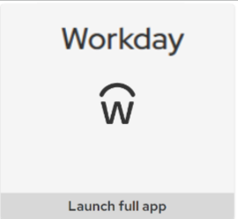
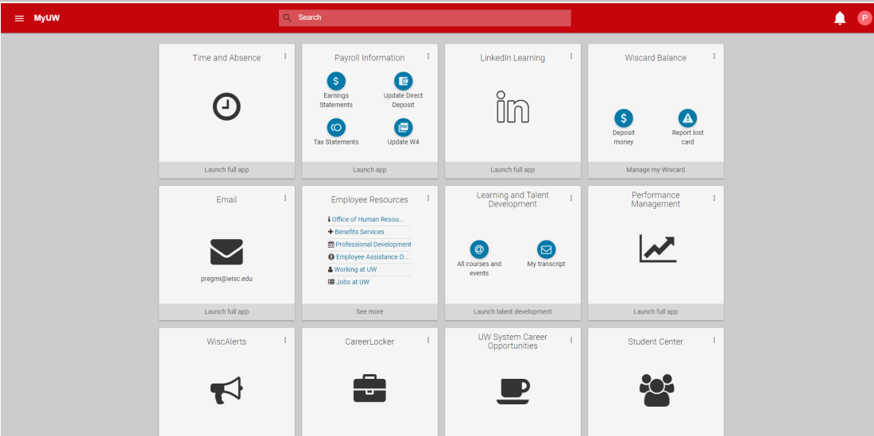
MyUW
5. Busque la aplicación de Workday
6. Haga clic en Launch full app (Abrir la aplicación)
Notes:
Once you get logged into MYUW, the Workday app will be automatically added to your MyUW website. The location of the Workday tile may be at the top, or somewhere else.
8. Find the Workday app,
9. Click “Launch full app” and that will get you logged into Workday.

Slide 25
Práctica: iniciar sesión en Workday
Inicie sesión en Workday
Practique durante 15 minutos
Use su teléfono o computadora
Baje la aplicación móvil de Workday (si lo desea)
Levante la mano si necesita ayuda
Si termina rápido, puede ayudar a los demás
Aplicación móvil
ID de organización:
wisconsin
Notes:
Now, everyone can practice logging into Workday.
On the screen, you will see the instructions. ​
You can use your phone or computer. You do not have to use the Workday aplicación móvil, but if you use your phone more than a computer, you can choose to download the Workday aplicación móvil.​
On your phone or computer, log into Workday. ​
If you think you need help, raise your hand and someone will come to help you.​
If you finish early, ask anyone around you if they need help.

Slide 26
Receso
Notes:
Provide a break of no more than 10 minutes. If the activity took the group the full time, give them 10 minutes. If it didn’t take the whole time, give them 5 minutes.

Slide 27
Explorar la página principal (Home Page)
Revisar la página principal
Practicar usar la página principal
Notes:
Now that you are logged into Workday, we will give you a brief tour of the home page.
We will look at some important spots for you to view to help you use the new system. Then, we will give you some time to explore and complete some actions to practice. During this time, we’d appreciate your attention so you can learn about the basics of the system.

Slide 28
Página principal (Home Page) de Workday (aplicación móvil)
Notes:
If you are using your smartphone, this is what you should see on the homepage. It is a bit more condensed than the homepage on the computer screen, but you have the same access to view and do things on your smartphone.

Slide 29
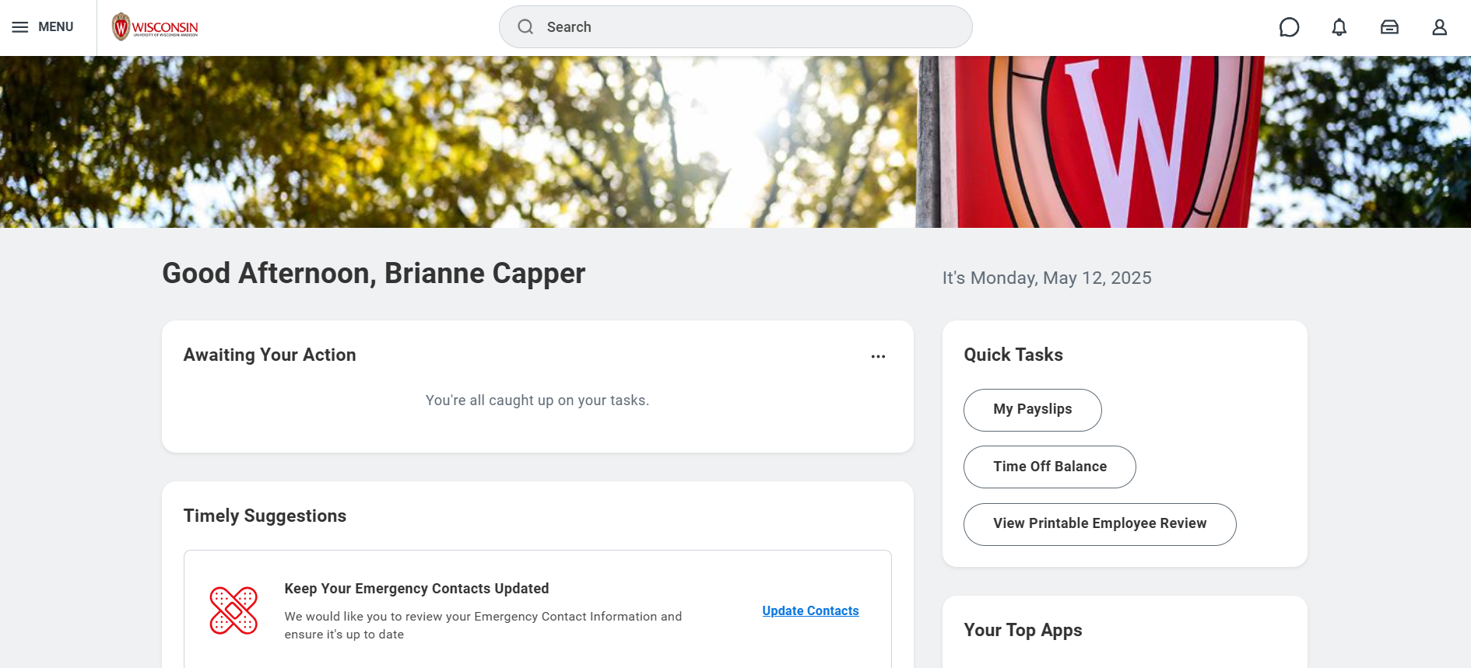
Página principal de Workday (sitio web)
Notes:
When you log into Workday on a computer, you will see this home page.
There are a lot of buttons that will take you to different places in Workday, so we will review some of the most important ones. The smartphone buttons should do the same things, but they may look different.

Slide 30
Menú y página principal (sitio web)
Busque estos 2 íconos en la esquina superior izquierda de cualquier página
Haga clic en el logo de Wisconsin para regresar a la página principal de Workday.
Haga clic en el menú de navegación principal (Global Navigation Menu) para buscar diversas aplicaciones (páginas) en el sitio web.
Notes:
The first two areas we will look at are in the top left corner of the computer screen. ​
​
The first button is the Wisconsin logo. This button will bring you back to this homepage from any page in Workday. So, if you’re exploring, and want to return home, you can click that button.​
​
The next button is the “Menu” button. This will open the Global Navigation Menu for quick access to the different apps in Workday, like the Jobs Hub, or the Benefits and Pay Hub.

Slide 31
Menú y página principal (aplicación móvil)
Las opciones del menú están en la parte inferior de la pantalla.
Toque el ícono de la casa en la esquina inferior izquierda de cualquier página para regresar a la página principal.
Notes:
Things look a little different in the aplicación móvil.
​
The home button at the bottom will always be there, and you can tap it to return the homepage at anytime.​
The menu, however, is not a button. Menu options are listed at the bottom of the screen.

Slide 32
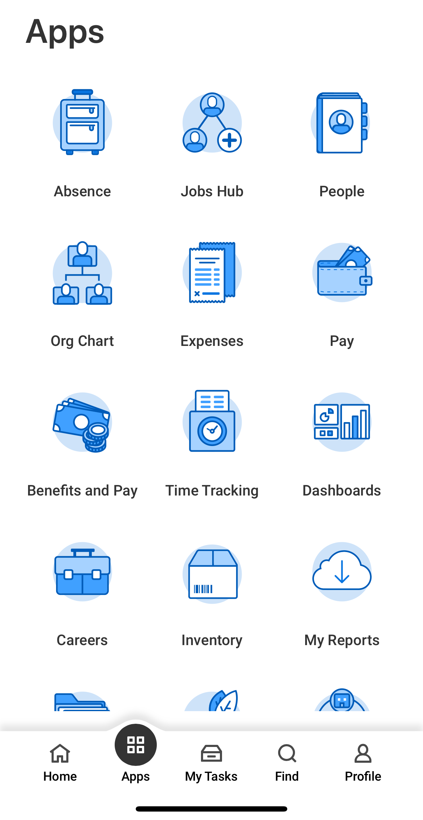
Navegación principal (aplicación móvil)
Toque Apps (Aplicaciones) para abrir el menú de navegación principal (Global Navigation Menu).
Notes:
To see all the Apps you can access from the Global Navigation Menu, tap the Apps button. We will review some important apps a bit later.

Slide 33
Barra de búsqueda (sitio web)
Use la barra de búsqueda para buscar personas, tareas, informes, etc.
Notes:
The next feature we want to highlight is the search bar. If you want to do a task or look something up, use the search bar just like you would with Google or a different search engine.

Slide 34
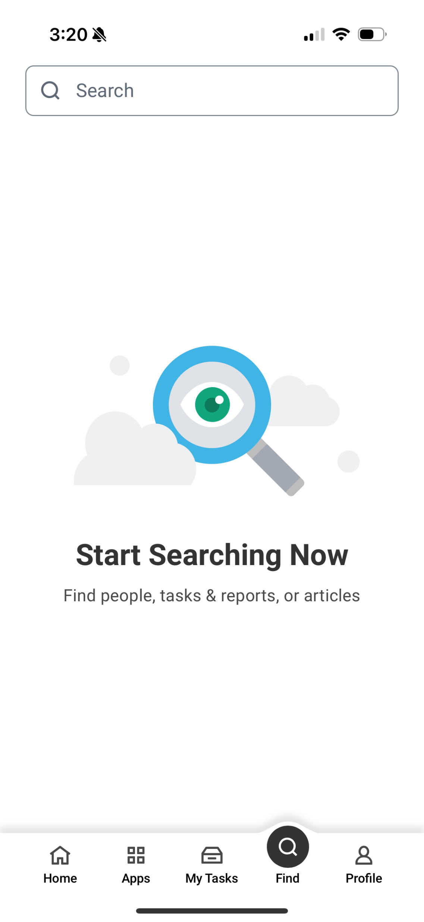
Barra de búsqueda (aplicación móvil)
La barra de búsqueda está donde dice Find (Buscar), en la parte inferior de la pantalla.
Notes:
The search feature is also available on the aplicación móvil. It is called “Find” with a magnifying glass, on the bottom bar.

Slide 35
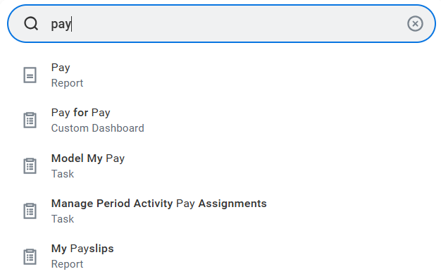
Ejemplo: barra de búsqueda
Busque sus recibos de pago:
Escriba pay (pago) en la barra de búsqueda.
Busque My Payslips (Mis recibos de pago) entre las opciones que aparecen.
Notes:
For example, if you want to find your payslip, you can type “pay” and the search feature will give you options. One of those is “My Payslips,” which will take you directly to your payslips. We will look at this a bit more in the next section.

Slide 36
Notificaciones (sitio web)
Haga clic en el ícono de la campana para leer sus notificaciones.
Notes:
The next button we want to highlight is the notifications button, which is the bell icon.
If you have a notification (a reminder or a message), a red circle with a number will pop up, and you can click the bell icon to read the notification.

Slide 37
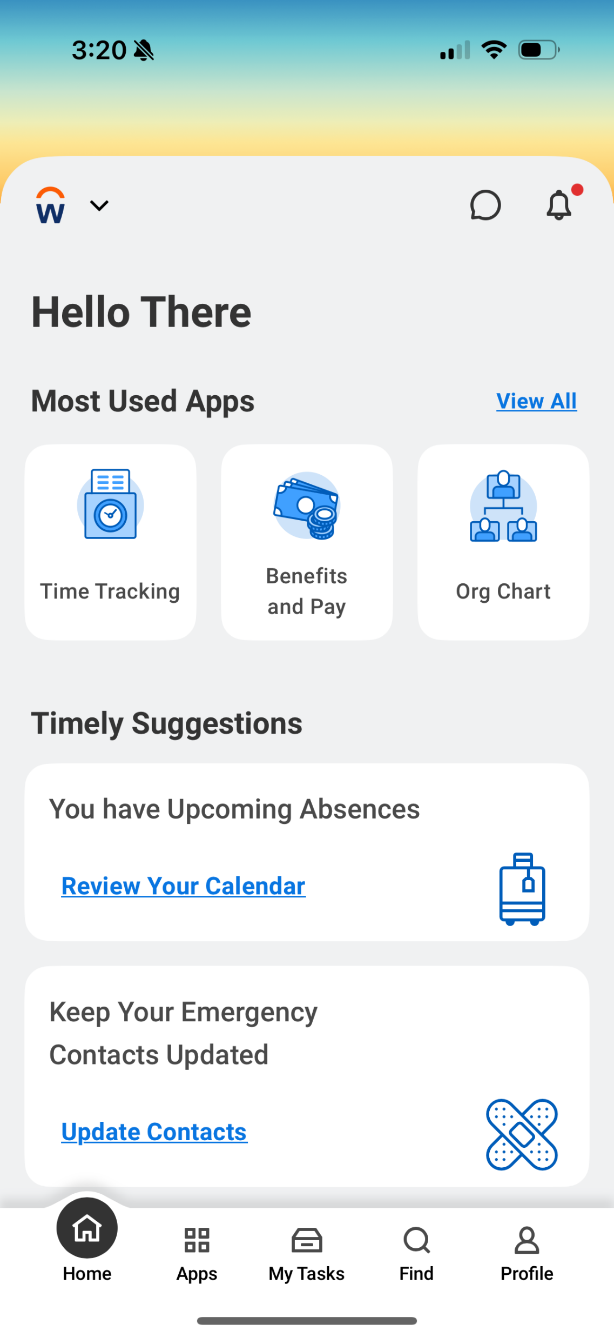
Notificaciones (aplicación móvil)
Toque el ícono de la campana para leer sus notificaciones.
Notes:
In the aplicación móvil, you’ll see the bell icon in the upper right corner. Tap it to see your notifications.

Slide 38
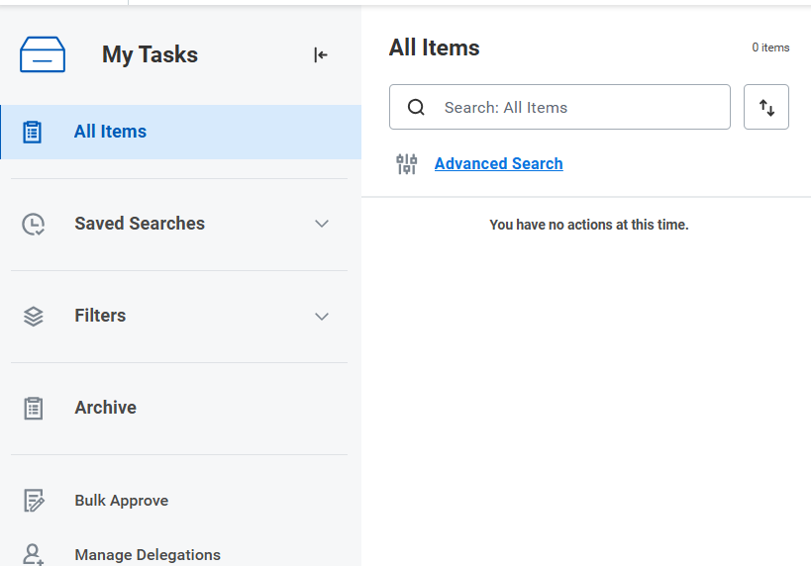
Mis tareas (sitio web)
Haga clic en el ícono del cajón.
Vaya a My tasks (Mis tareas) para ver sus tareas.
El número en el círculo rojo le dice cuántas tareas tiene.
Notes:
Next up is the “My tasks” button. In the upper right corner next to the notification bell, you’ll see a button that looks like a drawer. Click that to see your tasks.​
​
Tasks might include courses that you need to take for your job or messages from your local HR professional.

Slide 39
Mis tareas (aplicación móvil)
Toque My Tasks (Mis tareas) para ver sus tareas.
Notes:
In the aplicación móvil, the “My tasks” button is located at the bottom bar.

Slide 40
Perfil (sitio web)
El ícono del perfil en la esquina superior derecha de cualquier página abre su información de trabajo.
Notes:
Next up is the Profile button. This is in the top right corner, next to the notification bell and Tasks button. This may also be called the Worker Profile. This opens your employee information.

Slide 41
Perfil (aplicación móvil)
El ícono del perfil (Profile) está en la esquina inferior derecha.
Notes:
In the aplicación móvil, the profile icon is on the bottom bar, farthest to the right.

Slide 42
Tareas pendientes
La sección Awaiting Your Action (Tareas pendientes) muestra sus 3 tareas más recientes.
Notes:
Now let’s look at some larger features of the homepage. The first is “Awaiting your Action”. This space shows the 3 newest tasks assigned to you. These could be courses assigned to you or other tasks you need to complete for your job.

Slide 43
Sugerencias puntuales
La sección Timely Suggestions (Sugerencias puntuales) muestra sus tareas e informes recomendados.
Notes:
The other area you will see on the homepage is “Timely suggestions”. Here, you’ll find updates like required actions, reports, or recommended tasks. For example, you might see a reminder to update our emergency contacts or review upcoming time off requests.

Slide 44
Sugerencias puntuales (aplicación móvil)
También puede ver la sección de Timely Suggestions (Sugerencias puntuales) en la aplicación móvil.
Notes:
In the aplicación móvil, you’ll see the same timely suggestions in a smaller space.

Slide 45
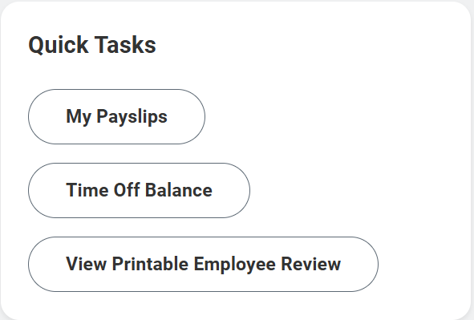
Tareas rápidas
Desde la sección Quick Tasks (Tareas rápidas), puede comenzar rápidamente las 3 actividades que hace más a menudo.
Notes:
Another important space is “Quick tasks.” Quick tasks helps you quickly access the 3 tasks you do most often. This space looks different from person to person. So, if I review my Payslip frequently, the “My Payslips” button will show up in the Quick tasks space.

Slide 46
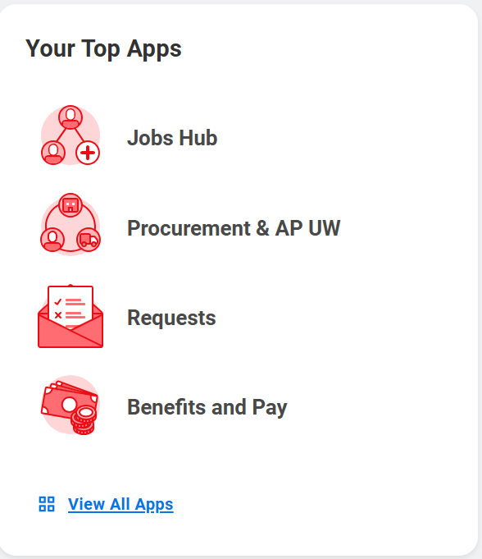
Sus aplicaciones principales
La sección Your Top Apps (Sus aplicaciones principales) muestra 4 íconos de aplicaciones predeterminadas.
Notes:
The final space we want to highlight is “Your Top Apps.”
On the computer, this space shows your top 4 apps. You can choose which apps you see here.
​
In the aplicación móvil, it shows the apps you regularly use. The apps change based on what you regularly do in Workday.

Slide 47
¿Preguntas?

Slide 48
Cómo actualizar su información personal
Dirección de residencia, teléfono, correo electrónico personal
Notes:
Next up we are going to look at how to update your personal information in Workday. This includes your home address, phone number, and your personal email address. Again, the personal information that you previously had entered in the old system should have transferred over, so not action is needed from you. But in case you want to update your information, we will review how to do so, then give you time to review and make any changes if you’d like.
It is important to note that if you do have a legal name change due to a marriage or divorce you should contact your local HR as this is a qualifying life event.

Slide 49
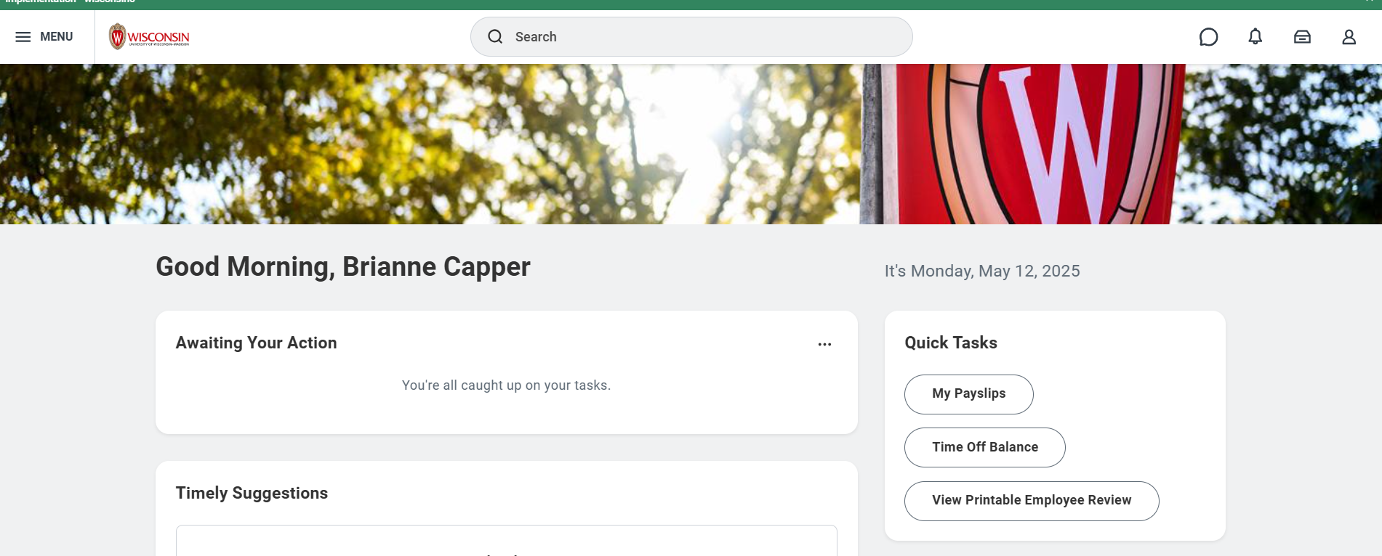
Actualizar su información personal
En la página principal (Home Page) de Workday, haga clic en el ícono de la persona en la esquina superior derecha
Este es el perfil de empleado.
Notes:
Let’s look at the steps to update your personal information.
From the Workday Home Page, click Person icon in the top right corner This is the Worker Profile.

Slide 50
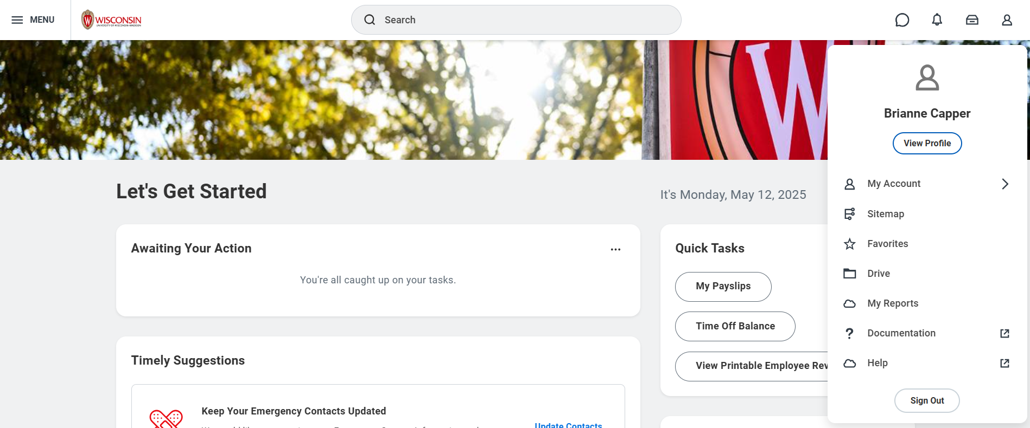
Actualizar su información personal
2. Haga clic en View Profile (Ver perfil)
Your Name
Notes:
From there, a pop up will appear, and you need to
2. Click View Profile

Slide 51
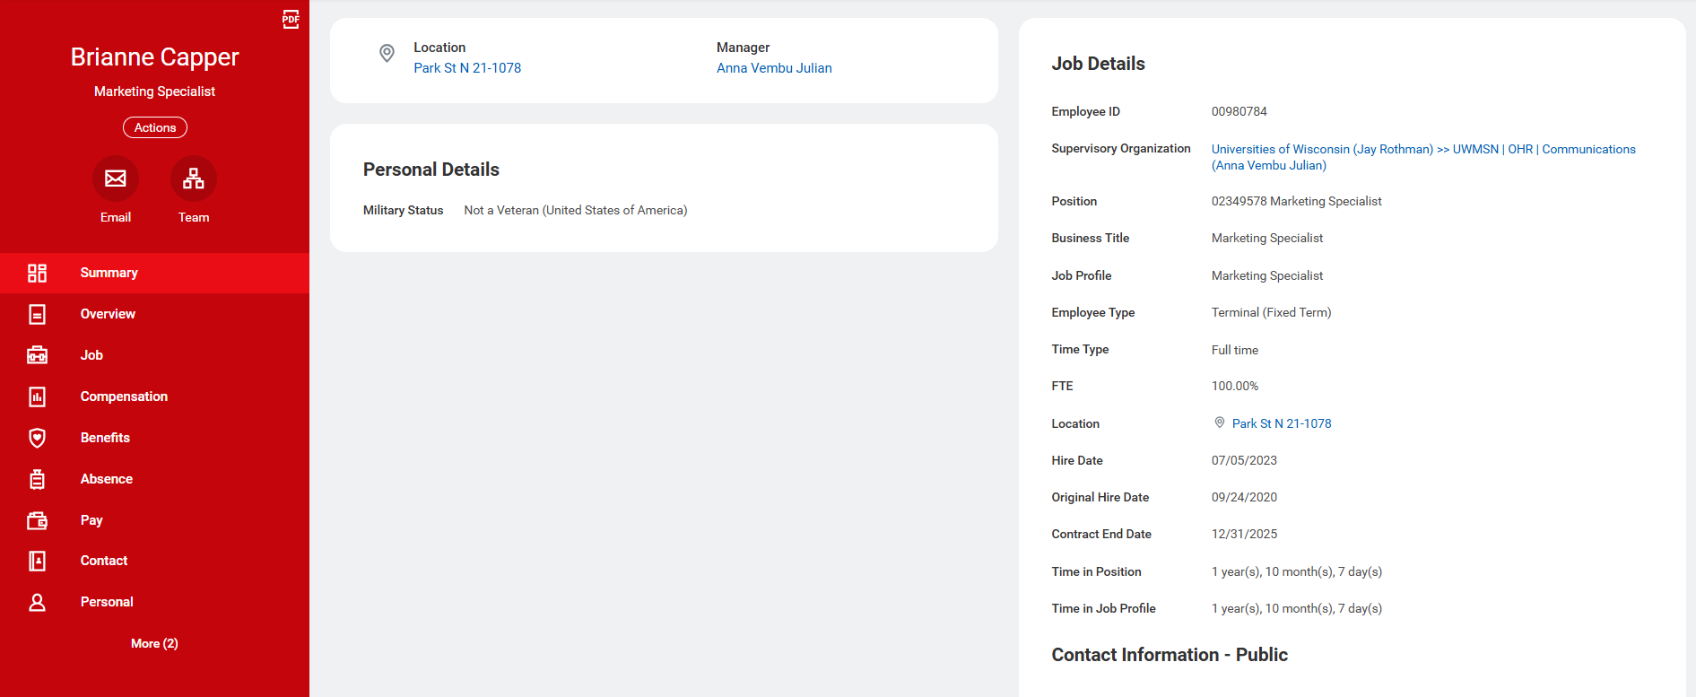
Actualizar su información personal
3. Haga clic en Contact (Contacto) en la barra roja al lado izquierdo de la pantalla
Notes:
To see your personal information,
3. Click Contact from the red bar on the left side of the screen. It will probably be near the bottom of your options.

Slide 52
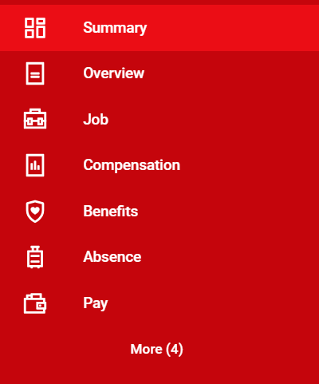
Actualizar su información personal
Si no encuentra Contact (Contacto), haga clic en More (Más)
Notes:
If you don’t see the Contact option, click More and it will show up for you to click.

Slide 53
Actualizar su información personal
4. Haga clic en Edit (Editar)
5. Haga clic en Change My Home Contact Information (Cambiar mi información personal de contacto)
Notes:
The page that will open up will show your home contact information, personal phone number, and your personal email address, along with your work contact information.
4. To edit your information, select the Edit button at the top of the page.
5. Then click Change My Home Contact Information

Slide 54
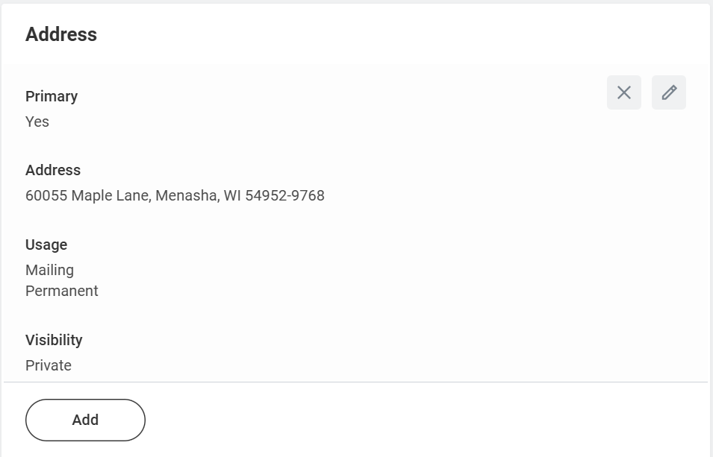
Actualizar su información personal
6. Haga clic en Add (Añadir) e ingrese su dirección de residencia, teléfono o correo electrónico nuevo.
Haga clic en el ícono del lápiz para editar la dirección de residencia, teléfono o correo electrónico existente.
Notes:
From the Change My Home Contact Information screen, you have some options.
6. To add a new address, phone number or personal email address, click the Add button. You would use this feature if you had two personal phone numbers (like a landline and a cell phone).
If you’d like to edit an existing address, phone number, or personal email, click the pencil icon to edit the information that is there.

Slide 55
Actualizar su información personal
7. Haga clic en la marca de verificación para guardar los cambios
8. Haga clic en Submit (Enviar)
Notes:
7. To save the information on the address, phone number, or personal email address, click the marca de verificación.
8. To Submit all of your changes to your personal information, click the Submit button. You can also choose to Save for Later or Cancel. None of your updates will take effect until you hit the Submit button.

Slide 56
Actualizar su información personal
En la pantalla, aparecerá una notificación de You Have Submitted (Enviado)
Notes:
To confirm that you have submitted successfully, a popup will appear that says you have submitted.

Slide 57
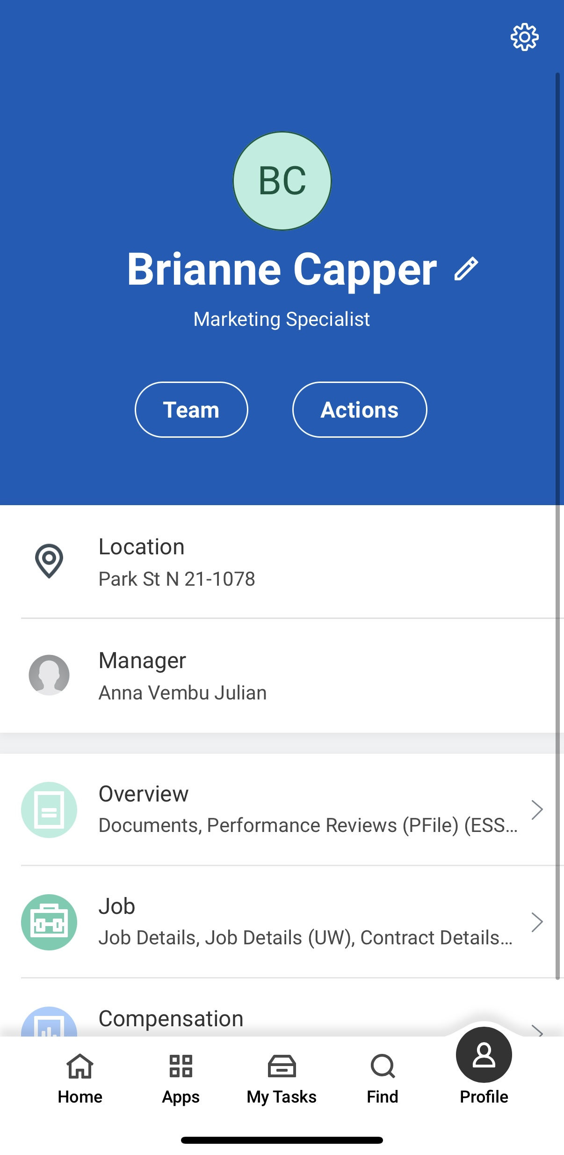
Actualizar su información personal (aplicación móvil)
Toque Profile (Perfil) en la esquina inferior derecha de la pantalla.
Toque el ícono del lápiz junto a su nombre.
Your Name
Notes:
If you’d like to update your personal information in the aplicación móvil, you also have the opportunity to do so. Most of the steps are the same, but what you click on might be different.
First, tap the Profile icon in the bottom right corner of the screen.
Then, tap the pencil icon next to your name.
Please remember that if you have a name change due to a marriage or divorce, you should contact your local HR as it may impact your benefits.

Slide 58
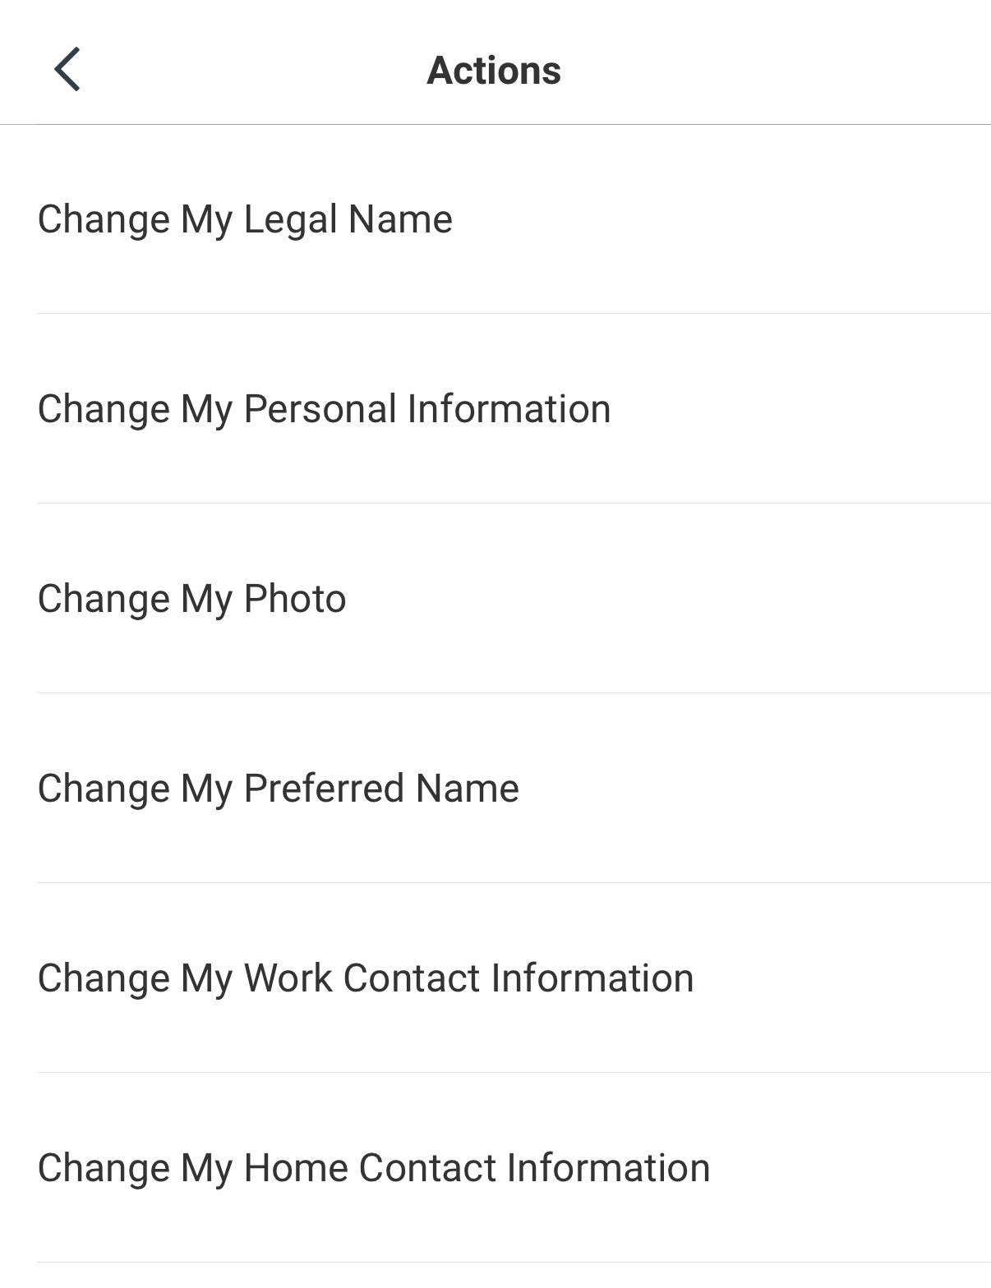
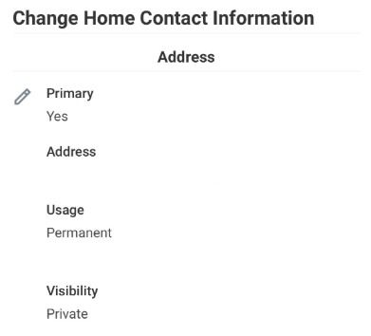
Actualizar su información personal (aplicación móvil)
3. Toque Change My Home Contact Information (Cambiar mi información personal de contacto).
4. Toque el ícono del lápiz para editar su información personal.
Notes:
To update your personal information from the app,
3. tap Change My Home Contact Information.
4. You will then see your address, phone number, and personal email. To update any of those, tap the pencil icon.

Slide 59
Actualizar su información personal (aplicación móvil)
5. Una vez que haya hecho los cambios, haga clic en Submit (Enviar).
Notes:
5. Finally, tap Submit once you have made your changes.

Slide 60
Práctica: explorar la página principal de Workday y revisar su información personal
Haga clic en diferentes lugares de la página principal de Workday para explorar y practicar
¿Tiene alguna tarea (task)?
¿ Tiene notificaciones (notifications)?
¿Cuáles son sus aplicaciones (apps) principales?
Revise su información personal
Vaya a su perfil (Profile) y haga clic en Contact (Contacto) para asegurarse de que la información en Home Contact Information (Información personal de contacto) esté correcta:
dirección de residencia, teléfono, correo electrónico
contactos de emergencia
Notes:
Timing: 10-15 minutes
Now let’s take some time to practice getting to those places that we just looked at. The tasks we have on the screen are just to help you review and explore Workday. You do not need to make any updates or changes to your information, but we want to give you an opportunity to get into Workday and review.
Go to your Profile and click Contact to make sure your Home Contact Information is correct:
Address, Phone Number, Email Address
Emergency Contacts

Slide 61
Recursos y próximos pasos
Notes:
Before we end our session, I want to share a couple of resources to help you continue your learning, and some next steps.

Slide 62
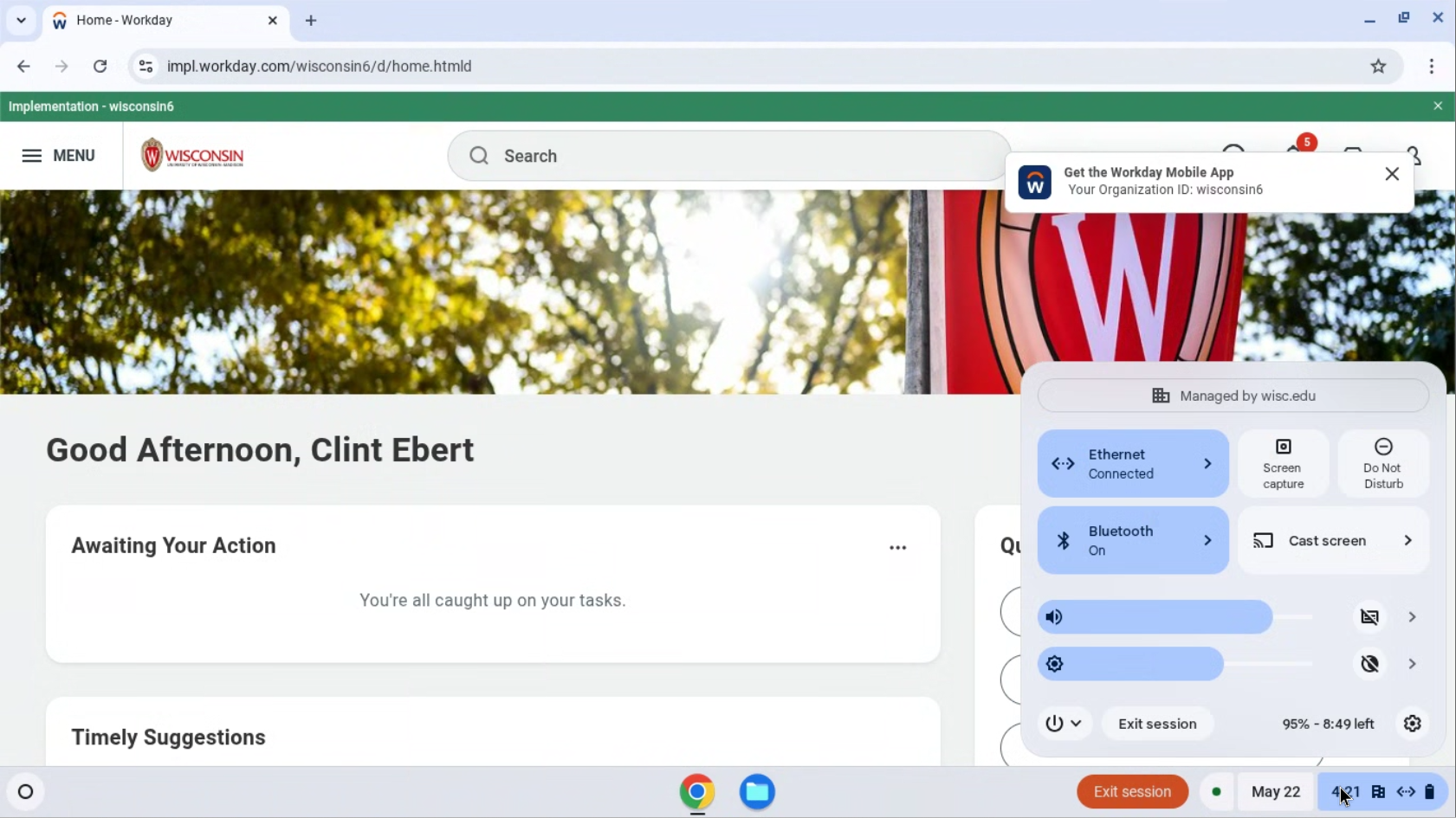
Cerrar sesión
Antes de irse, reinicie su computadora.
Haga clic en la hora en la esquina inferior derecha de la pantalla.
Notes:
Before you leave, please log off your computer. Click on the time at the bottom right corner of your screen.

Slide 63
Cerrar sesión
2. Haga clic en el ícono de encendido/apagado.
3. Seleccione Restart (Reiniciar).
La pantalla va a ponerse en blanco y luego apagarse.
Notes:
Click on the power icon. Select restart. The screen will turn white and then turn off. You are now logged out of the computer and the device is ready for the next person to use it.

Slide 64
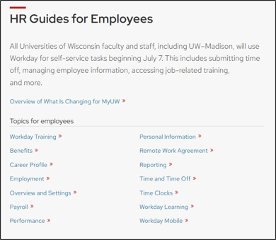
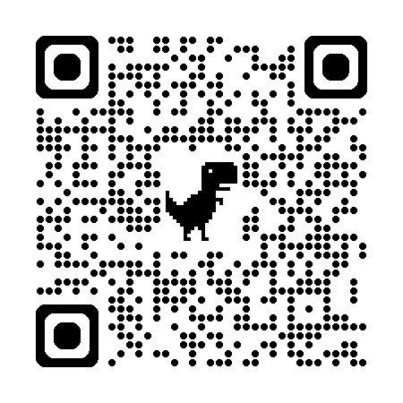
Guías de Recursos Humanos para empleados
hr.wisc.edu/hr-guides/#for-employees
Recursos de capacitación
Respuestas a preguntas comunes
Notes:
A great place for you to go for help is the HR Guides for Employees. Whether you’re looking for guidance, training, or answers to common questions, this directory can help you navigate HR functions in Workday.

Slide 65
Próximos pasos
Regístrese en la lista de asistencia al frente del salón (si no lo ha hecho todavía)
Confirme su próxima capacitación (fecha, hora y lugar)
Hable con su supervisor(a) si necesita ayuda
Practique iniciar sesión en Workday
Notes:
Here are some next steps: ​
Make sure you signed in at the front of the room​
Confirm the date, time, and location of your next session​
Contact your supervisor for help​
Practice logging into Workday

Slide 66
¡Gracias!
Hable con su supervisor(a) si tiene dudas
Notes:
Thanks for being here today! If you have any questions or need support, contact your supervisor.

