Slide 1
Instructions for Presenting this Slide Deck
In the facilitator guide, you will find:
A script that you can use to present the information in this slide deck.
Timing estimates for each section,
Timing for the engagement activities
Tips to make the engagement activities run smoothly.
If your room has more than 30 people, some people will not be able to use a computer.
When you give employees time to log into Workday, you can ask people to move around to give access to computers if some people only want to use their phones.

Slide 2
Workday In-Person Training Series
Week 1
Sign in at the front of the room
Sit at an open computer
Notes:
Welcome to the Workday In-Person Training Series. My name is [your name] and I'll be facilitating today's training. I work at [your unit] as a [your job title]. With us here today to help are [introduce helpers]. [Allow helpers to introduce themselves – their names, where they work, etc].
If you haven't yet signed in, we will bring the sign-in sheet to you, so you can raise your hand.

Slide 3


What to Expect
We will…
show you how to do tasks in Workday
give you time to practice
We can not…
answer your personal questions
talk about policies for specific departments
Notes:
So, let's talk about what you can expect to do during our time together.
We will...
review how to complete tasks in Workday
give you time to practice completing tasks
You'll see the computers in front of you, and we will walk through using those here in a little bit.
Some things we will not be able to do today...
answer personal employee questions
If you do have questions about your job or any personal details, we cannot answer those today. We would encourage you to talk to your supervisor or your local HR staff to help you with those personal questions.
address department-specific policies or procedures
We know that different departments and units have different policies and procedures, so if you have a question about how something will work in your own department, you should talk to your supervisor.

Slide 4
Training Series Overview
Log into Workday
View payslips and leave balances
Update tax forms (W4) and address
Update direct deposit
Request time off
Apply for UW jobs
Find help
Notes:
So let's talk about some things we will review over the next few weeks. We will review how to
Log into Workday
View payslips and leave balances
Update tax forms (W4) and address
Update direct deposit
Request time off
Apply for UW jobs
Find help

Slide 5
Learning Objectives
By the end of today’s session, you will know how to:
  Log into Workday on a phone or computer
  Navigate the home screen
  Update personal information
Notes:
Today, specifically, here are our learning objectives. By the end of today's session, you will know how to:
Log into Workday on a phone or computer
Navigate the home screen
Update personal information

Slide 6




Agreements for Today
Listen and practice doing new tasks.
Raise your hand if you have a question or need help.
Follow the presenter. Don’t work ahead.
Ask permission before you look at someone’s screen.
Notes:
As we present information today and give you time to practice, we’ll ask you to:
Stay engaged – Listen to the presentation and use the time to practice.
Listening to the presentation will help you know what to do during our practice times.
Ask questions – Raise your hand if you have a question or need help during the practice times.
Follow along – Don’t work ahead or do other things. Follow along with the presentation, so you don’t get lost.
Ask before you look at someone’s screen – Sometimes, we will look at personal information, like payslips and benefit choices. Before you look at someone’s screen (even if you are helping them), ask if it’s OK.
Some people may be comfortable with you helping, but others might not. So, always ask first.
If you think you can agree to these, give us a thumbs up.

Slide 7
Partner Discussion
Introduce yourself to the person next to you
  Name
  Where you work
Discuss:
  What have you heard about Workday?
  How do you think you will use Workday?
Notes:
Before we start our overview of Workday, I’m curious to know what you have heard about Workday.
Please talk with someone close to you. Introduce yourself (your name and where you work), and talk about two questions:
What have you heard about Workday?
What do you think you can use Workday for?
*Note to Facilitator: – Give the participants about 5 minutes to chat. When they are done, ask for a few volunteers to share what they have heard, or what their prior knowledge of Workday is.

Slide 8

Overview of Workday
Notes:
First, we will review what Workday is and what you will use it for.
Facilitator tip:
Try connecting some of the information in this section to what the participants shared from the partner discussion. This will help keep them engaged.

Slide 9
What is Workday?
Workday is a new system all Universities of Wisconsin employees will use.
Workday has a website and a mobile app (optional).
Notes:
So What is Workday?
Workday is a new system all Universities of Wisconsin employees will use for employment-related tasks
You can use the Workday website or an optional mobile app

Slide 10
What can I do in Workday?
Update contact information
Update direct deposit
Choose your federal and state tax elections
View and print payslips
View benefits information
Notes:
You can do a lot in Workday! You can:
Update your contact information
Update your direct deposit for paychecks
Choose your federal and state tax elections
View and print pay slips
View benefits information
With Workday, you have direct access to important information about your employment.
For example, you might need a payslip if you apply for a loan or are renting an apartment. You can also see the health insurance you chose in the Benefits app. You can find all this information yourself, whenever you need it.
In this training you will learn how to access this information at any time (including on a mobile device).

Slide 11
Workday
You can:
  use the mobile app
  find what you need with the search bar
  change your personal information
Notes:
There are many advantages of Workday. For an employee, a few key ones are
You can use the mobile app to access your information
The search bar helps you find what you need quickly
You can change your personal information as well
I think a huge benefit of Workday is that all these things are in one spot. Instead of logging into different systems, you will log into Workday and you can see all your employment information.
Throughout today and the next two weeks, we will talk about key features you may use regularly. And we’ll give you time to explore Workday and practice doing specific actions.
So let's get started!

Slide 12
Logging into Workday
Workday mobile app
Workday website
Notes:
First, we are going to look at the ways that you can log into Workday.
You have two options: from your smart phone with the Workday mobile app or online using a computer or web browser.
We are going to review all of the steps to download the mobile app, and then we will look at how you can log into Workday on a computer. After that, we will give you all time to get logged into Workday, and we will walk around and help as needed.

Slide 13



What You Will Need
  Computer or Smartphone
  Personal NetID and Password
  Smartphone or Duo Device
Notes:
For today, here are the things you will need.
To get logged into Workday, you will need a computer or smartphone.
You will also need your personal NetID and password.
You will then have to authenticate using Duo, so you’ll either need your smartphone, or your duo device to authenticate.

Slide 14


Install the Workday Mobile App
On your device:
Go to Apple App Store or Google Play Store
Search for (and select) Workday
Select Install or Get
Accept application permissions, if necessary
Notes:
Now, we’ll talk about instructions to download the mobile app. This is optional. You do not have to download the mobile app. However, if you use your phone everyday, it might be easier than logging into a computer.
If you want to download the mobile app now, you can pull out your phone and follow the instructions. You can let the app download while we look at other instructions in Workday.
First, go to the Apple App Store or Google Play Store
Search for Workday in the search field.
Look for the W logo to know that you have the right app.
Select Install or Get and accept application permissions, if necessary

Slide 15
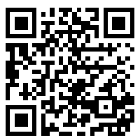
Log into the Workday Mobile App
Open the Workday Mobile app
Tap Log in
Enter Your Organization ID or scan the QR code
  Your Organization ID: wisconsin
Notes:
First, Open the Workday Mobile app
Then, tap Log in
Enter the organization ID in the Your Organization ID field, or scan the QR code
Organization ID: XXXXXXXXX

Slide 16
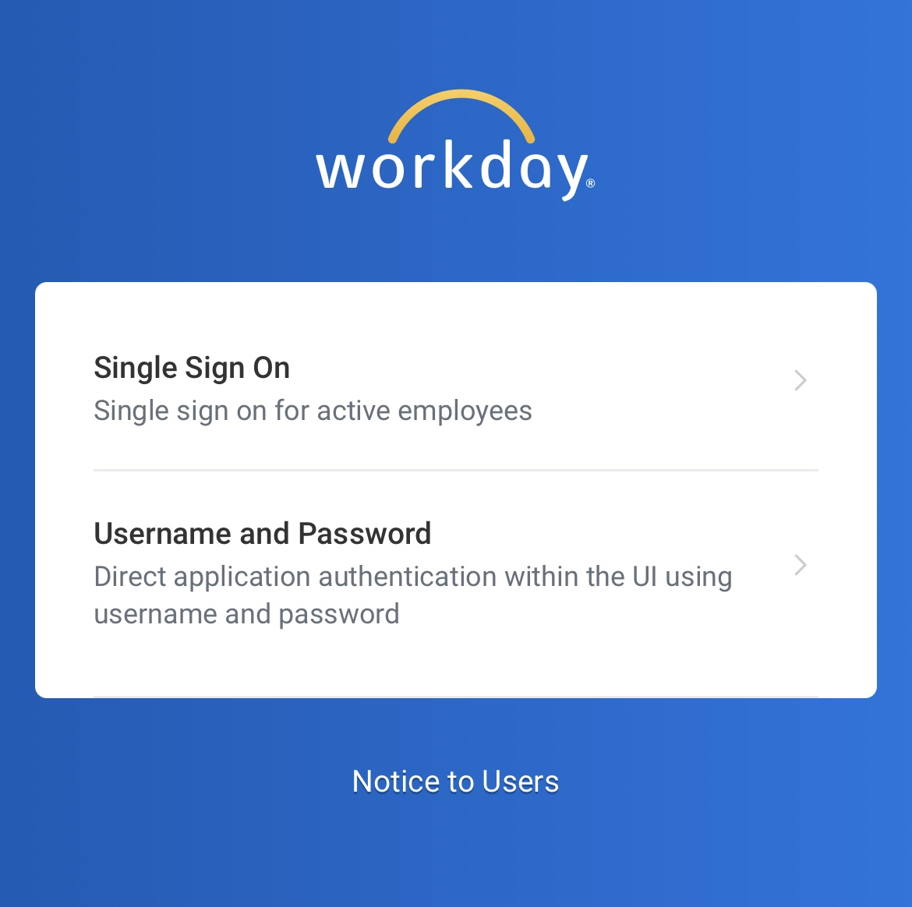
Log in to the Workday Mobile App
4. Tap Single Sign On (in the app)
Notes:
Next, you will tap Single Sign On

Slide 17
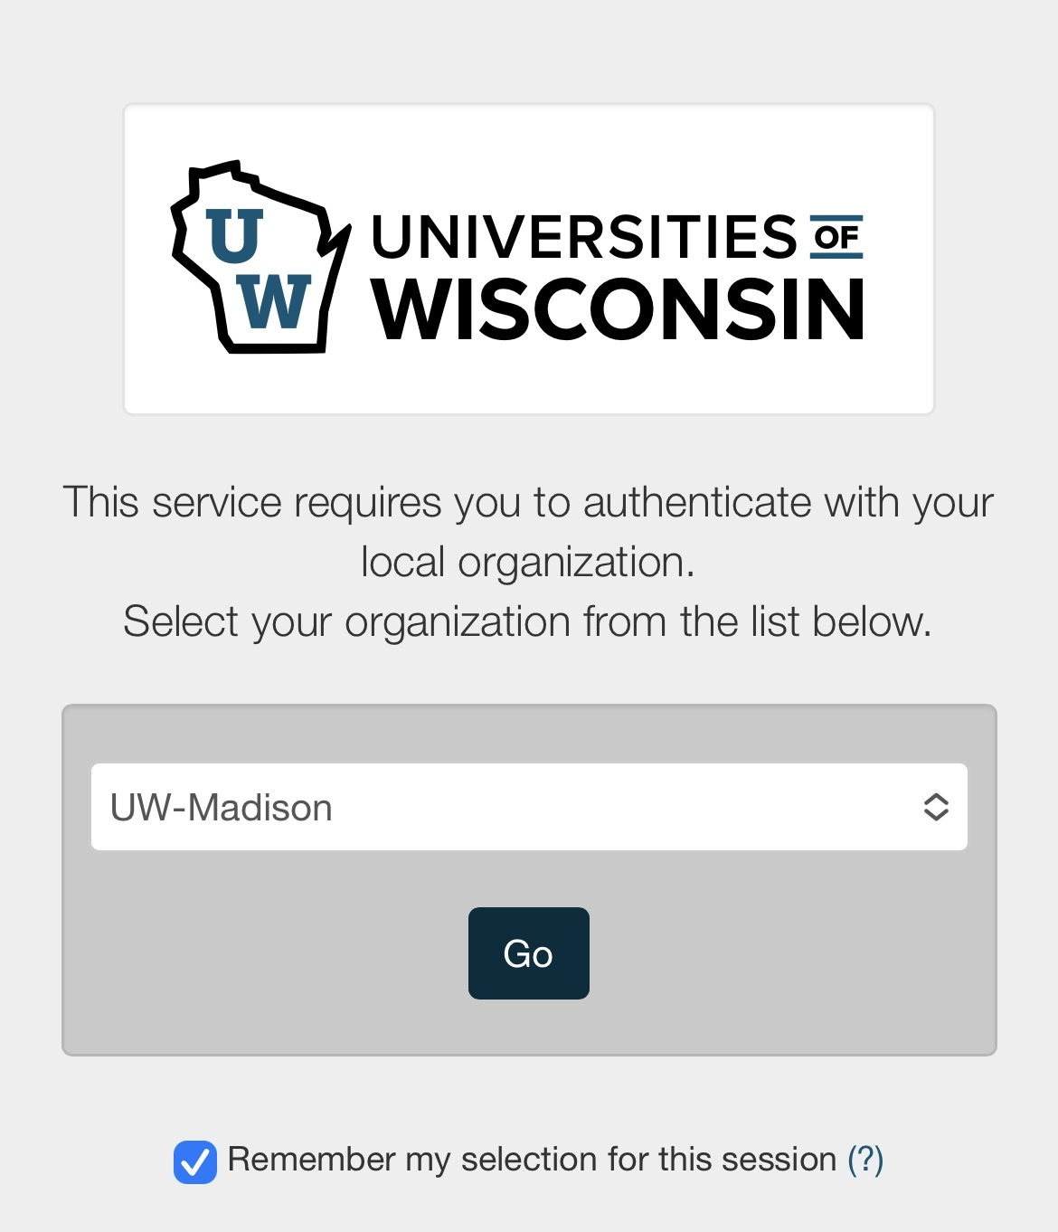
Log in to the Workday Mobile App
5. Select UW-Madison
6. Tap Go
Notes:
That will take you to this screen, where you need to select UW-Madison from the dropdown menu
Then tap Go

Slide 18
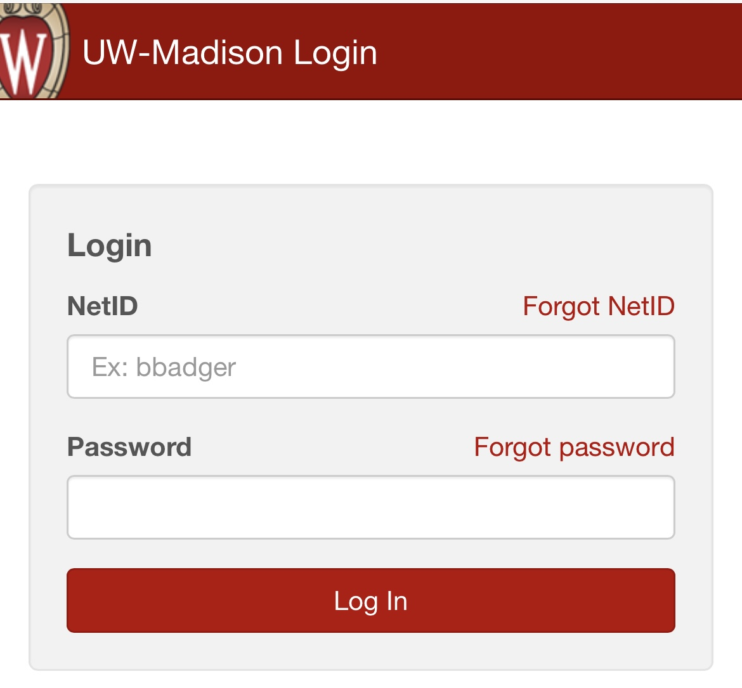
Enter Your UW Credentials
7. Type your NetID and password
8. Tap Log In
Notes:
Here is where you will need to enter your NetID and password.​
Type in your NetID and Password​
Then tap Log In

Slide 19
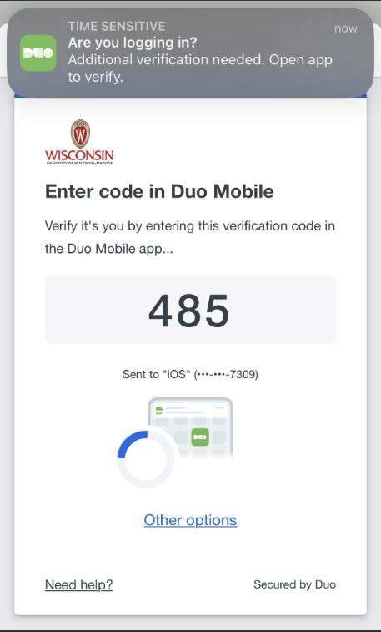
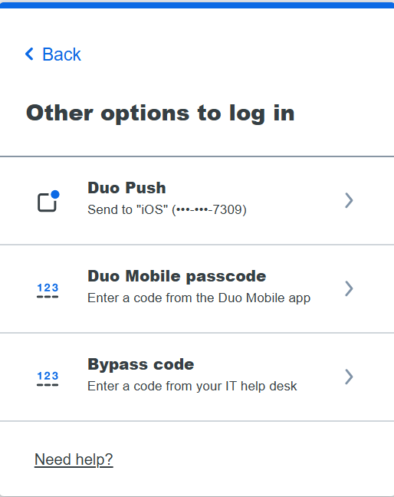
Verify Your Account
9. Verify with Duo Mobile:
  Enter the Verification Code
  or
  Tap Other options and enter your Duo Mobile passcode
You are logged into the Workday app!
Notes:
You will then need to verify your account.
You can enter the verification code on your phone or tap “other options” and enter your Duo mobile passcode.​
​
After this step, you should be logged into Workday on your phone.

Slide 20

Log in to Workday Website
Internet browsers
Notes:
You can also use a computer to access Workday. You can use any web browser, but for today and the other sessions, we will be using Chrome. You’ll see that your computer is already set up to use Chrome.

Slide 21
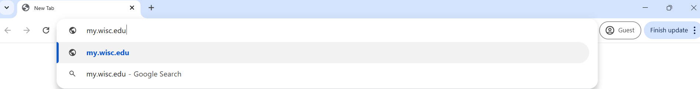
Go to the MyUW Website
Open an internet browser
Find the address bar
Type my.wisc.edu into the address bar
Hit the enter key on your keyboard
Notes:
Your computer is set up to bring you right to MyUW, but we are going to review all of the steps in case you want to access it on your own outside of today’s session.
First, you’ll open your internet browser,
Then, type in my.wisc.edu into the address bar.
And then hit enter

Slide 22
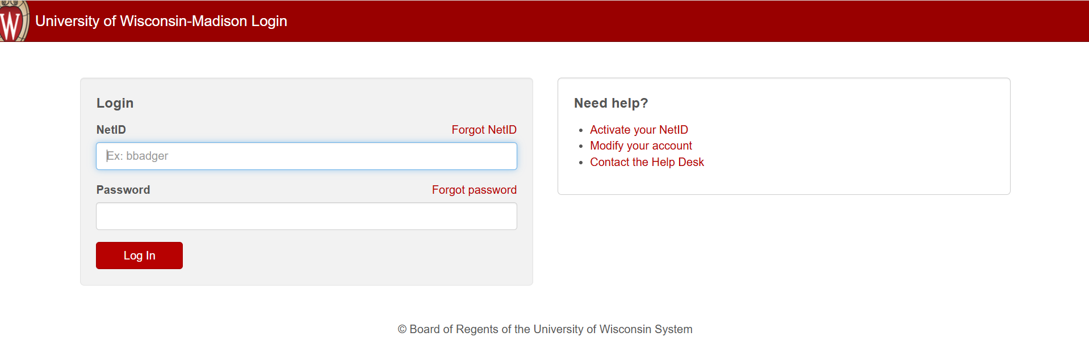
Log in to MyUW
Type in your NetID
Type in your Password
Click Log In
Notes:
Next you have to enter your NetID and password.

Slide 23
Duo Authentication
4. Enter the Verification Code on your smartphone
OR
Tap Other options and enter your Duo Mobile passcode
Notes:
Then you’ll have to authenticate. So enter the verification code on your smartphone, or tap “other options” and enter your Duo mobile passcode.

Slide 24
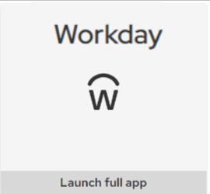
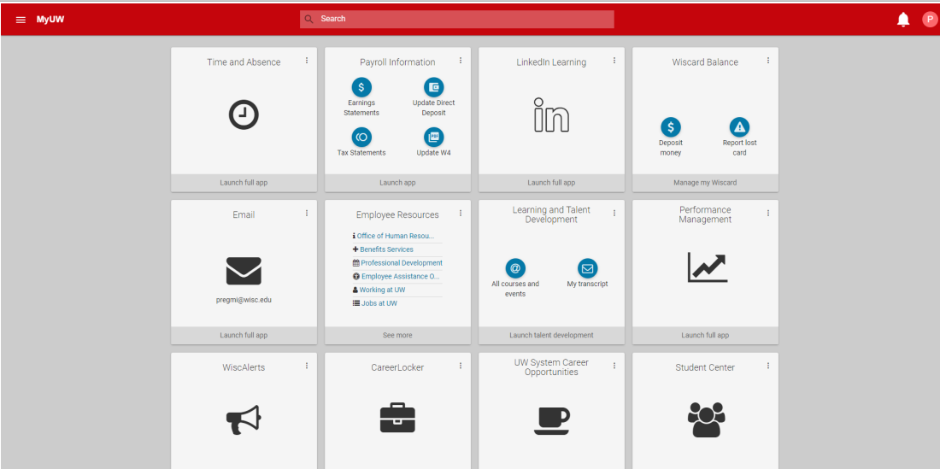
MyUW
5. Find the Workday app
6. Click Launch full app
Notes:
Once you get logged into MYUW, the Workday app will be automatically added to your MyUW website. The location of the Workday tile may be at the top, or somewhere else.
8. Find the Workday app,
9. Click “Launch full app” and that will get you logged into Workday.

Slide 25
Practice: Log into Workday
Log into Workday
Practice for 15 minutes
Use your phone or computer
Download the Workday mobile app (if you want)
Raise your hand if you need help
If you finish early, you can help others
Mobile App
Organization ID:
wisconsin
Notes:
Now, everyone can practice logging into Workday.
On the screen, you will see the instructions. ​
You can use your phone or computer. You do not have to use the Workday mobile app, but if you use your phone more than a computer, you can choose to download the Workday mobile app.​
On your phone or computer, log into Workday. ​
If you think you need help, raise your hand and someone will come to help you.​
If you finish early, ask anyone around you if they need help.

Slide 26
Break Time
Notes:
Provide a break of no more than 10 minutes. If the activity took the group the full time, give them 10 minutes. If it didn’t take the whole time, give them 5 minutes.

Slide 27
Tour of the Home Page
Review the home page
Practice using the home page
Notes:
Now that you are logged into Workday, we will give you a brief tour of the home page.
We will look at some important spots for you to view to help you use the new system. Then, we will give you some time to explore and complete some actions to practice. During this time, we’d appreciate your attention so you can learn about the basics of the system.

Slide 28
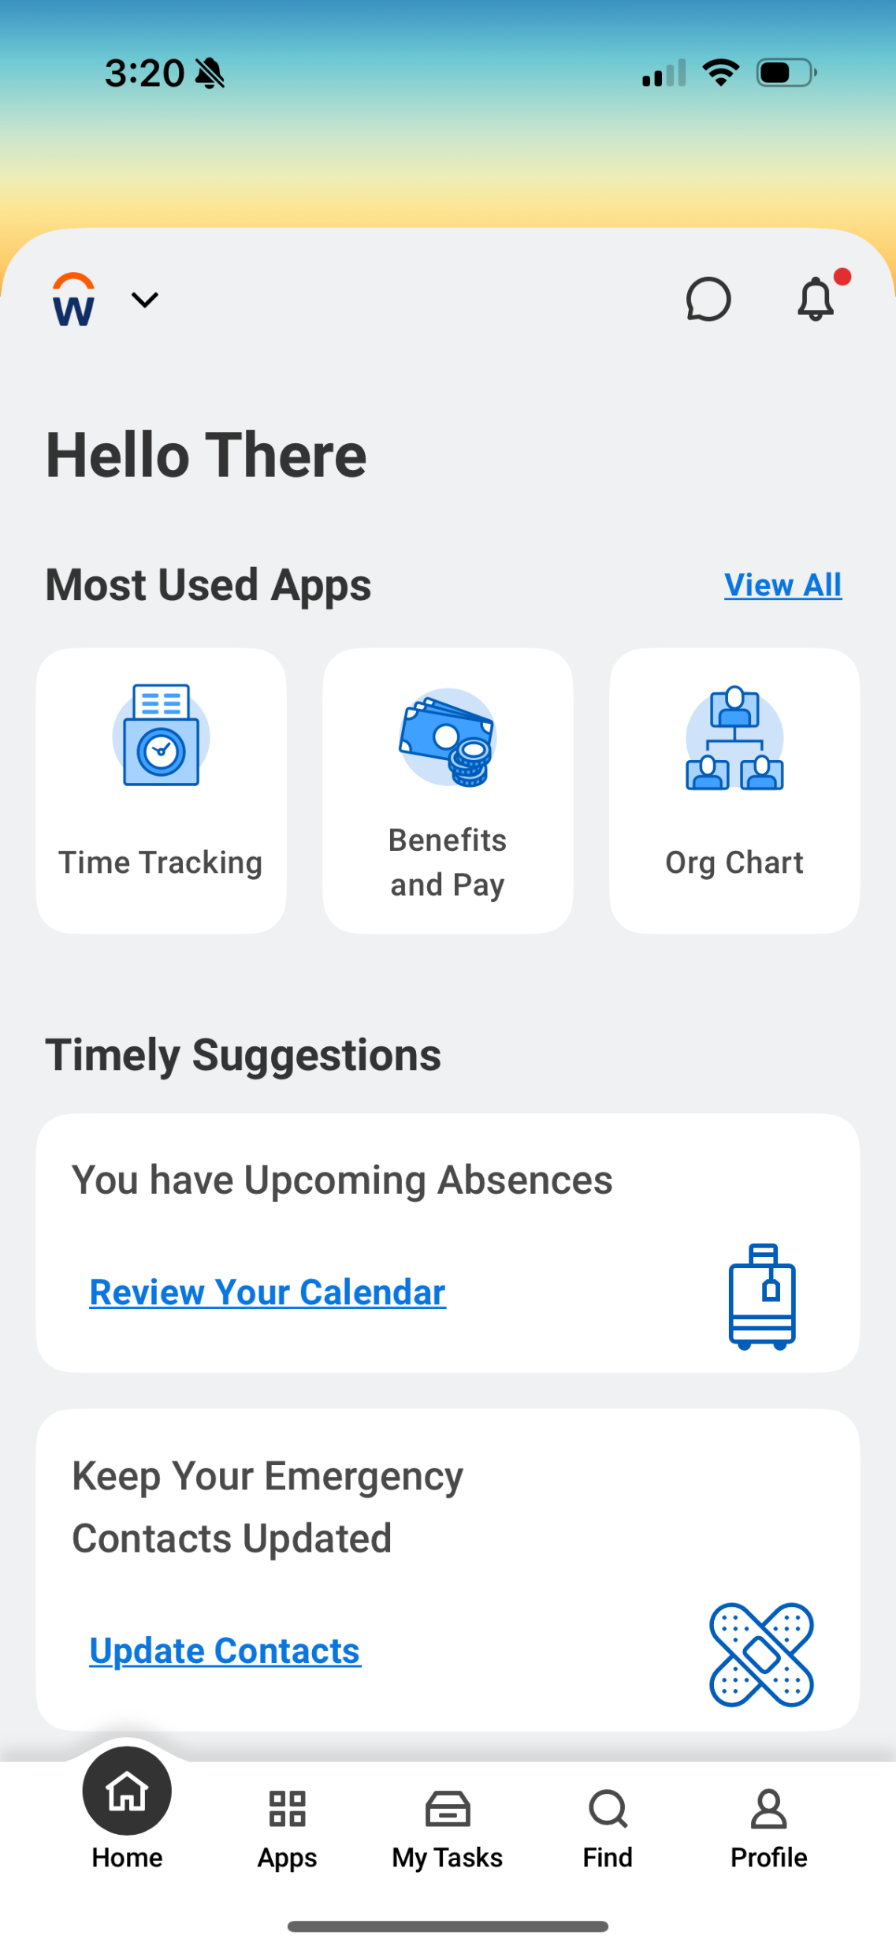
Workday Home Page (Mobile App)
Notes:
If you are using your smartphone, this is what you should see on the homepage. It is a bit more condensed than the homepage on the computer screen, but you have the same access to view and do things on your smartphone.

Slide 29
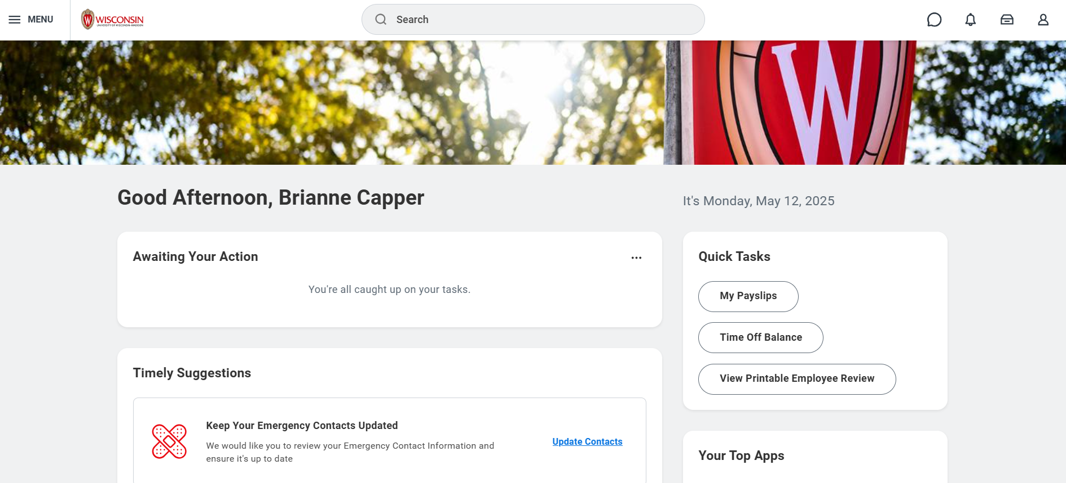
Workday Home Page (Website)
Notes:
When you log into Workday on a computer, you will see this home page.
There are a lot of buttons that will take you to different places in Workday, so we will review some of the most important ones. The smartphone buttons should do the same things, but they may look different.

Slide 30


Menu and Home (Website)
Find these 2 icons in the top left corner of every page
Click the Wisconsin logo to go back to the Workday home page.
Click the Global Navigation Menu to find different apps (pages) in the website.
Notes:
The first two areas we will look at are in the top left corner of the computer screen. ​
​
The first button is the Wisconsin logo. This button will bring you back to this homepage from any page in Workday. So, if you’re exploring, and want to return home, you can click that button.​
​
The next button is the “Menu” button. This will open the Global Navigation Menu for quick access to the different apps in Workday, like the Jobs Hub, or the Benefits and Pay Hub.

Slide 31

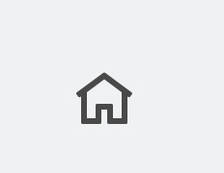
Menu and Home (Mobile App)
The menu options are on the bottom of the screen.
Tap the home icon (bottom left side of all pages) to go back to the home page.
Notes:
Things look a little different in the mobile app.
​
The home button at the bottom will always be there, and you can tap it to return the homepage at anytime.​
The menu, however, is not a button. Menu options are listed at the bottom of the screen.

Slide 32
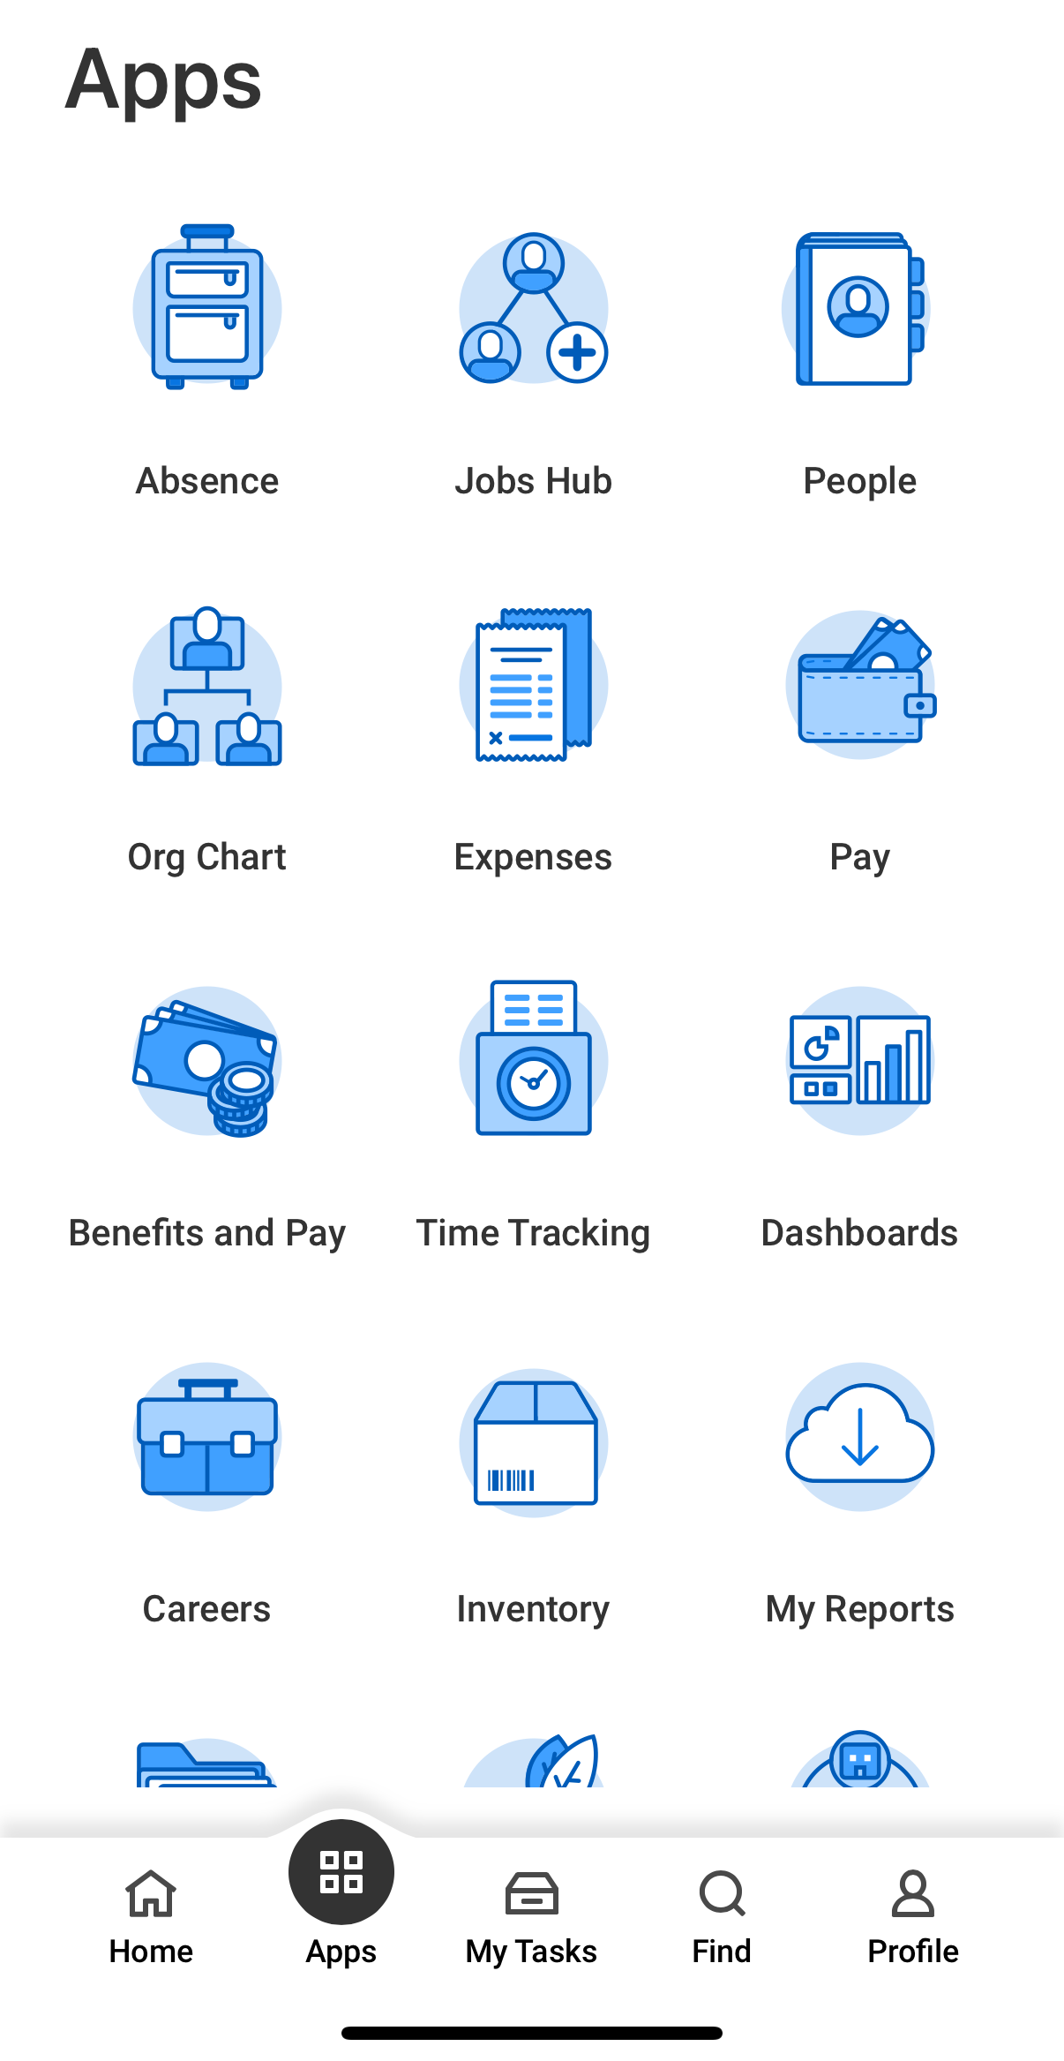
Global Navigation (Mobile App)
Tap Apps to open the Global Navigation Menu.
Notes:
To see all the Apps you can access from the Global Navigation Menu, tap the Apps button. We will review some important apps a bit later.

Slide 33
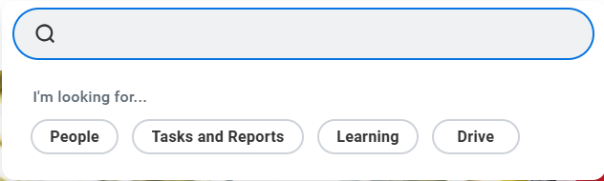
Search Bar (Website)
Use the search bar to find people, tasks, reports, and more.
Notes:
The next feature we want to highlight is the search bar. If you want to do a task or look something up, use the search bar just like you would with Google or a different search engine.

Slide 34
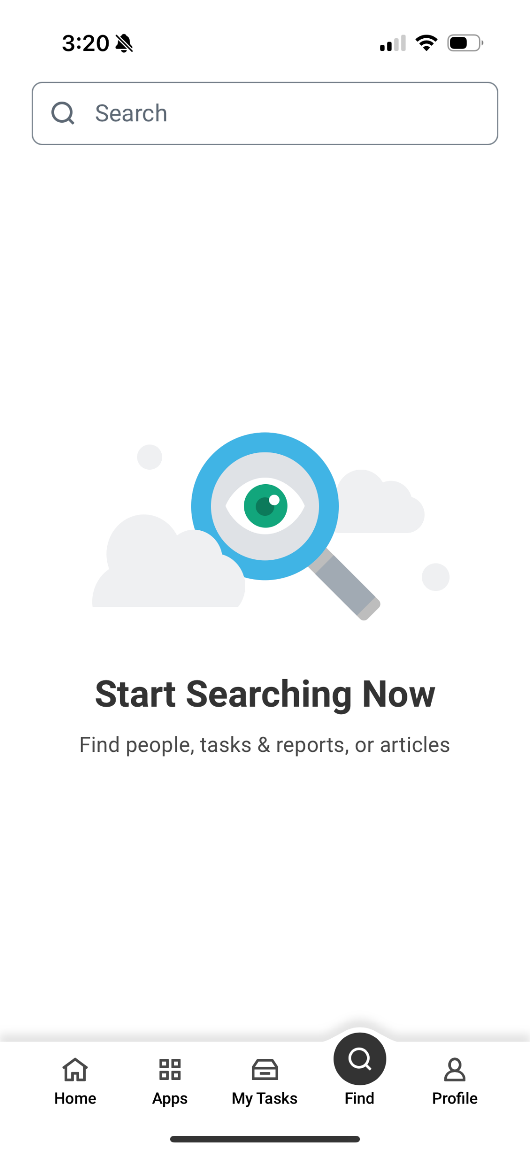
Search Bar (Mobile App)
The search bar is under Find (bottom of the screen).
Notes:
The search feature is also available on the mobile app. It is called “Find” with a magnifying glass, on the bottom bar.

Slide 35
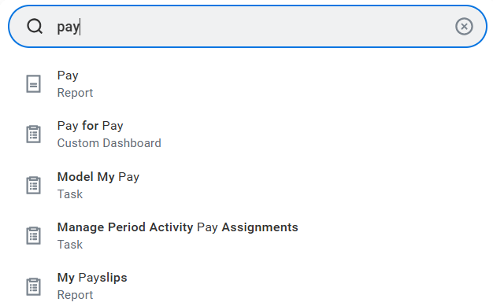
Example: Search Bar
Find your payslips:
Type pay in the search bar.
Find My Payslips from the dropdown options.
Notes:
For example, if you want to find your payslip, you can type “pay” and the search feature will give you options. One of those is “My Payslips,” which will take you directly to your payslips. We will look at this a bit more in the next section.

Slide 36
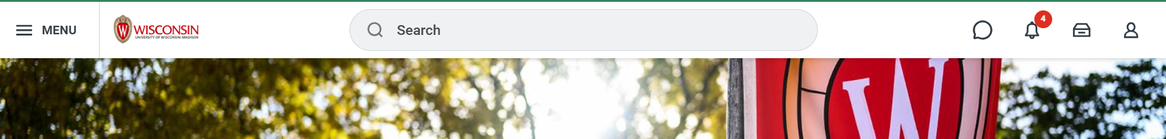
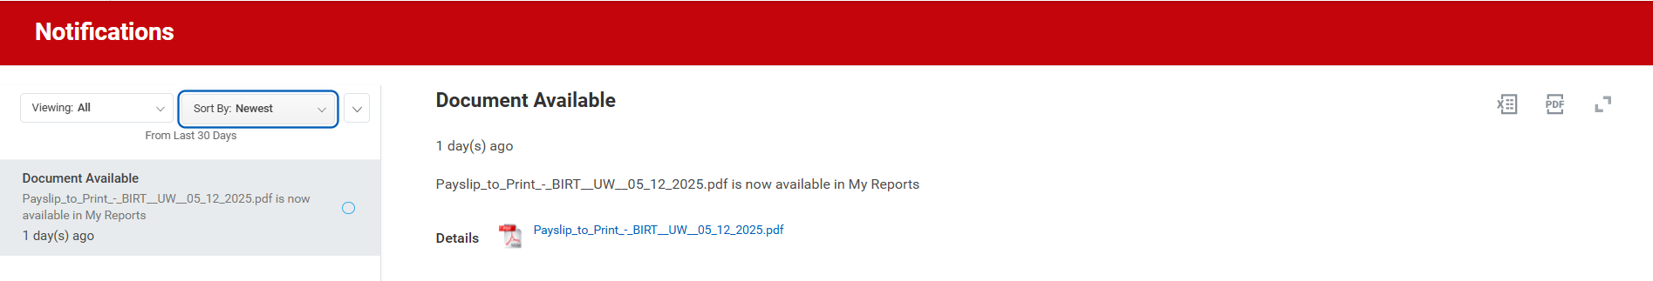
Notifications (Website)
Click the bell icon to read your notifications.
Notes:
The next button we want to highlight is the notifications button, which is the bell icon.
If you have a notification (a reminder or a message), a red circle with a number will pop up, and you can click the bell icon to read the notification.

Slide 37
Notifications (Mobile App)
Tap the bell icon to read your notifications.
Notes:
In the mobile app, you’ll see the bell icon in the upper right corner. Tap it to see your notifications.

Slide 38

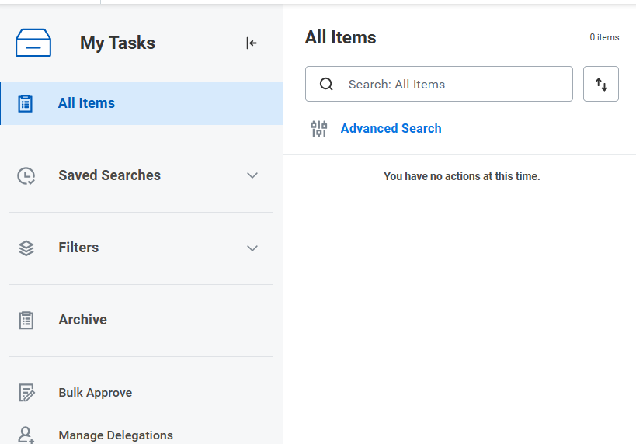
My Tasks (Website)
Click the drawer icon.
Go to My tasks to see your tasks.
The number in the red circle tells how many tasks you have.
Notes:
Next up is the “My tasks” button. In the upper right corner next to the notification bell, you’ll see a button that looks like a drawer. Click that to see your tasks.​
​
Tasks might include courses that you need to take for your job or messages from your local HR professional.

Slide 39
My Tasks (Mobile App)
Tap My Tasks to see your tasks.
Notes:
In the mobile app, the “My tasks” button is located at the bottom bar.

Slide 40
Profile (Website)
The profile icon (top right corner of all pages) opens your employee information.
Notes:
Next up is the Profile button. This is in the top right corner, next to the notification bell and Tasks button. This may also be called the Worker Profile. This opens your employee information.

Slide 41
Profile (Mobile App)
The profile icon is in the bottom right corner.
Notes:
In the mobile app, the profile icon is on the bottom bar, farthest to the right.

Slide 42
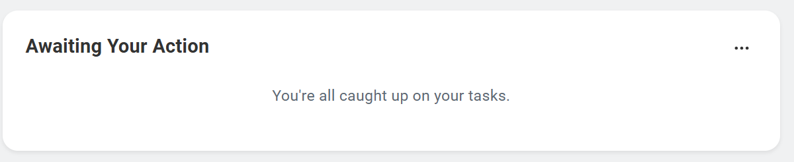
Awaiting Your Action
Awaiting your action shows your 3 newest tasks.
Notes:
Now let’s look at some larger features of the homepage. The first is “Awaiting your Action”. This space shows the 3 newest tasks assigned to you. These could be courses assigned to you or other tasks you need to complete for your job.

Slide 43
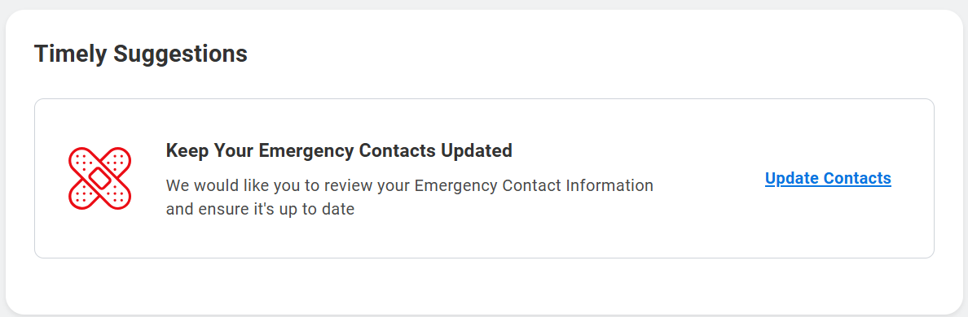
Timely Suggestions
Timely suggestions shows your recommended tasks and reports.
Notes:
The other area you will see on the homepage is “Timely suggestions”. Here, you’ll find updates like required actions, reports, or recommended tasks. For example, you might see a reminder to update our emergency contacts or review upcoming time off requests.

Slide 44
Timely Suggestions (Mobile App)
You will also see timely suggestions in the mobile app.
Notes:
In the mobile app, you’ll see the same timely suggestions in a smaller space.

Slide 45
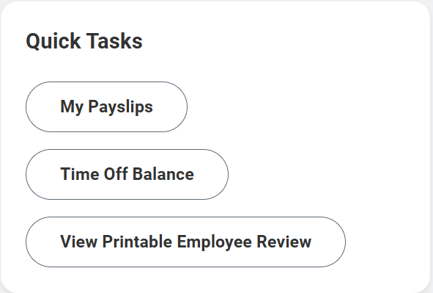
Quick Tasks
Quick tasks helps you quickly start the 3 activities you do most often.
Notes:
Another important space is “Quick tasks.” Quick tasks helps you quickly access the 3 tasks you do most often. This space looks different from person to person. So, if I review my Payslip frequently, the “My Payslips” button will show up in the Quick tasks space.

Slide 46
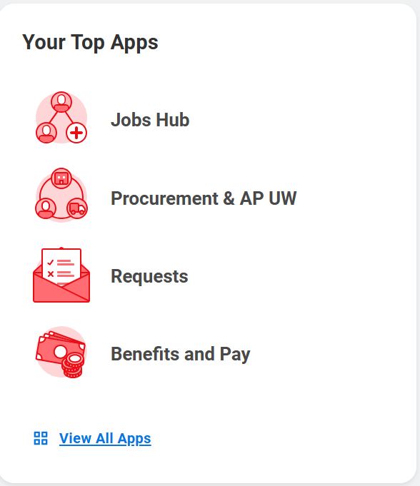
Your Top Apps
Your top apps shows 4 default app icons.
Notes:
The final space we want to highlight is “Your Top Apps.”
On the computer, this space shows your top 4 apps. You can choose which apps you see here.
​
In the mobile app, it shows the apps you regularly use. The apps change based on what you regularly do in Workday.

Slide 47

Questions?

Slide 48

How to Update Personal Information
Home address, phone number, personal email address
Notes:
Next up we are going to look at how to update your personal information in Workday. This includes your home address, phone number, and your personal email address. Again, the personal information that you previously had entered in the old system should have transferred over, so not action is needed from you. But in case you want to update your information, we will review how to do so, then give you time to review and make any changes if you’d like.
It is important to note that if you do have a legal name change due to a marriage or divorce you should contact your local HR as this is a qualifying life event.

Slide 49
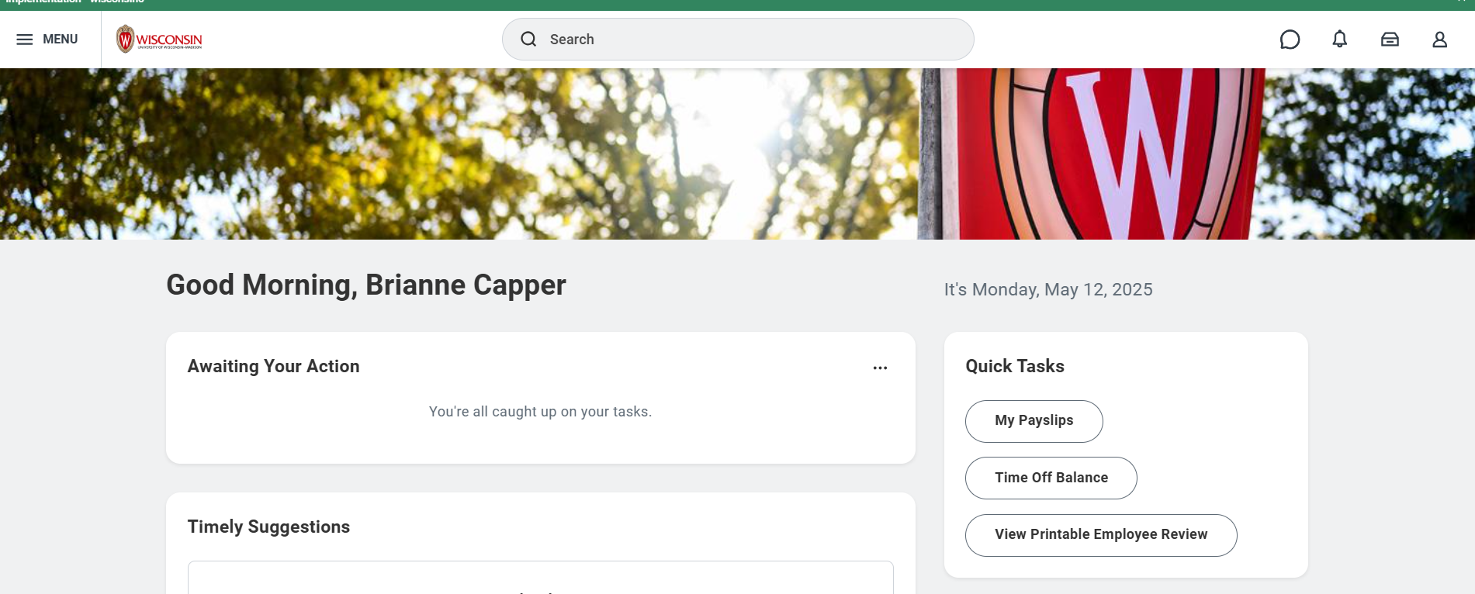
Update personal information
From the Workday Home Page, click Person icon in the top right corner
This is the Worker Profile.
Notes:
Let’s look at the steps to update your personal information.
From the Workday Home Page, click Person icon in the top right corner This is the Worker Profile.

Slide 50
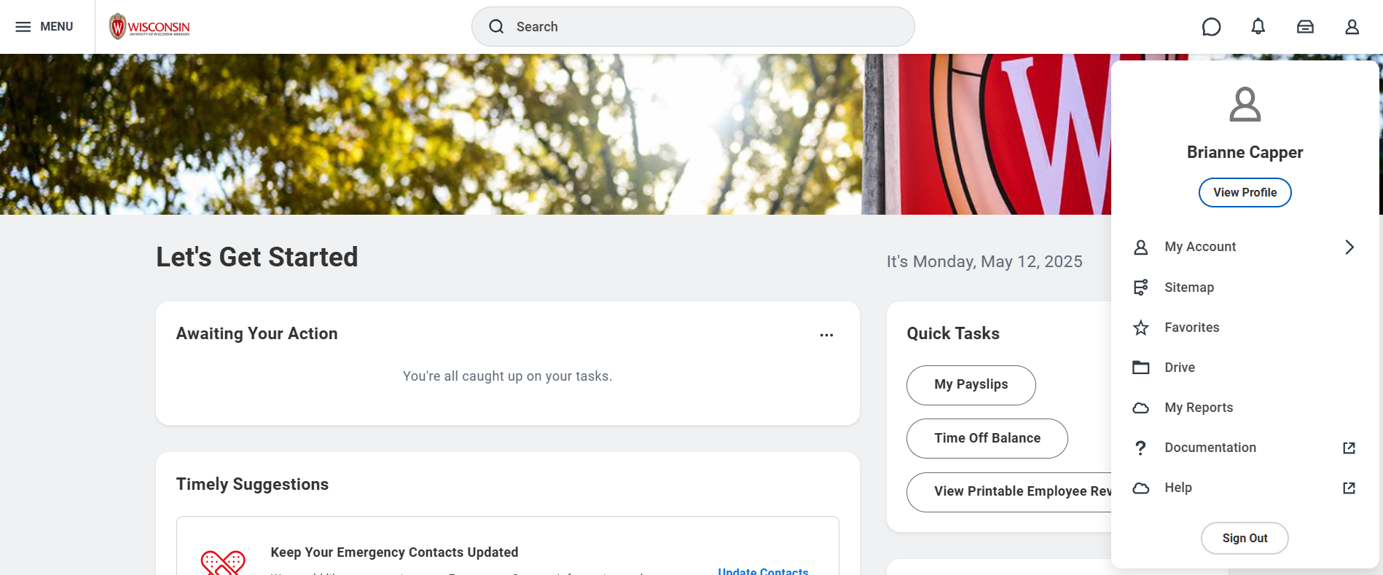
Update personal information
2. Click View Profile
Your Name
Notes:
From there, a pop up will appear, and you need to
2. Click View Profile

Slide 51
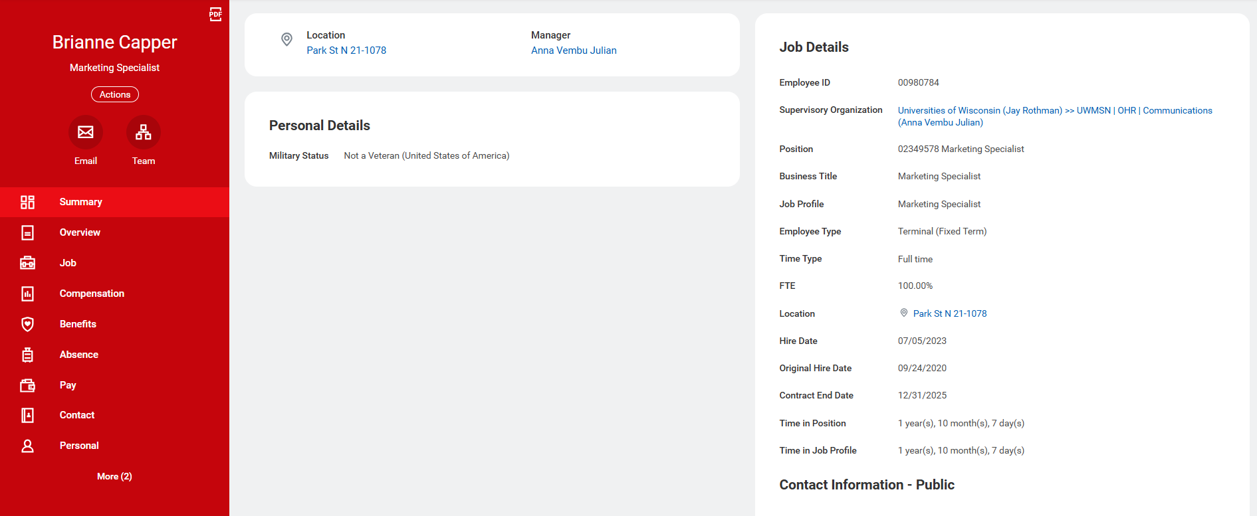
Update personal information
3. Click Contact from the red bar on the left side of the screen
Notes:
To see your personal information,
3. Click Contact from the red bar on the left side of the screen. It will probably be near the bottom of your options.

Slide 52
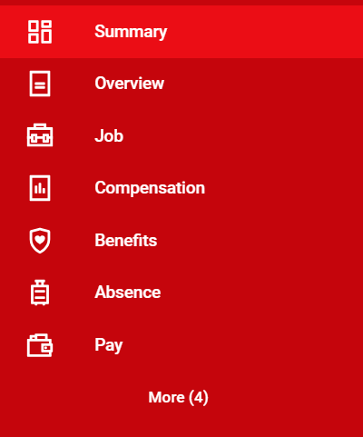
Update personal information
If you cannot find Contact, click More
Notes:
If you don’t see the Contact option, click More and it will show up for you to click.

Slide 53

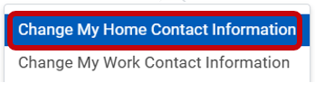
Update personal information
4. Click Edit
5. Click Change My Home Contact Information
Notes:
The page that will open up will show your home contact information, personal phone number, and your personal email address, along with your work contact information.
4. To edit your information, select the Edit button at the top of the page.
5. Then click Change My Home Contact Information

Slide 54
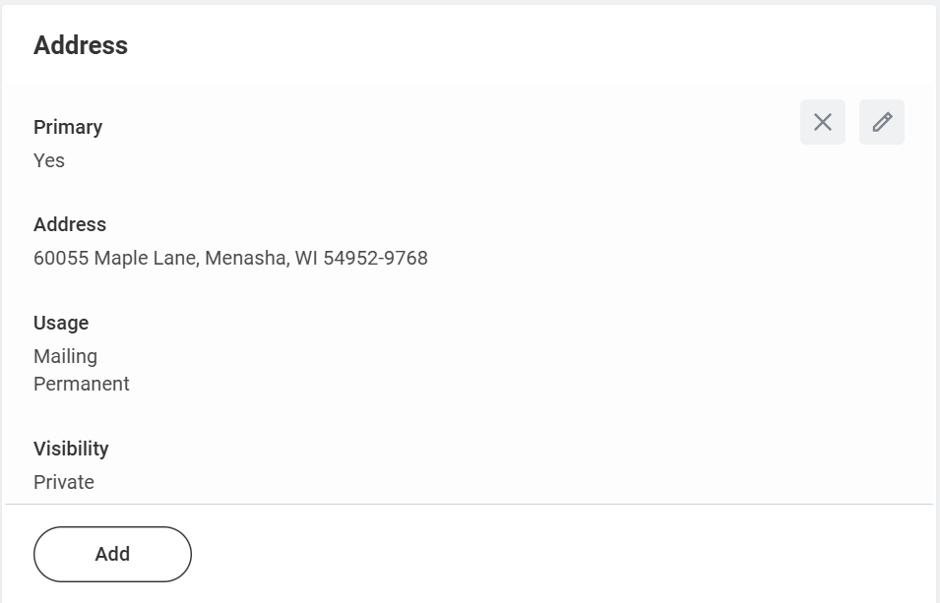
Update personal information
6. Click Add to enter a new address, phone number, or email
Click Edit (pencil icon) to edit the existing address, phone number, or email.
Notes:
From the Change My Home Contact Information screen, you have some options.
6. To add a new address, phone number or personal email address, click the Add button. You would use this feature if you had two personal phone numbers (like a landline and a cell phone).
If you’d like to edit an existing address, phone number, or personal email, click the pencil icon to edit the information that is there.

Slide 55


Update personal information
7. Click the Checkmark to save
8. Click Submit
Notes:
7. To save the information on the address, phone number, or personal email address, click the Checkmark.
8. To Submit all of your changes to your personal information, click the Submit button. You can also choose to Save for Later or Cancel. None of your updates will take effect until you hit the Submit button.

Slide 56
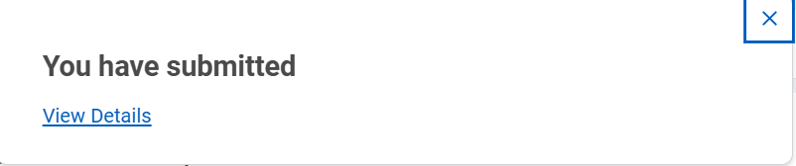
Update personal information
A popup will appear: You have submitted
Notes:
To confirm that you have submitted successfully, a popup will appear that says you have submitted.

Slide 57
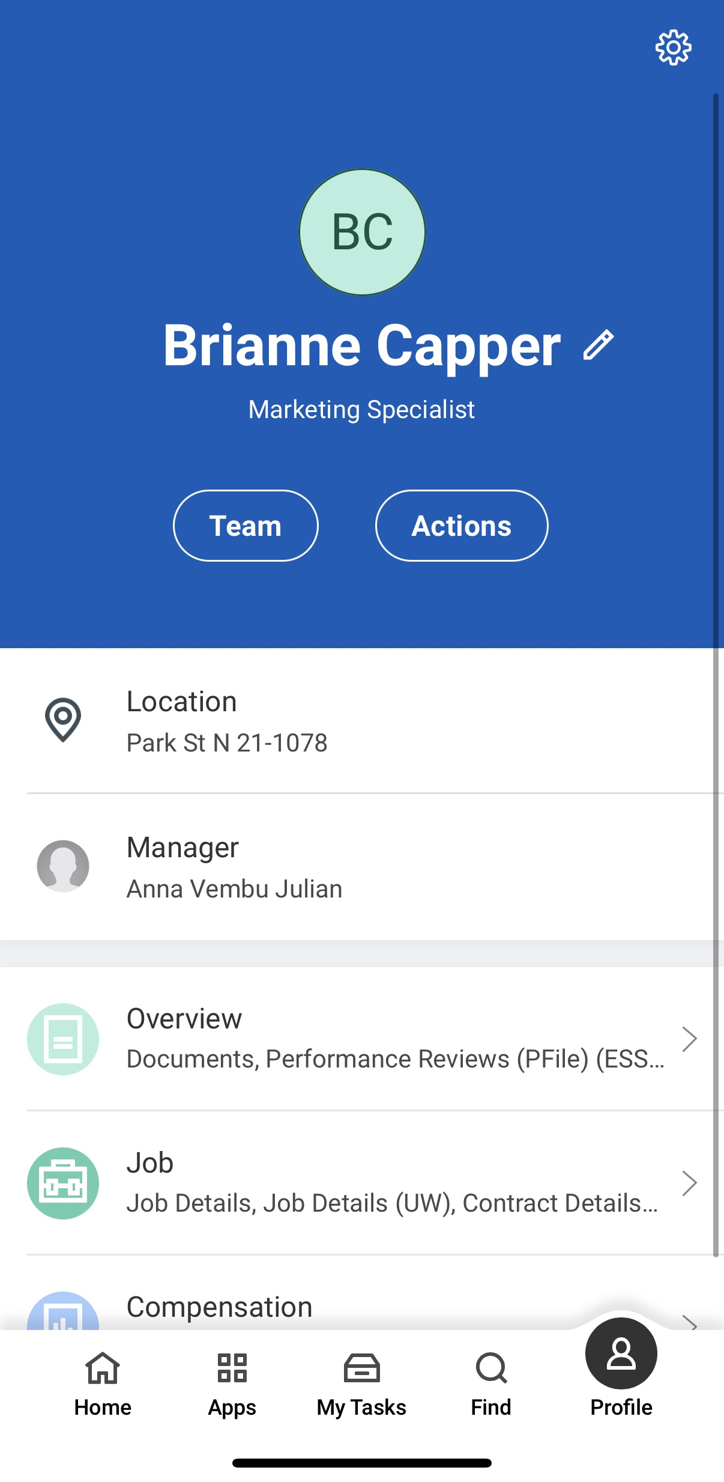


Update personal information (Mobile app)
Tap Profile in the bottom right corner of the screen.
Tap the pencil icon next to your name.
Your Name
Notes:
If you’d like to update your personal information in the mobile app, you also have the opportunity to do so. Most of the steps are the same, but what you click on might be different.
First, tap the Profile icon in the bottom right corner of the screen.
Then, tap the pencil icon next to your name.
Please remember that if you have a name change due to a marriage or divorce, you should contact your local HR as it may impact your benefits.

Slide 58
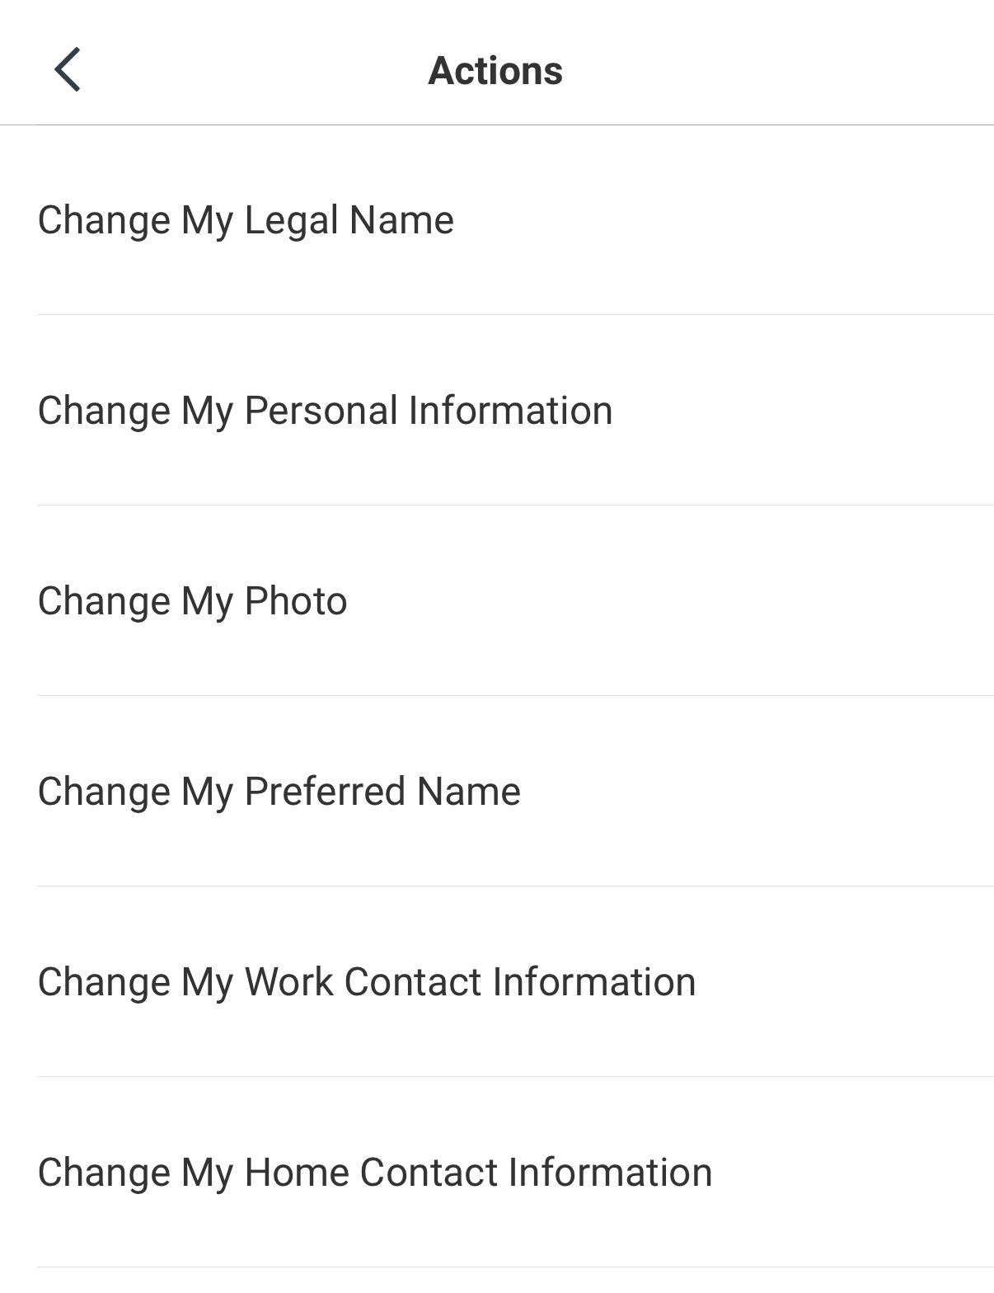
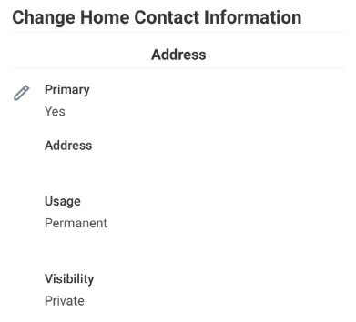
Update personal information (Mobile app)
3. Tap Change My Home Contact Information.
4. Tap the pencil icon to edit your personal information
Notes:
To update your personal information from the app,
3. tap Change My Home Contact Information.
4. You will then see your address, phone number, and personal email. To update any of those, tap the pencil icon.

Slide 59
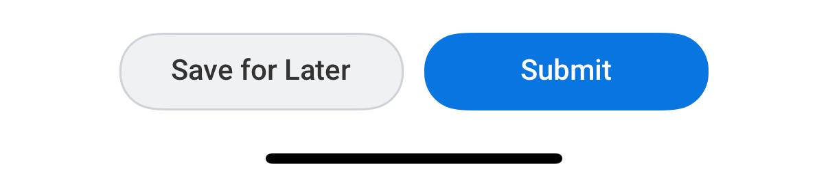
Update personal information (Mobile app)
5. Once you have made changes, tap Submit.
Notes:
5. Finally, tap Submit once you have made your changes.

Slide 60
Practice: Explore the Workday Homepage and Review Personal Information
Click around on the Workday homepage to explore and practice
  Do you have any tasks?
  Do you have any notifications?
  What are your top apps?
Review your Personal Information
  Go to your Profile and click Contact to make sure your Home Contact Information is correct.
    Address, Phone Number, Email Address
    Emergency Contacts
Notes:
Timing: 10-15 minutes
Now let’s take some time to practice getting to those places that we just looked at. The tasks we have on the screen are just to help you review and explore Workday. You do not need to make any updates or changes to your information, but we want to give you an opportunity to get into Workday and review.
Click around on the Workday homepage to explore and practice
Do you have any tasks?
Do you have any notifications?
What are your top apps?
Go to your Profile and click Contact to make sure your Home Contact Information is correct:
Address, Phone Number, Email Address
Emergency Contacts

Slide 61
Resources and Next Steps
Notes:
Before we end our session, I want to share a couple of resources to help you continue your learning, and some next steps.

Slide 62
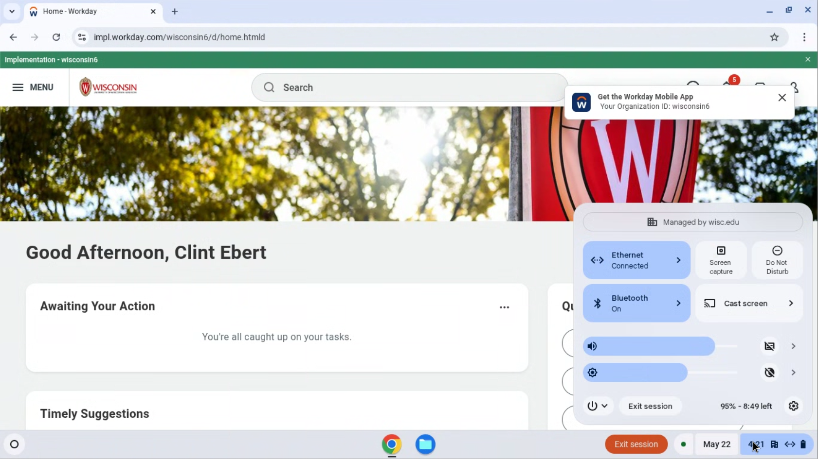
Log off
Before you leave, please restart your computer.
Click on the time at the bottom right corner of your screen.
Notes:
Before you leave, please log off your computer. Click on the time at the bottom right corner of your screen.

Slide 63

Log off
2. Click on the power icon.
3. Select Restart.
The screen will turn white and then turn off.
Notes:
Click on the power icon. Select restart. The screen will turn white and then turn off. You are now logged out of the computer and the device is ready for the next person to use it.

Slide 64
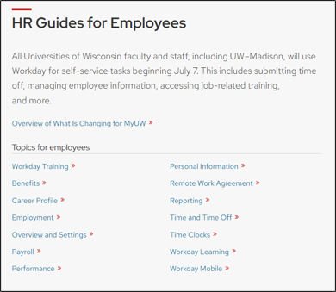
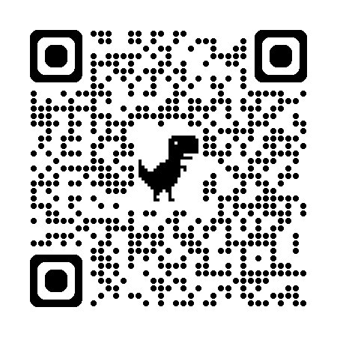
HR Guides for Employees
hr.wisc.edu/hr-guides/#for-employees
Training resources
Answers to common questions
Notes:
A great place for you to go for help is the HR Guides for Employees. Whether you’re looking for guidance, training, or answers to common questions, this directory can help you navigate HR functions in Workday.

Slide 65
Next Steps
Sign in at the front of the room (if you didn’t already)
Confirm your next training (date, time, and location)
Ask your supervisor if you need help
Practice logging into Workday
Notes:
Here are some next steps: ​
Make sure you signed in at the front of the room​
Confirm the date, time, and location of your next session​
Contact your supervisor for help​
Practice logging into Workday

Slide 66
Thank you!
Ask your supervisor if you have questions
Notes:
Thanks for being here today! If you have any questions or need support, contact your supervisor.

