Slide 1
Instructions for Presenting this Slide Deck
In the facilitator guide, you will find:
A script that you can use to present the information in this slide deck.
Timing estimates for each section,
Timing for the engagement activities
Tips to make the engagement activities run smoothly.
If your room has more than 30 people, some people will not be able to use a computer.
When you give employees time to log into Workday, you can ask people to move around to give access to computers if some people only want to use their phones.

Slide 2
Workday In-Person Training Series
Week 2
Sign in at the front of the room
Sit at an open computer
Notes:
Welcome to the Workday In-Person Training Series. My name is [name] and I'll be facilitating today's training. I work at [your unit] as a [your job title].
With us here today to help are [introduce helpers]. [Allow helpers to introduce themselves – their names, where they work, etc].
If you haven't yet signed in, we will bring the sign-in sheet to you, so you can raise your hand.

Slide 3
What to Expect
We will…
Show you how to do tasks in Workday
give you time to practice
We can not…
Answer your personal questions
Talk about policies for specific departments
Notes:
So, let's talk about what you can expect to do during our time together.
We will...
review how to complete tasks in Workday
give you time to practice completing tasks
You'll see the computers in front of you, and we will walk through using those here in a little bit.
Some things we will not be able to do today...
answer personal employee questions
If you do have questions about your job or any personal details, we cannot answer those today. We would encourage you to talk to your supervisor or your local HR staff to help you with those personal questions.
address department-specific policies or procedures
We know that different departments and units have different policies and procedures, so if you have a question about how something will work in your own department, you should talk to your supervisor.

Slide 4
Learning Objectives
By the end of today’s session, you will know how to:
Review your benefits elections
Update retirement accounts
Update W4 (tax withholdings)
Update direct deposit
View and print payslip
Notes:
For today’s session, here are our learning objectives. By the end of today's session, you will know how to: ​
Review your benefits elections
Update retirement accounts
Update W2 and W4
Update direct deposit
Update personal information

Slide 5
Agreements for Today
Listen and practice doing new tasks.
Raise your hand if you have a question or need help.
Follow the presenter. Don’t work ahead.
Ask permission before you look at someone’s screen.
Notes:
As we present information today and give you time to practice, we’ll ask you to:
Stay engaged – Listen to the presentation and use the time to practice.
Listening to the presentation will help you know what to do during our practice times.
Ask questions – Raise your hand if you have a question or need help during the practice times.
Follow along – Don’t work ahead or do other things. Follow along with the presentation, so you don’t get lost.
Ask before you look at someone’s screen – Sometimes, we will look at personal information, like payslips and benefit choices. Before you look at someone’s screen (even if you are helping them), ask if it’s OK.
Some people may be comfortable with you helping, but others might not. So, always ask first.
If you think you can agree to these, give us a thumbs up.

Slide 6
Partner Discussion
Introduce yourself to the person next to you
Name
Where you work
Answer: True or False
You can only log into Workday using a computer.
You need your personal NetID and Password to log into Workday.
To return to the homepage from anywhere in Workday, all you need to do is click Wisconsin logo.
To change your personal information, like your phone number, you will have to contact your supervisor.
Notes:
Before we get into this week’s information, let’s review the information that we talked about last week.
Please introduce yourself to the person next to you, including your name and where you work. Then, identify if the four statements are true or false based on the information from last week. Discuss the statements with your partner, and we will talk about them in a few minutes.
You can only log into Workday using a computer.
You need your personal NetID and Password to log into Workday.
To return to the homepage from anywhere in Workday, all you need to do is click Wisconsin logo.
To change your personal information, like your phone number, you will have to contact your supervisor.
*Note to Facilitator: – Give the participants about 5 minutes to chat. When they are done, ask for a few volunteers to share their answers and discuss the correct answers, sharing some more details. See the answers below.
Answers:
False – You can use a computer or your phone to access Workday
True – You will need to enter your NetID and Password when logging into Workday.
True – The Wisconsin logo in the upper left corner will bring you back to the homepage, no matter where in the system you are.
False – You can update your personal information yourself. However, if you have a change in name or address due to a marriage, divorce, or other life event, you should contact your local HR as these changes may impact your benefits.

Slide 7
Recap of Week 1
What is Workday?
How to log into Workday
Notes:
Let’s get into a bit deeper of a recap from last week.

Slide 8
Partner Discussion – Review of Workday
What are some of the advantages of Workday?
What are some things you can do in Workday?
Having access to the system using the mobile app​
The search bar to help you find what you need ​
Make quick changes to your personal information
Update contact information, direct deposit, federal and state tax elections​
View and print payslips​
View benefits information
Notes:
Facilitator Note: Slide uses an animation to reveal the bulleted lists.
Timing: 10 minutes: 2 minutes for instructions, 5-7 minutes for partner discussion, 3-5 minutes for full group share out/discussion/present information on slides.
Last time we shared some advantages of using Workday, and an overview of things you can do in Workday. Take 5 minutes to chat with a person or people near you about some advantages of the system and some of the actions you can do in Workday. After, we will share out some of our ideas.
*Give 5-7 minutes for participants to discuss.
*Ask for volunteers to share out the advantages first, then the things you can do in Workday. After you have a few people share, click to reveal the lists.
Advantages of Workday:
Having access to the system using the mobile app​
The search bar to help you find what you need ​
Make quick changes to your personal information
Things you can do in Workday:
Submit time off​
Update contact information, direct deposit, federal and state tax elections​
View and print pay slips​
View benefits information

Slide 9
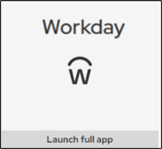
Logging into Workday
How to log into Workday on the computer.
Visit MyUW (my.wisc.edu)
Enter your NetID and Password
Duo Authenticate using the Verification Code or Due Mobile passcode
Once logged into MyUW, find the Workday app and click Launch full app
Workday Mobile App
Notes:
Timing: Give 10 minutes to allow everyone to log into Workday.
We are going to give you time to log into Workday on the computer if you are choosing to use one. The instructions to log into Workday on the computer are on the screen. If you want to use your phone to log into Workday, you can find the app that you downloaded last week. The icon for the app is on the screen.
Open Google Chrome (internet browser) on the computer
Visit MyUW (my.wisc.edu)
Enter your NetID and Password
Duo Authenticate using the Verification Code or Due Mobile passcode
Once logged into MyUW, find the Workday app and click Launch full app

Slide 10
Overview of the Benefits and Pay Hub
Notes:
Today one of our main focuses is the Benefits and Pay Hub. This space in Workday is a single location where you can view your benefits, pay, and compensation information. Nothing about your benefits or pay are changing. You will still be receiving your pay and benefits as you do today. But if you want to review your payslips and benefit elections, you will be using Workday to do so.

Slide 11
What is the Benefits and Pay Hub?
The Benefits and Pay Hub is where you will:
Review your benefits
Find tax documents
Update W2 and W4 (tax withholdings)
View and print payslips
Notes:
In this space, you can:
Review your benefit elections, such as your health insurance or other insurance plans you’re enrolled in. Employees can only update benefits during a life change event (such as the birth of a child, marriage, or divorce for example) or during the annual open enrollment period. Open enrollment will happen in the fall.
Find your tax documents, like
Update information for federal and state withholding elections
And view and print your payslips

Slide 12
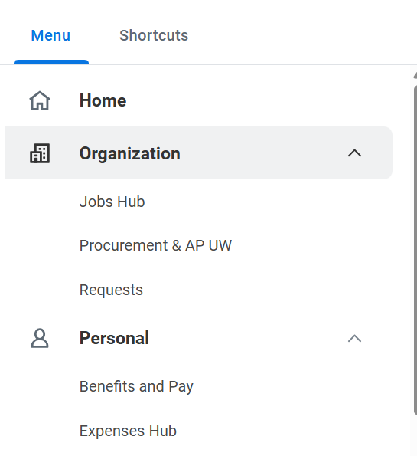
Benefits and Pay Hub
From the Workday home page, click Menu.
Click the Benefits and Pay app.
Notes:
To get to the benefits and pay hub,
1. you can start from the Workday home page and click the Menu button
2. Then click the Benefits and Pay app to open.

Slide 13
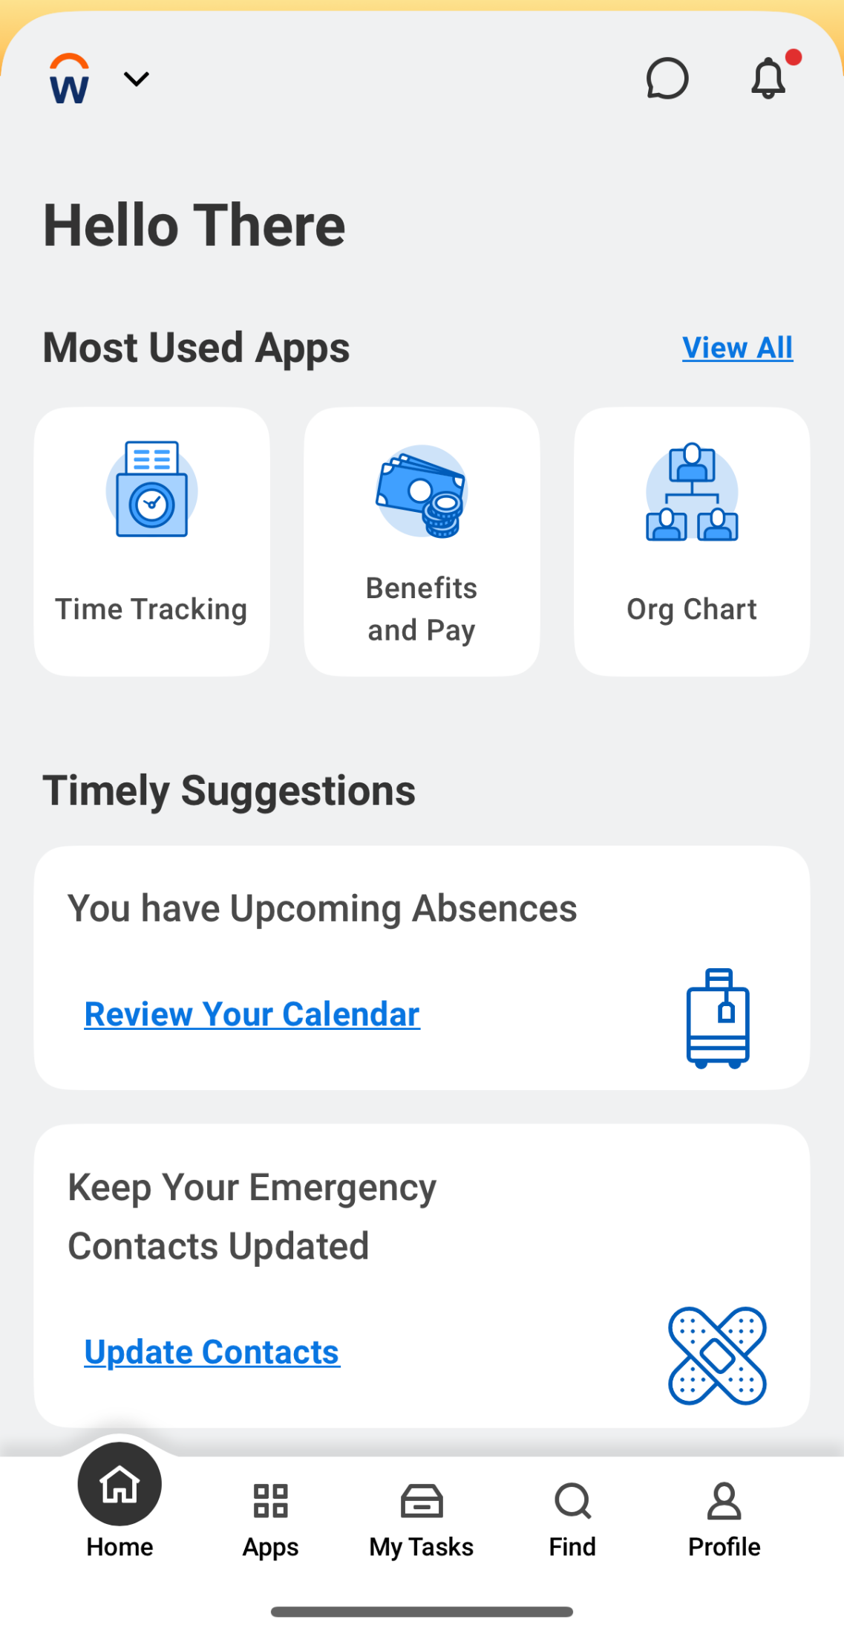
Benefits and Pay Hub (Mobile app)
From the Workday home page, tap Apps.
Tap the Benefits and Pay app.
Notes:
To do this from the mobile app,
1. Tap the Apps button on the bottom bar
2. Then Tap the Benefits and Pay app to open it.

Slide 14
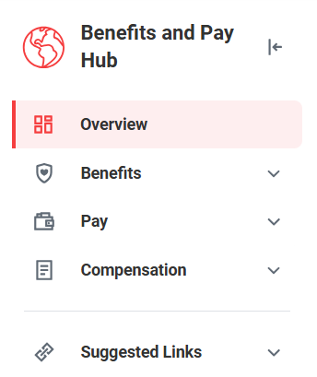
Overview of the Benefits and Pay Hub
Overview
Benefits
Pay
Compensation
Suggested Links
Notes:
The Benefits and Pay Hub is your go to spot if you want to view or update anything related to your benefits and pay. On the left side of the screen, there is an expandable task bar that will show you all of the things you can view in this hub. Each of these items expands and allows you to view and do different things, which we will review in this section of the training, but here is a brief overview:
Overview – This is what the Benefits and Pay hub will automatically open to each time.
Benefits – You can view your benefit elections, like your health or dental insurance.
Pay – Here you can view your payslips and tax information
Compensation – This is where you can see details about your annual income based on your employee contract.
Suggested Links – This final spot expands to give you some additional resources related to your benefits and pay, most of which connect to information from the Universities of Wisconsin.
Next we will look a little bit more in detail about each of those areas.

Slide 15
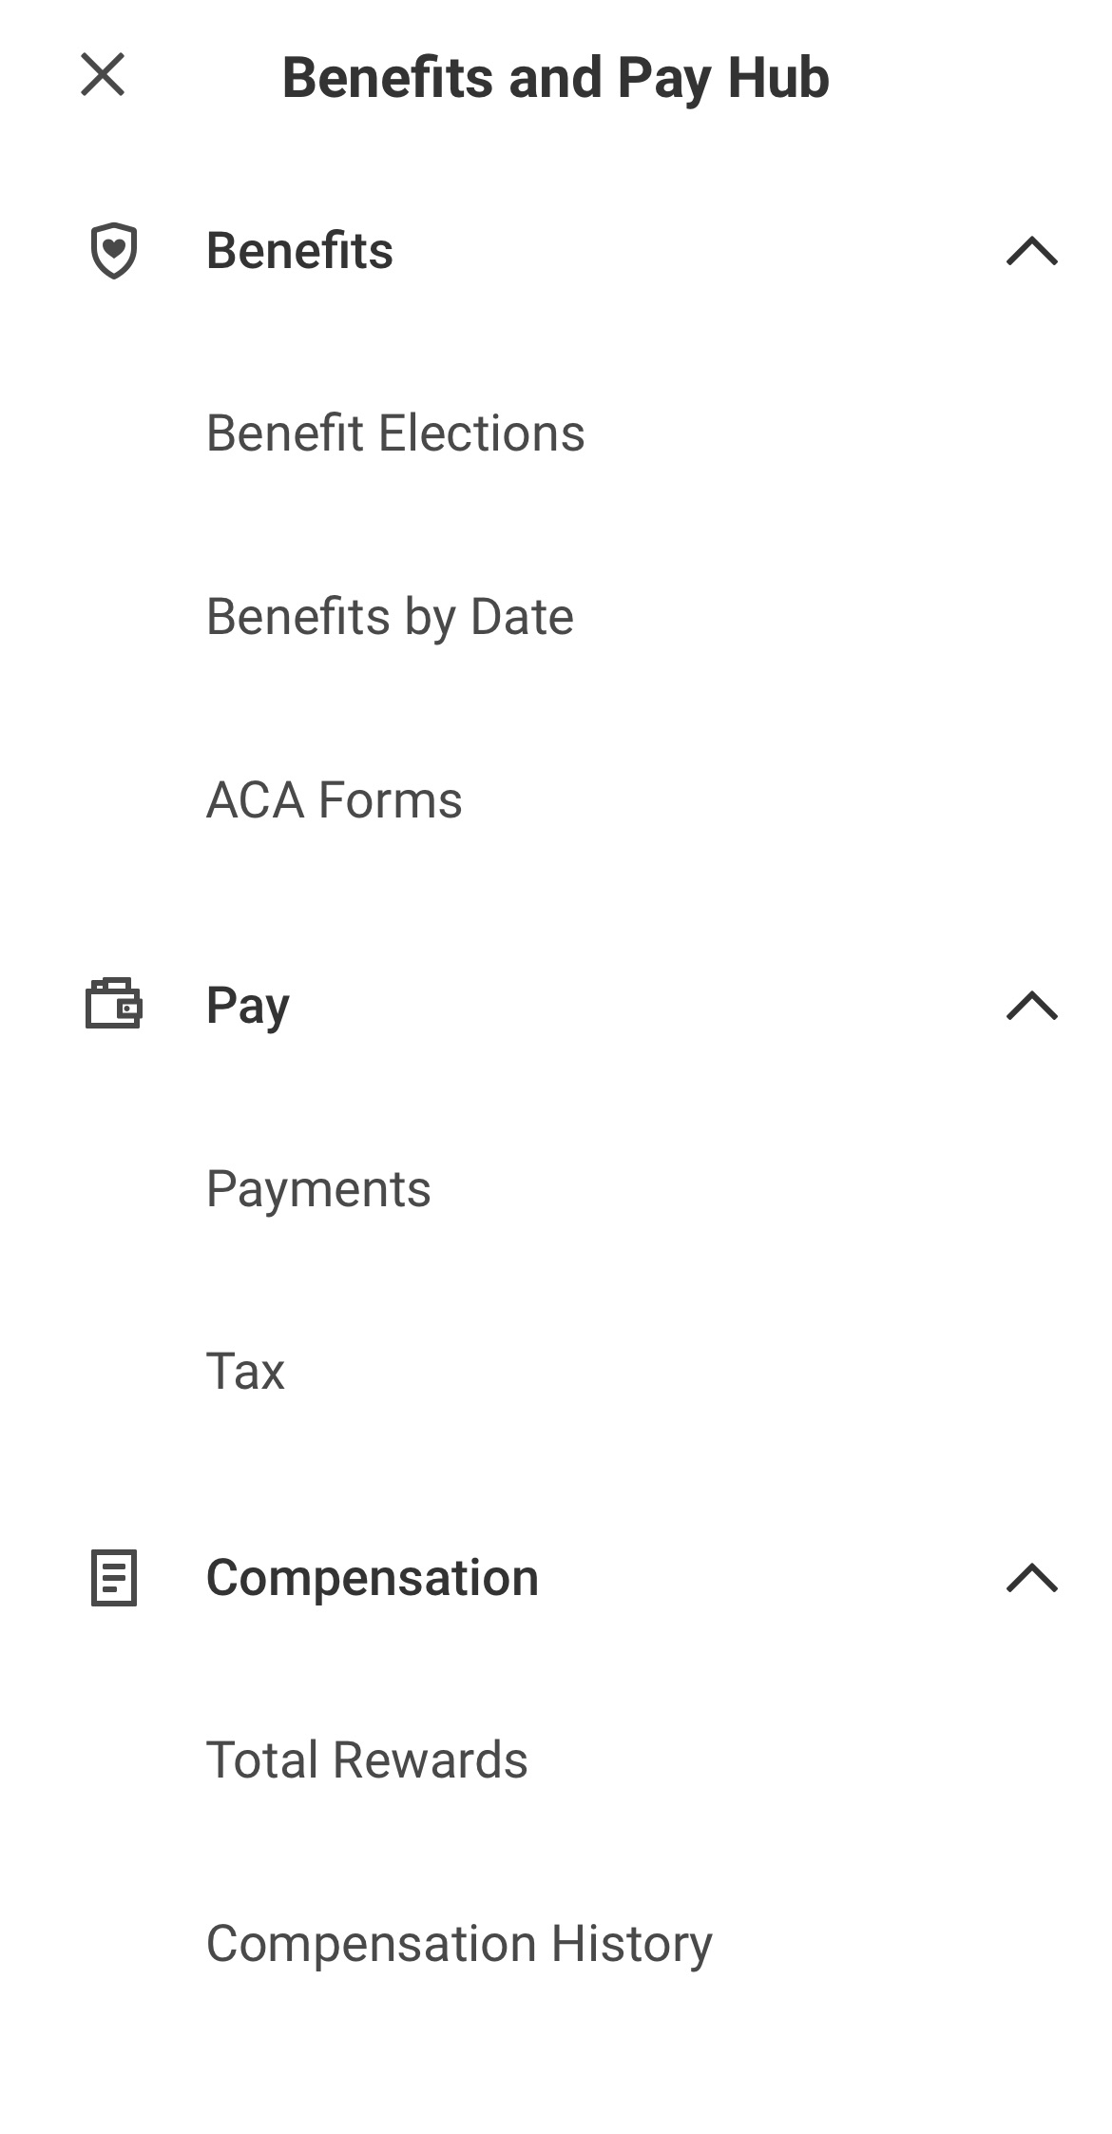
Benefits and Pay Hub (Mobile app)
Notes:
To access the tabs in the mobile app version, tap on Benefits and Pay Hub at the top of the screen. This will open a dropdown list of the other areas of the hub.

Slide 16
Overview page
Notes:
The first page that will open up is an Overview page. This page includes an overview of your pay, including most recent pay, deduction amounts, current benefit costs, withholding elections, payment elections, a link to change benefits, and a link to view your tax documents.

Slide 17
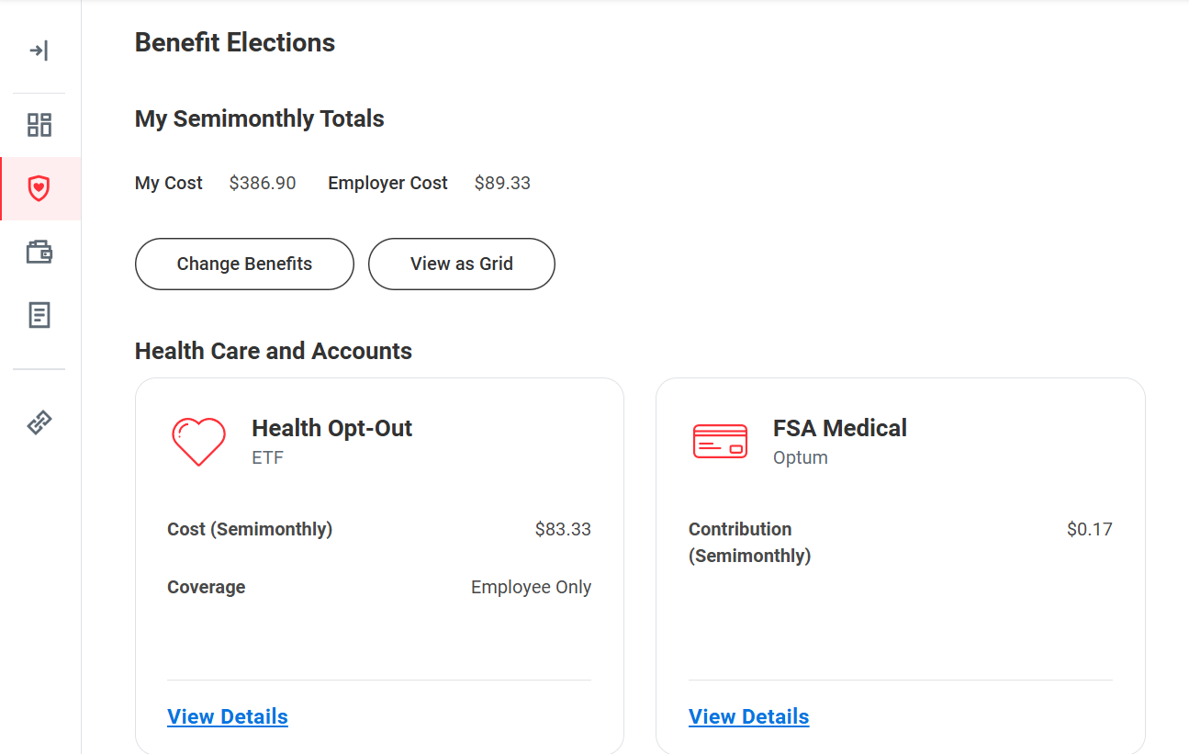
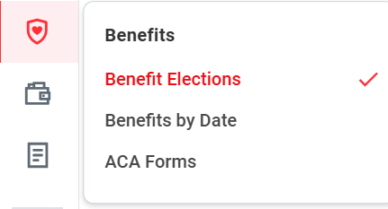
How to view benefits elections
On the left side, click on the Benefits tab.
Click Benefits Elections from the dropdown menu.
Here, you can review your benefit elections.
Notes:
In the Benefits tab, there are three areas that you can review: Benefit Elections, Benefits by Date, and ACA Forms. We will be looking at the benefit elections page.
The benefits elections page shares an overview of your current benefits elections and their semimonthly cost (which means twice per month). This includes health care and accounts as well as insurance and retirement benefits. These are the benefits you chose during open enrollment, or during a life change event. If you were recently hired to the university then you elected these benefits when you started employment.

Slide 18
Benefits tab
You can enroll or update your Supplemental Retirement Plan 403(b) in Workday.
To update all other benefits enrollments, you must log into My Insurance Benefits by clicking the link under Instructions in Workday.
Notes:
In Workday, you can make updates to your Supplemental Retirement Plan 403(b) and WRS Voluntary Additional Contributions. All other benefit enrollments (health, dental, etc.) will be through the My Insurance Benefits system, which is linked on the Change Benefits page on the right. More information on registering for and using My Insurance Benefits is coming soon. You will use this link during the open enrollment period to make changes to your benefits elections.

Slide 19
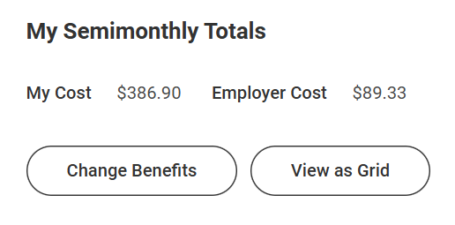
How to update supplemental retirement
To make updates to your benefits, click Change Benefits.
Notes:
If you do want to make updates to your benefit elections, you can click Change Benefits button, and it will open the Change Benefits screen which we just saw. But as we just covered, you can only make changes to your supplemental Retirement in Workday. All other updates will happen in the State of Wisconsin Employee Trust Funds (ETF) system called My Insurance Benefits. All university employees are also state of Wisconsin employees. As such, our benefits (such as health insurance, dental and Wisconsin Retirement System) are administered by the Employee Trust Funds.

Slide 20
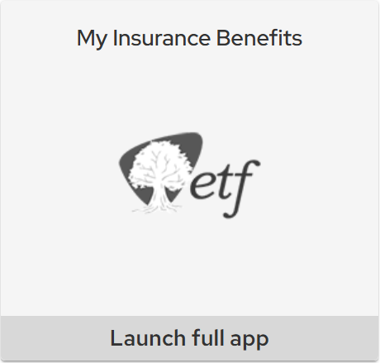
New Benefits Tile in MyUW
Notes:
You can access the My Insurance Benefits system from the Benefits and Pay hub, or you can easily access it through the new tile in MyUW.

Slide 21
What can I do in Workday vs. My Insurance Benefits?
Workday replaces the current Human Resource System (HRS)
View benefits elections
View benefits costs
Link to My Insurance Benefits
Update:
Supplemental Retirement Plan (403b)
Wisconsin Retirement System (WRS) Additional Contributions
My Insurance Benefits; administered by Employee Trust Funds (ETF) is a new benefits platform
Elect or make changes to most benefits
View benefits elections
View benefits costs
Enter and update spouse/dependent information
View WRS Statement of Benefits
Notes:
Just for your awareness, here is an overview of what you will use Workday for, and what you will use My Insurance Benefits for in terms of benefits. Again, nothing about your benefits or eligibility will change. The only thing that is changing is where you review it and where you make changes.
In Workday, you can:
View benefits elections
View benefits costs
Review, Elect, or Update:
Supplemental retirement plan (403b)
Wisconsin Retirement System (WRS) Additional Contributions
In My Insurance Benefits from ETF, you can:
View benefits elections
View benefits costs
Update most benefits during:
Qualifying life event (marriage, birth, divorce)
Yearly open enrollment Update dependent information
View WRS Statement of Benefits

Slide 22
What should I do now?
You do not need to do anything right now.
If you have a qualifying life event or employment change that impacts your benefits and need to update or change your benefits, contact your local HR.
Notes:
So you may be thinking what do you need to do now. The answer is nothing. You do not need to go into the system to make any updates or make any benefits elections. More communication will be coming soon about the yearly open enrollment.
If you do experience a qualifying life event, such as a marriage or a birth of a child and need to update or change your benefits, contact your local HR and they can help you.

Slide 23
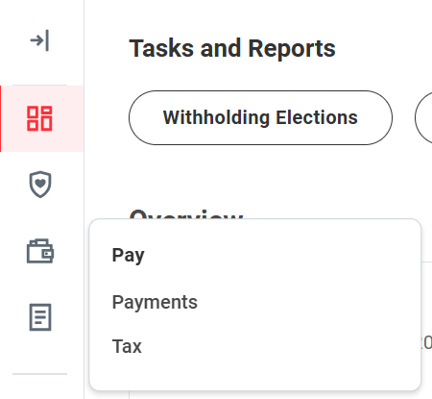
View payslips and pay history
On the left side, click on the Pay tab.
Click Payments from the dropdown menu.
Notes:
Next we’re going to look at the Pay part of the Benefits and Pay Hub. Under Pay under the lefthand options, you can select to review Payments, or Tax information. We’re going to start with the Payments page.

Slide 24
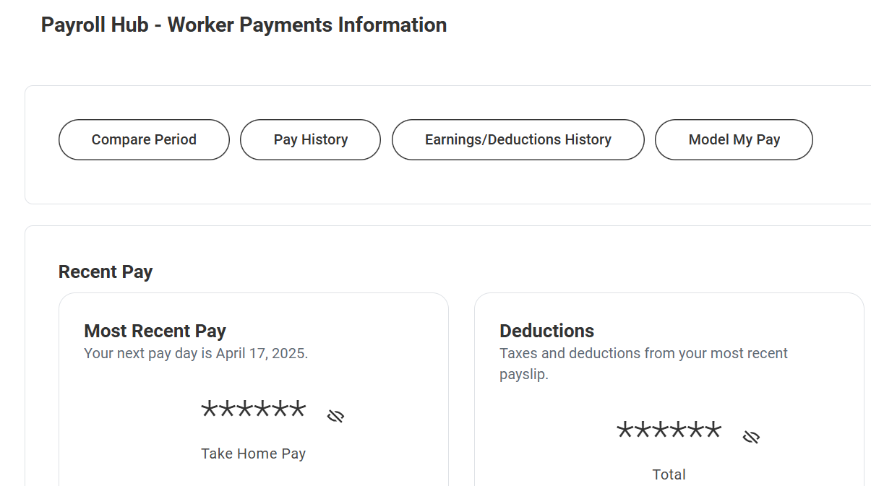
Overview of payments page
You can review your payslips, most recent pay, deductions, and pay history.
Notes:
In the Payments page, you can view and print your payslips, your most recent pay, deductions, and pay history. In the Most Recent Pay box, you can also see your next pay date, along with the expected take home pay. In the Deductions box, you can see the total about of taxes and deductions from your most recent payslip, along with a breakdown of each type of deduction and for how much.
In our next section, we will look more closely at how you can view and print your payslips.

Slide 25
View and update tax forms
On the left side, click on the Pay tab.
Click Tax from the dropdown menu.
Notes:
Now we’re going to look at the Tax part of the Pay tab. To open this, click the Pay tab on the left side, then Tax from the dropdown.

Slide 26
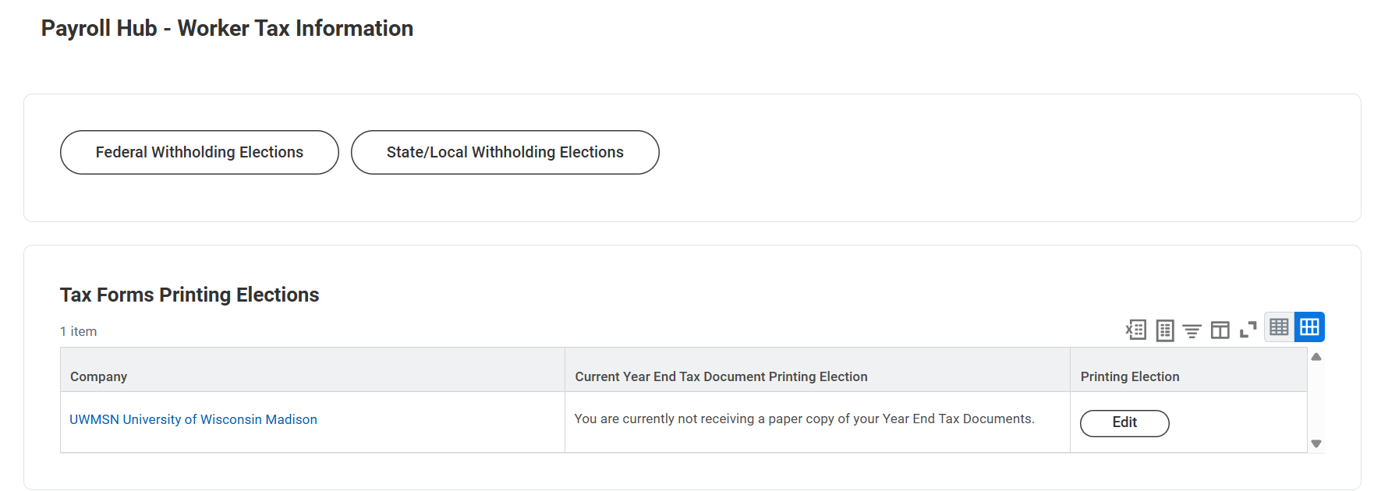
Overview of tax page
You can review and update the information on your W4 and see your tax forms from June 29, 2025 and beyond.
Notes:
Here, you can review and update information for your W2 and W4 tax withholdings. You will also be able to see your tax forms from June 29, 2025 and beyond.

Slide 27
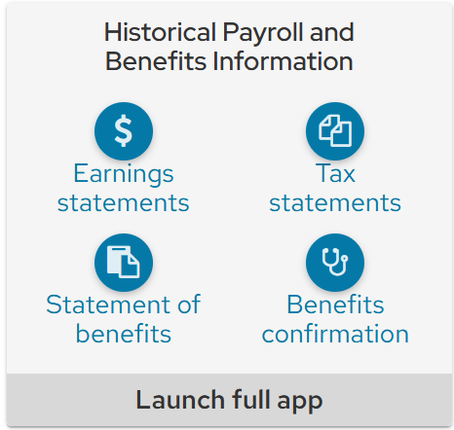
Tax and earning statements
Tax statements and earning statements from before June 29, 2025 are available in the Historical Payroll and Benefits tile in MyUW.
Notes:
If you’re trying to see your tax statements from before June 29, 2025, you will need to go to the Historical Payroll and Benefits tile in MyUW, as that information will not transfer to Workday. This tile also includes historical Wisconsin System Retirement Statement of Benefits. The Statement of Benefits is a summary of your WRS retirement account available each year in mid-April. It helps you keep information up to date and track the growth of your retirement account for those who are eligible. Your benefits confirmation includes previous benefits you selected during open enrollment.

Slide 28
How to Update your W4
1. Click Federal Withholding Elections or State/Local Withholding Elections on the Worker Tax Information page.
2. Update your information. Click the I Agree checkbox before submitting.
3. Click OK to submit.
Notes:
To update that information, you can follow these steps:
1. Click Federal Withholding Elections or State/Local Withholding Elections on the Worker Tax Information page.
2. Update your information. Click the I Agree checkbox before submitting.
3. Click OK to submit.

Slide 29
Update W4 confirmation
4. A You Have Submitted popup window will appear to confirm that your changes have been updated.
Notes:
4. To confirm you have submitted properly, you will a popup window will show “You have submitted”

Slide 30
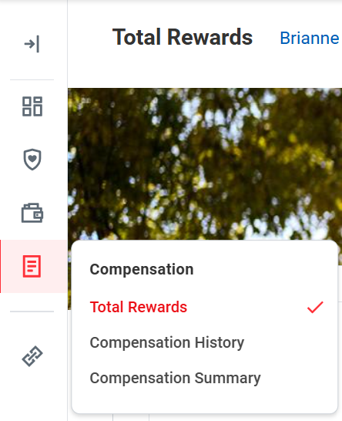
Compensation tab
On the left side, click on the Compensation tab.
Here, you can review total rewards, compensation history, and compensation summary.
Notes:
The final tab we have to look at is the Compensation tab. There are three areas under that tab: Total Rewards, Compensation history, and Compensation summary.
Total rewards shows the total value of your annual income.
Compensation history shares changes to your compensation, including effective dates. Only data or information from after July 7 will be in Workday. No historical compensation data will be available.
Compensation summary shares an overview of your current compensation amount. This information will include your annual salary and any possible additional pay you may receive (such as a bonus or differential pay)

Slide 31
Practice: Explore the Benefits and Pay Hub
Look at the Overview Page
Look for your most recent Take Home Pay (you may have to click to unhide the information)
Review the Benefit Elections
Look at what Health Care and Accounts you have.
Look at the “My Cost” and the “Employer Cost”
Review the Compensation tabs
Look at your total pay (Total Rewards and Compensation Summary)
Notes:
To help you explore Workday’s Benefits and Pay Hub, complete the tasks on the screen. You do not necessarily need to take action on any of these items, but we wanted to give you some specific things to look through to help you explore.
10-15 minutes
Look at the Overview Page
Identify your most recent Take Home Pay (you may have to click to unhide the information)
Review the Benefit Elections
Identify what Health Care and Accounts you have.
Review the Benefit Elections
Identify the “My Cost” and the “Employer Cost”
Review the Compensation tabs
Look at your Total Rewards and Compensation Summary

Slide 32
Break Time
Notes:
Provide a break of no more than 10 minutes

Slide 33
View and Print your Payslip
Notes:
Now, we will review how to view and print your payslip. We will review the instructions first, then you’ll have time to practice.

Slide 34
Payslips in Workday
Payslip - earning statement, paycheck, paystub
Before June 29, 2025 – MyUW, earning statement tile
After June 29, 2025 –Workday, payslips
Notes:
In Workday, the term payslip is used. You may have called this an “earning statement” or a paycheck or pay stub in the past.
Keep in mind that you will not be able to see any of your payroll information from before June 29 in Workday.
Anything after June 29 will show up in Workday, but if you are trying to see your earning statement from before June 29, you can go to MyUW under the earning statements tile.
Payments made in Workday will have statements visible in Workday. Payments made from HRS (any payments before June 29) will be visible in the payroll tile in MyUW.

Slide 35
View Your Payslip (Website)
From your Workday home page:
Click Menu
Click Benefits and Pay app
Notes:
To begin, start at the homepage and click the menu button. Next, navigate to the Benefits and Pay Hub.

Slide 36
View Your Payslip (Website)
3. Click the Pay icon
Notes:
We’ll click on the pay icon, along the left side tool bar, the fourth icon down from the top.

Slide 37
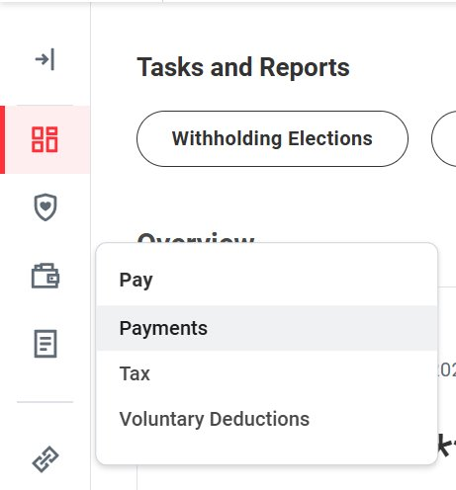
View Your Payslip (Website)
4. Click Payments
Notes:
From the pay icon, other options will pop open. Click payments, which will open another screen.

Slide 38
View Your Payslip (Website)
5. Scroll to All Payslips
6. Find the payslip you want to see (listed in the table)
7. Click View
Notes:
The screen that opens is the Payroll Hub. From here, scroll down until you see “All Payslips” and a table underneath.​
Find the payslip you want to see and click the “View” button.

Slide 39
Print Your Payslip
8. Find the payslip you want to print (listed in the table)
9. Click Print
Notes:
If you want to print that payslip, click “print” instead of “view”

Slide 40
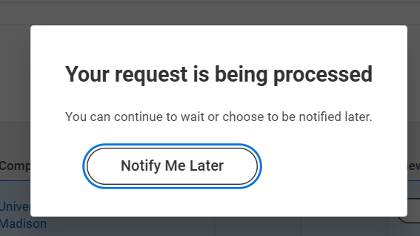
Print Your Payslip
10. Wait for a few seconds
A message will pop up: Your request is being processed
Notes:
After you click the print button, a pop-up will appear that says “your request is being processed.” Wait a few seconds. The pop up will go away and you will see the payslip on your screen.

Slide 41
Print Your Payslip
11. Watch for the PDF to pop up on your screen
12. Click the print button (top right corner)
Notes:
A PDF of your payslip will show up on your screen. ​
If you want to print it, click the print button in the top right corner. ​
If you do not have access to a printer or need help printing, ask your local HR.

Slide 42
View Your Payslip (Mobile App)
From your Workday home page:
Tap Apps
Tap Benefits and Pay app
Notes:
You can also view or print a payslip from your smartphone on the Workday mobile app.
​
From the home screen, tap “apps” and then tap the Benefits and Pay app.

Slide 43
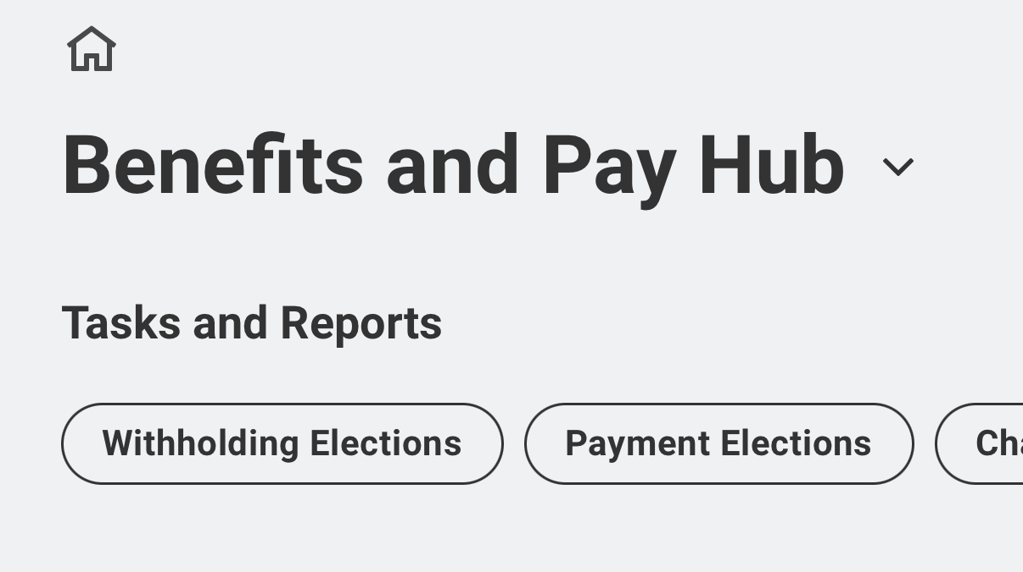
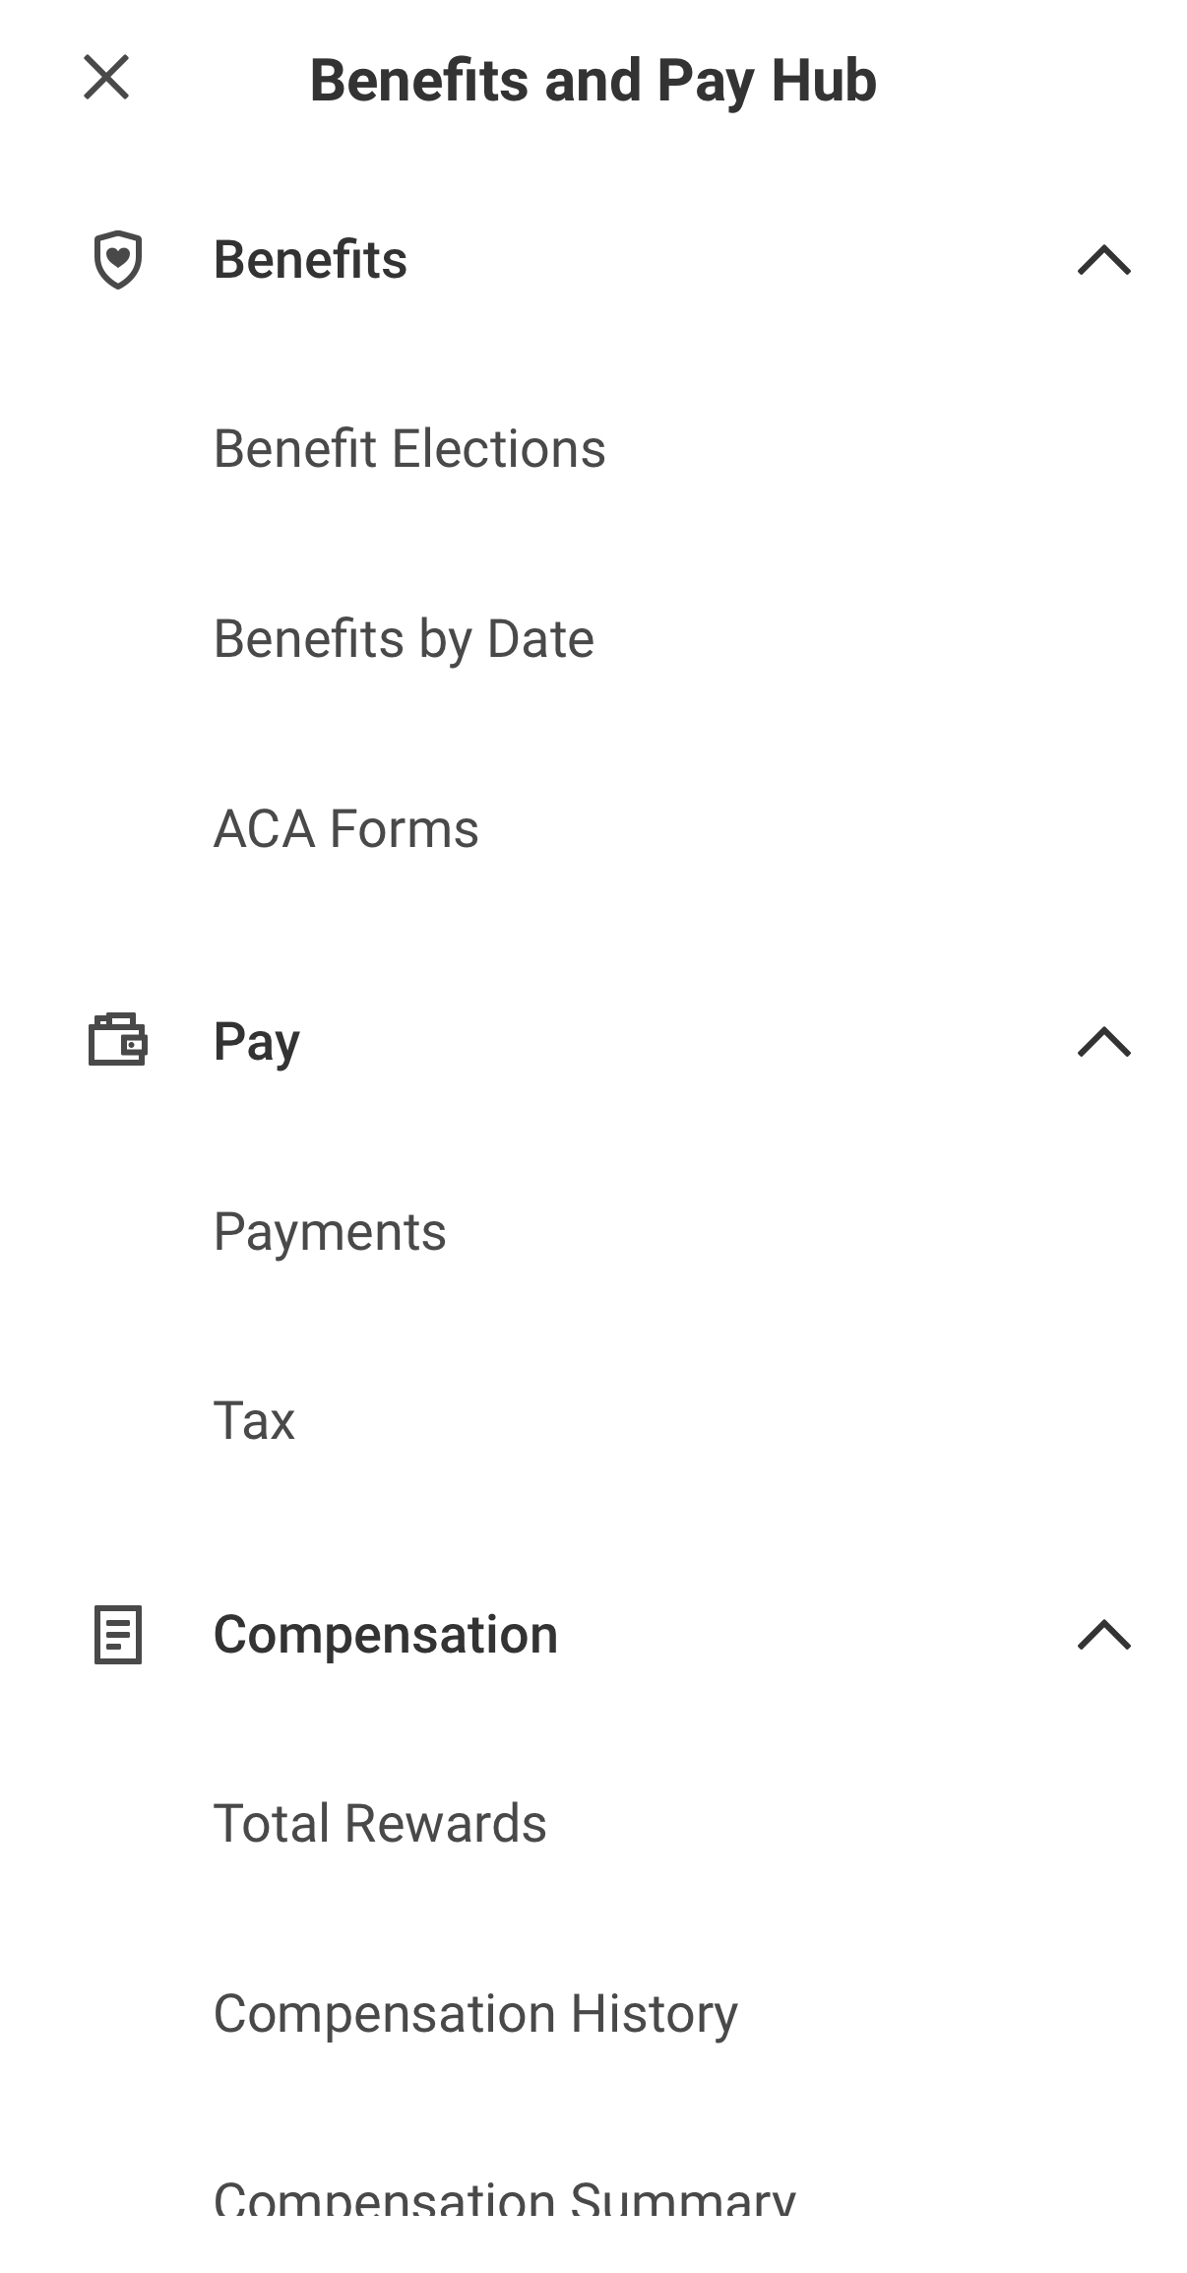
View Your Payslip (Mobile App)
3. Tap Benefits and Pay Hub (top of the screen)
4. Tap Payments
Notes:
Tap the Benefits and Pay hub at the top of the screen.​
​
From the dropdown, tap “Payments”

Slide 44
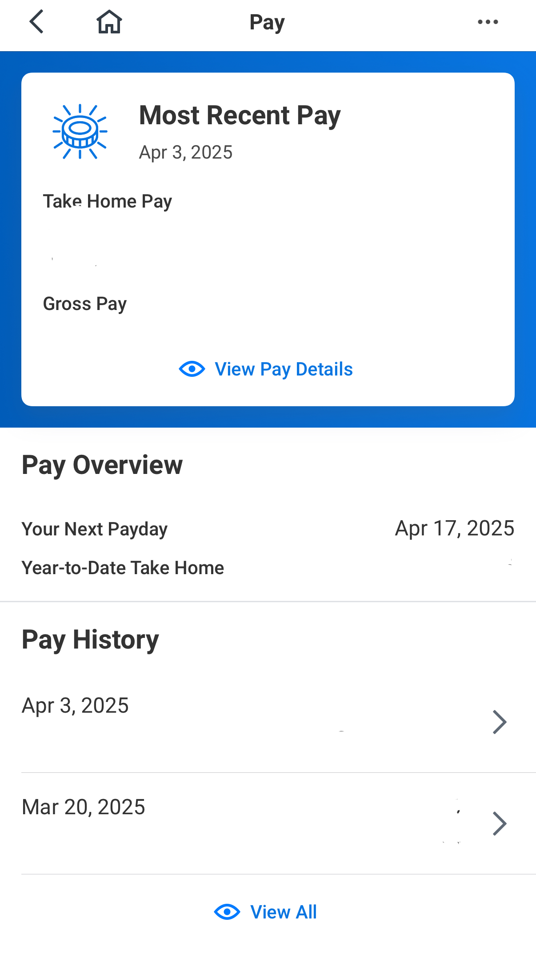
View Your Payslip (Mobile App)
5. Find Pay History
6. Tap the payslip you want to print
7. Tap Get PDF (bottom of screen)
8. Tap Open PDF when the PDF loads
Notes:
On the next screen, find “Pay History.” Tap the payslip you want to view or print.​
At the bottom of the screen, tap “Get PDF.” The pdf will load. Then you can tap “Open pdf” to view the payslip.

Slide 45
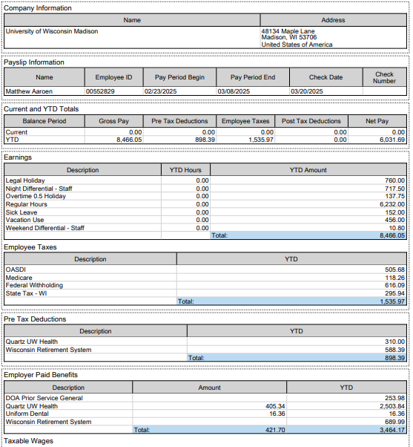
Payslip overview
Institution name, address
Name, employee ID, pay period dates, check date
Current and Year to Date (YTD) totals
Earnings
Employee taxes
Pre-tax deductions
Employer paid benefits
Notes:
Here is a preview of what a payslip might look like. Payslips will look different for each employee.
Institution name, address
Name, employee ID, pay period dates, check date
Current and Year to Date (YTD) totals
Earnings
Employee taxes
Pre tax deductions
Employer paid benefits

Slide 46
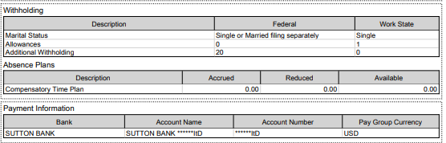
Payslip overview
8. Tax withholding
9. Absence plans
10. Payment information
Information may look different for each employee.
Notes:
Tax withholding
Absence plans
Payment information

Slide 47
Practice: View Your Payslip
Use your phone or computer
Practice the instructions to print your payslip
You can’t print now – just practice
Raise your hand if you need help
When you finish, you can help others if they agree to it.
Notes:
Now, you’ll have time to practice accessing your payslips. You can’t print right now, but this will be good practice so you can find and print your payslips in the future. ​
​
Follow the instructions, either from your computer or your phone to print your most recent payslip.

Slide 48
Resources and Next Steps
Notes:
Before we end our session, I wanted to highlight a couple of resources to help you continue your learning, and some next steps.

Slide 49
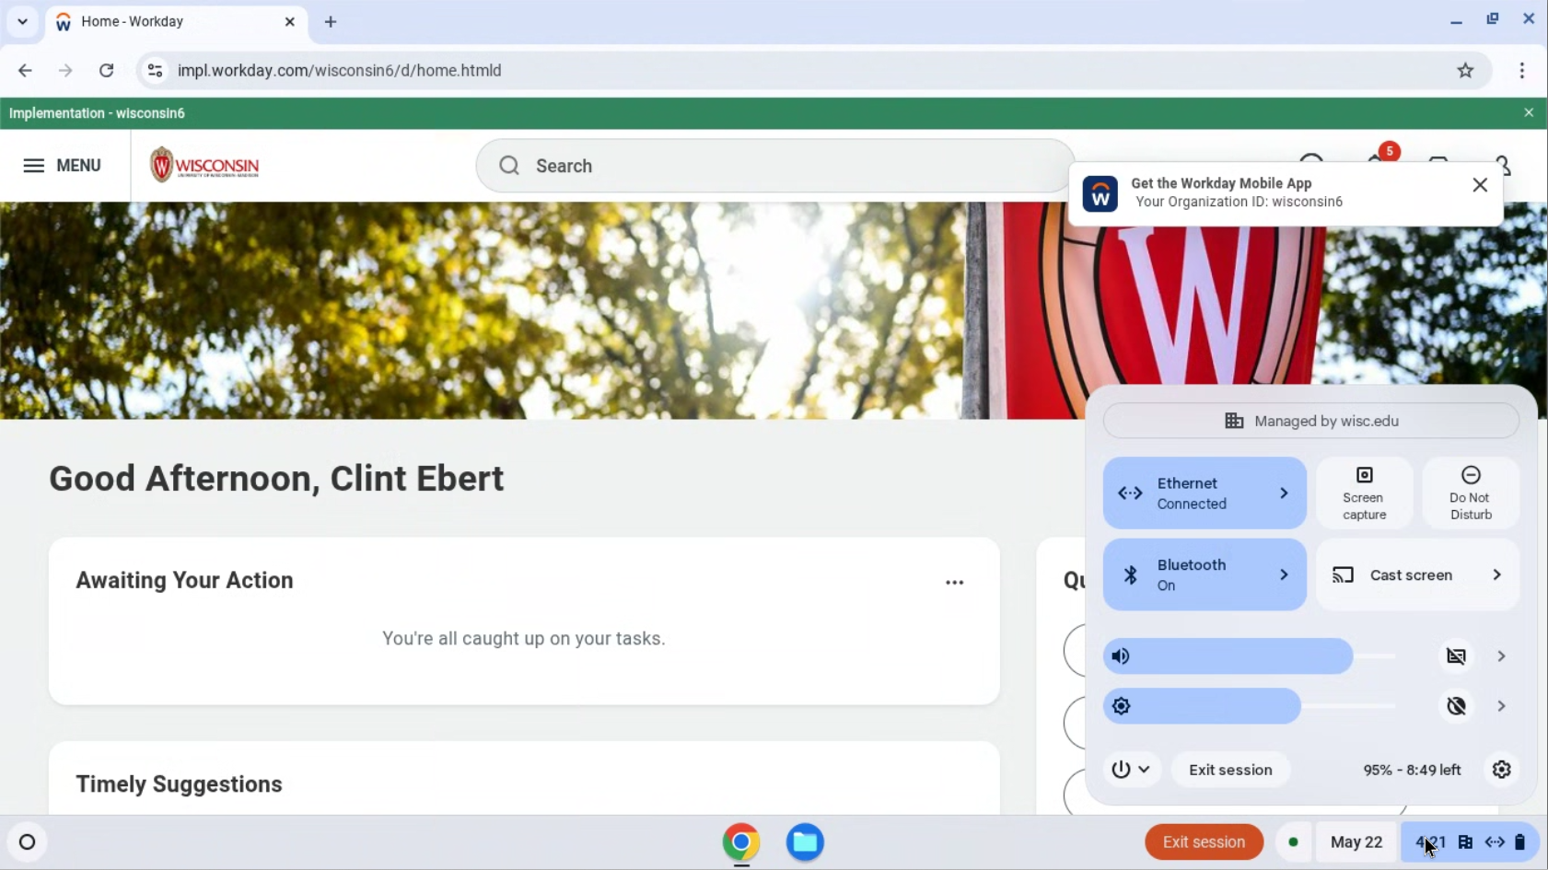
Log off
Before you leave, please restart your computer.
Click on the time at the bottom right corner of your screen.
Notes:
Before you leave, please log off your computer. Click on the time at the bottom right corner of your screen.

Slide 50
Log off
2. Click on the power icon.
3. Select Restart.
The screen will turn white and then turn off.
Notes:
Click on the power icon. Select restart. The screen will turn white and then turn off. You are now logged out of the computer and the device is ready for the next person to use it.

Slide 51
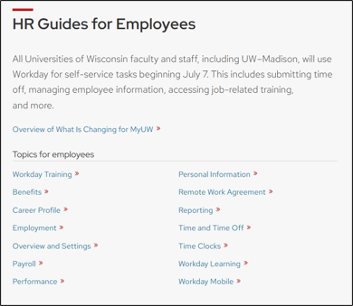
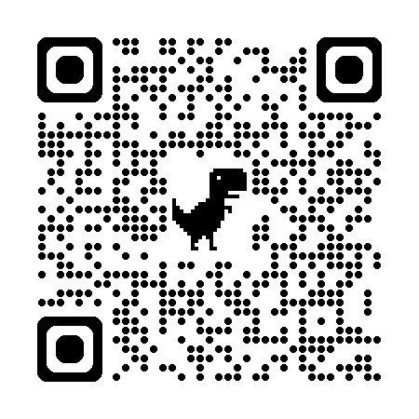
HR Guides for Employees
hr.wisc.edu/hr-guides/#for-employees
Training resources
Answers to common questions
Notes:
A great place for you to go for help is the HR Guides for Employees. Whether you’re looking for guidance, training, or answers to common questions, this directory can help you navigate HR functions in Workday.

Slide 52
Next Steps
Sign in at the front of the room (if you didn’t already)
Confirm your next training (date, time, and location)
Ask your supervisor if you need help
Practice logging into Workday
Notes:
Here are some next steps: ​
Make sure you signed in at the front of the room​
Confirm the date, time, and location of your next session​
Contact your supervisor for help​
Practice logging into Workday

Slide 53
Thank you!

