Slide 1
Instructions for Presenting this Slide Deck
In the facilitator guide, you will find:
A script that you can use to present the information in this slide deck.
Timing estimates for each section,
Timing for the engagement activities
Tips to make the engagement activities run smoothly.
If your room has more than 30 people, some people will not be able to use a computer.
When you give employees time to log into Workday, you can ask people to move around to give access to computers if some people only want to use their phones.

Slide 2
Workday In-Person Training Series
Week 3
Sign in at the front of the room
Sit at an open computer
Notes:
Welcome to the final week of the Workday In-Person Training Series. My name is [name] and I'll be facilitating today's training. I work at [your unit] as a [your job title]. ​
​
With us here today to help are [introduce helpers]. [Allow helpers to introduce themselves – their names, where they work, etc]. ​
​
If you haven't yet signed in, we will bring the sign-in sheet to you, so you can raise your hand. ​
​

Slide 3
What to Expect
We will…
show you how to do tasks in Workday
give you time to practice
We can not…
answer your personal questions
talk about policies for specific departments
Notes:
So, let's talk about what you can expect to do during our time together.
We will...
review how to complete tasks in Workday
give you time to practice completing tasks
You'll see the computers in front of you, and we will walk through using those here in a little bit.
Some things we will not be able to do today...
answer personal employee questions
If you do have questions about your job or any personal details, we cannot answer those today. We would encourage you to talk to your supervisor or your local HR staff to help you with those personal questions.
address department-specific policies or procedures
We know that different departments and units have different policies and procedures, so if you have a question about how something will work in your own department, you should talk to your supervisor.

Slide 4
Learning Objectives
By the end of today’s session, you will know how to:
Update direct deposit
View time off balances
Request time off
Understand the Compensation tab
Apply for UW jobs as an employee
Apply for Blue Collar Multi-Shift (BCMS) jobs
How to get help
Notes:
Here is an overview of today’s learning objectives. By the end of today’s session, you will know how to:
Update direct deposit
View time off balances
Request time off
Understand the Compensation tab
Apply for UW jobs as an employee
Apply for Blue Collar Multi-Shift (BCMS) jobs
How to get help
​

Slide 5
Agreements for Today
Listen and practice doing new tasks.
Raise your hand if you have a question or need help.
Follow the presenter. Don’t work ahead.
Ask permission before you look at someone’s screen.
Notes:
As always, we wanted to review our agreements as we present and practice the information today. We ask that you:
Stay engaged – Listen to the presentation and use the time to practice.
Listening to the presentation will help you know what to do during our practice times.
Ask questions – Raise your hand if you have a question or need help during the practice times.
Follow along – Don’t work ahead or do other things. Follow along with the presentation, so you don’t get lost.
Ask before you look at someone’s screen – Sometimes, we will look at personal information, like payslips and benefit choices. Before you look at someone’s screen (even if you are helping them), ask if it’s OK.
Some people may be comfortable with you helping, but others might not. So, always ask first.
If you think you can agree to these, give us a thumbs up.

Slide 6
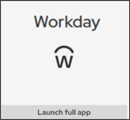
Logging into Workday
How to log into Workday on the computer.
Visit MyUW (my.wisc.edu)
Enter your NetID and Password
Duo Authenticate using the Verification Code or Due Mobile passcode
Once logged into MyUW, find the Workday app and click Launch full app
Workday Mobile App
Notes:
Timing: Give 10 minutes to allow everyone to log into Workday.
We are going to give you time to log into Workday on the computer if you are choosing to use one. The instructions to log into Workday on the computer are on the screen. If you want to use your phone to log into Workday, you can find the app that you downloaded last week. The icon for the app is on the screen.
Open Google Chrome (internet browser) on the computer
Visit MyUW (my.wisc.edu)
Enter your NetID and Password
Duo Authenticate using the Verification Code or Due Mobile passcode
Once logged into MyUW, find the Workday app and click Launch full app

Slide 7
How to Update Direct Deposit
Notes:
To start us off, we are going to look at how you can update your direct deposit. If you have already had direct deposit setup, that same information will transfer over to Workday, so you do not need to take any action unless you’d like to update your direct deposit information. Workday allows you to add up to 5 separate bank accounts for direct deposit. The system we used before (HRS) only allowed 3 separate accounts. Please note that Workday calls direct deposit payment elections.

Slide 8
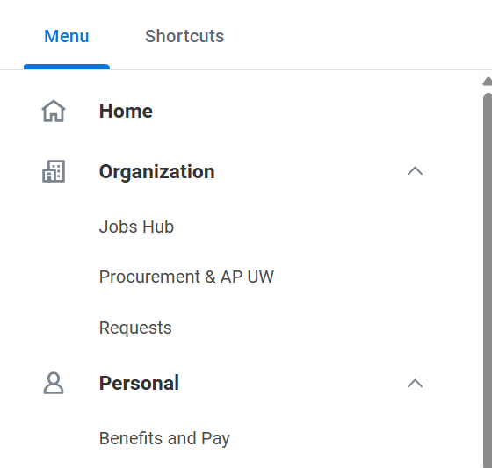
Update direct deposit
From the Workday Home Page, click Menu.
Click Benefits and Pay app.
Notes:
To start this process, you will follow these steps:
From the Workday Home Page, click Menu.
Click Benefits and Pay to open the Benefits and Pay Hub.

Slide 9
Update direct deposit
3. Click payment elections.
Notes:
3. Then from the Overview page, click Payment Elections.
As a reminder Workday calls direct deposit payment elections.

Slide 10
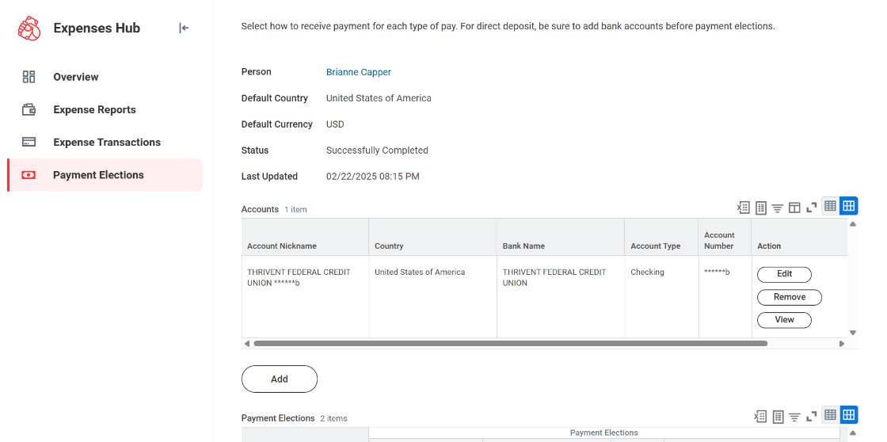
Update direct deposit
4. Click edit to update your direct deposit.
Notes:
4. Click edit to update your direct deposit information.
You can also click "Remove" to delete your current direct deposit, or you can click "View" to review your direct deposit information.
If you want to add an additional direct deposit account, click "Add".

Slide 11
Update direct deposit
A message will pop up: Your changes have been saved.
Notes:
After you have made the changes to your direct deposit information, you’ll receive a pop up message confirming your changes have been saved.

Slide 12
Questions?

Slide 13
View Your Time Off Balances
Notes:
Next up, we are going to review how to view your time off balances.
We won’t have practice time for this section, so you can click along with me as I review the instructions, if you want.

Slide 14
Time Off
Time Off
Time away from work
Vacation, sick, personal or legal holidays
Leave of Absence
Time away for a specific reason
Family Medical Leave Act (FMLA), paid parental leave, etc.
Talk with your supervisor or HR first
Notes:
In Workday, time off is considered time away from work. For example, vacation, personal holiday, and sick leave. ​
Today, this may be called absence, leave, or time off. ​
In Workday, a leave of absence is when you take time off for a specific reason, like if you are taking an extended leave for a medical reason, or other extended reasons.​
If you are taking a leave of absence, contact your local HR.​
​
Employees received their new leave balances starting July 1, 2025

Slide 15
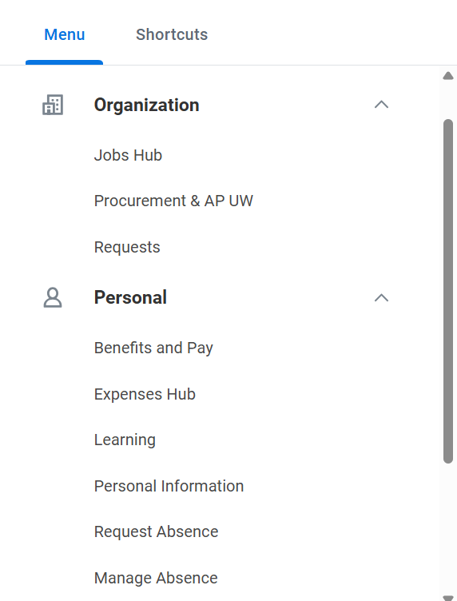
View Time Off Balances (Website)
From your Workday Home Page:
1. Click Menu
2. Click Manage Absence
Notes:
To view you time off balances, start from the Workday homepage. Click the Wisconsin logo to return to the homepage.​
​
From the homepage, click the “Menu”​
Then, click Manage Absence.

Slide 16
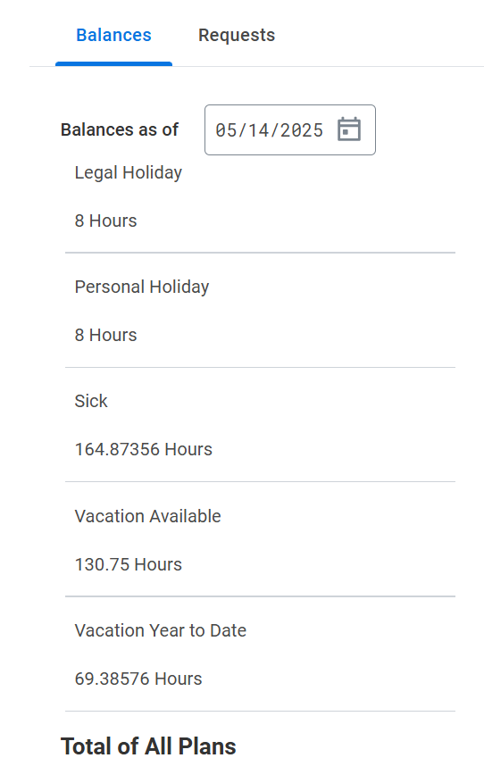
View Time Off Balances (Website)
3. Find Balances (right side of screen)
Scroll to see how many hours you have available for each type of time off
Notes:
From the new screen, you can see your time off balances on the right side of the screen. ​
​
Scroll down to see how many hours you have available for each type of time off.​
​
Ask your manager or local HR if you have questions about your time off balances.

Slide 17
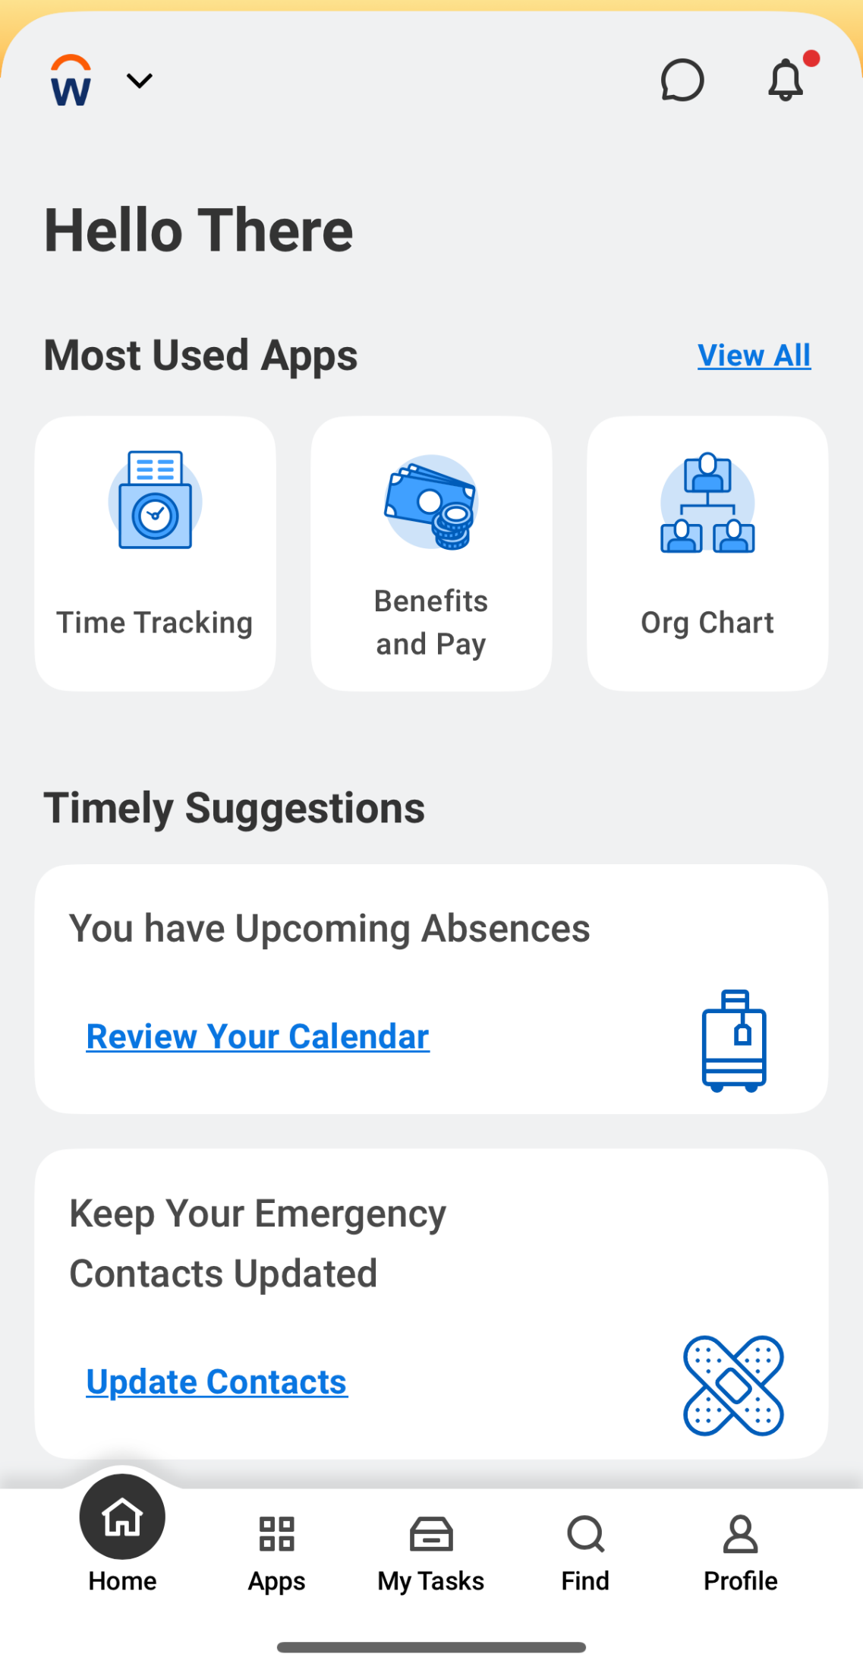
View Time Off Balances (Mobile App)
From your Workday home page:
1. Tap Apps
2. Tap the Absence app
Notes:
If you want to view your time off balances from your phone, click the apps button, then open the Absence app.

Slide 18
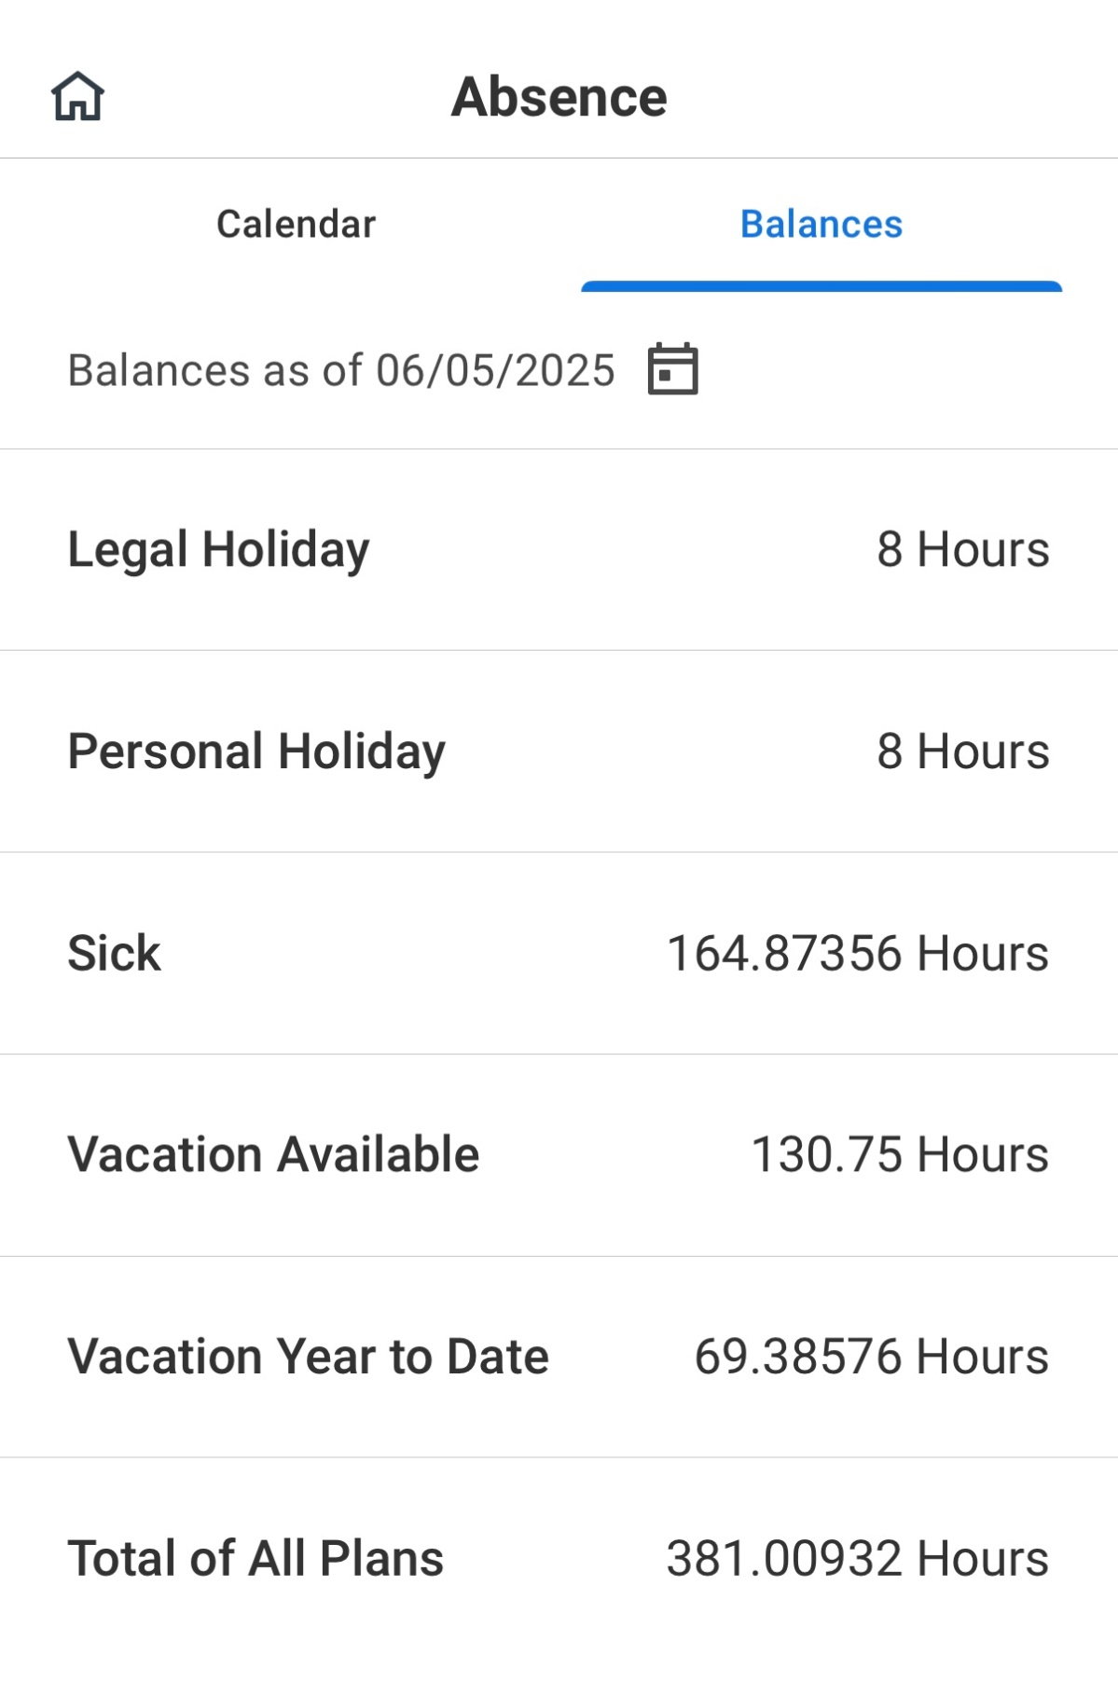
View Time Off Balances (Mobile App)
3. Tap Balances (top of screen)
Scroll to see how many hours you have available for each type of time off
Notes:
At the top of the screen, you can see calendar and Balances. Tap “Balances.” Scroll down to see how many hours you have available for each type of time off.

Slide 19
Questions?

Slide 20
Request Time Off
Notes:
Previously, each division across campus had a different process to submit a request for time off. Many have different paper forms that they've used, so this new paper form will make sure everyone has the same one, so if you ever switch divisions, for example, it will be consistent for you as an employee.

Slide 21
How to request time off
You will use a paper form to submit a time off request.
Ask your supervisor for a paper form
Fill out the paper form
Return the paper form to your supervisor
Notes:
Instead of using Workday to submit your time off, you will use a paper form to submit a time off request.
Ask your supervisor for a paper form
Fill out the paper form
Return the paper form to your supervisor

Slide 22
Request time off form
Screen grab of form
Notes:
This is what the paper form will look like. Some divisions have different guidelines about time off, so if you have questions, we’d recommend you ask your supervisor for help.

Slide 23
Overview of Compensation tab
Notes:
In this final section of our training, we will look at the compensation page. In this area, it will show you the details and breakdown your compensation or pay. This may include your salary or hourly pay, along with any bonuses, allowances, or lump sum payments.

Slide 24
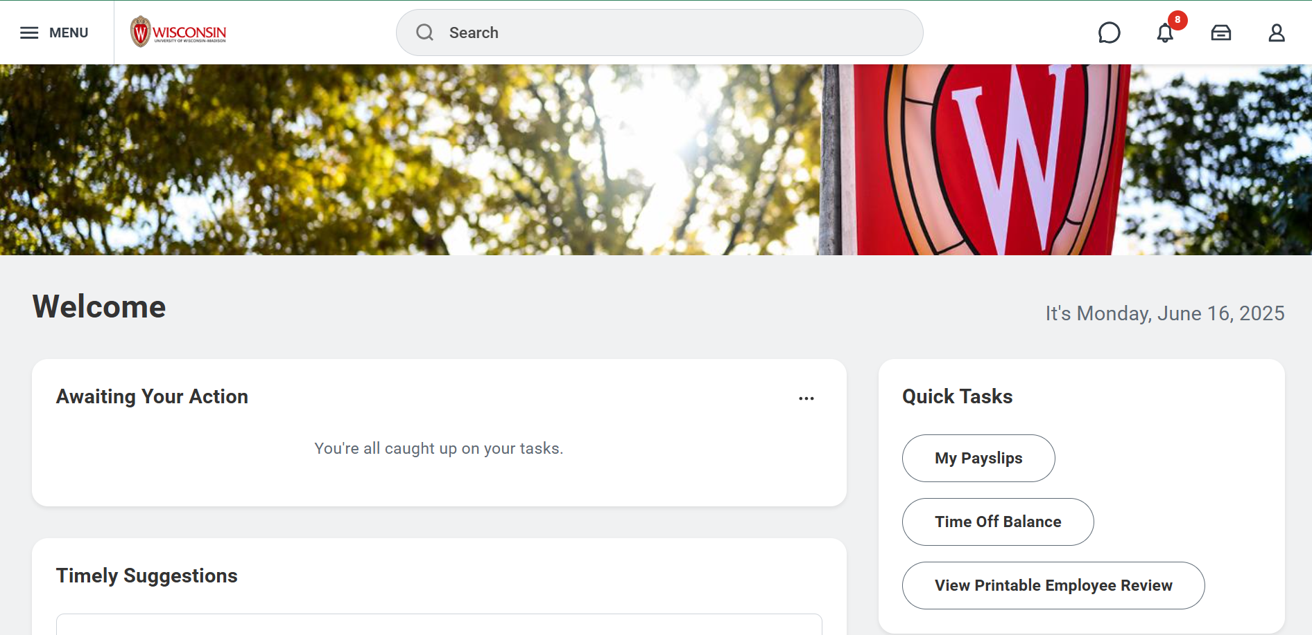
Compensation tab
1. Click on your Worker Profile.
Notes:
1. To get started, from the homepage, click the Worker profile in the upper right corner.

Slide 25
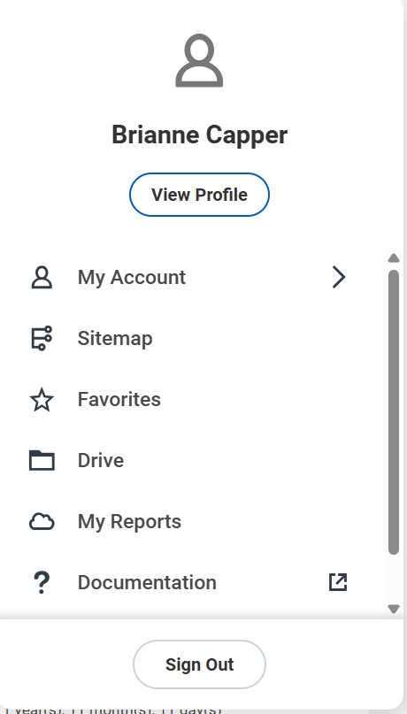
Compensation tab
2. Click on View Profile.
Your Name
Notes:
2. From the drop down that opens, click the “View Profile” button.

Slide 26
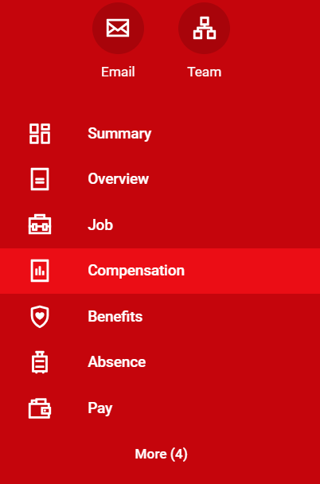
Compensation tab
3. Click on Compensation.
Notes:
3. From your Worker Profile, look at the red bar on the left to find the Compensation tab. That will bring you to the Compensation Overview page.

Slide 27
Compensation overview
Notes:
The compensation overview page shows you a couple of things. At the top, it displays your total salary plus allowances, total base pay, and the frequency, as well as any additional lump sum payments you may be receiving or have already received. The bottom provides a breakdown of the top box.
For example, the screenshot here displays the employee’s compensation plan, which shows they are on an hourly plan. It also shows two allowances: one is a uniform allowance, and one is their supplemental night differential allowance. Next to each, it shows the assignment, or how much money they get for that specific pay adjustment.

Slide 28
Compensation overview
Notes:
The bottom box will show off the employee’s compensation plan or pay and assignment (or rate). For example, their compensation plan type is hourly, and the assignment for that plan it $18.73 per hour.
It also shows that this employee has two allowances: one is a uniform allowance, and one is their supplemental night differential allowance. Next to each, it shows the assignment, or how much money they get for that specific plan. Any pay you receive will also be reflected on your payslip.
If you have questions about your compensation plan breakdown, you can reach out to your supervisor or your local HR.

Slide 29
What is a Lump Sum payment?
A lump sum is money you receive outside of your regular pay. It will be included in your paycheck.
Examples of lump sum payments:
Night/Weekend/Shift differential pay
Shoe allowance
Performance bonus
Snow removal bonus
Hiring bonus
Referral bonus
Notes:
One item that may show up on your Compensation overview page is a lump sum payment.
A lump sum payment is money that you receive outside of your regular pay. You may receive a lump sum for a variety of reasons. Some examples are:
Night/Weekend/Shift differential pay
Shoe allowance
Performance bonus
Snow removal bonus
Hiring bonus
Referral bonus
Some allowances may not receive a notification, but other types of lump sums will.

Slide 30
What is a Lump Sum (Trades)
A lump sum is money you receive outside of your base compensation.
Examples of lump sum payments:
Craftworker Leads add-on
Painter add-on
Night/Weekend Differential
Standby Pay
Notes:
One item that may show up on your Compensation overview page is a lump sum payment.
A lump sum payment is money that you receive outside of your regular pay. You may receive a lump sum for a variety of reasons. Some examples are:
Craftworker Leads add-on
Painter add-on
Night/Weekend Differential
Standby Pay
Some allowances may not receive a notification, but other types of lump sums will.

Slide 31
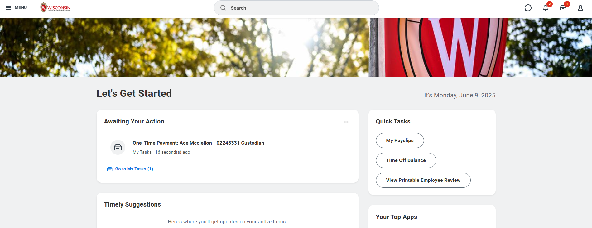
Lump Sum letter
1. New lump sum payments will appear under the Awaiting Your Action section on the Workday home page.
Notes:
If you do receive a lump sum payment letter, it will appear under the Awaiting Your Action section on the Workday homepage.
1. To see the letter, you can click on the title of the task.

Slide 32
Accepting a letter
2. When you click on the allowance, you will see a letter. Click on the letter.
Notes:
From the list of your Tasks, Click the one-time payment to see the allowance. Then, click on the document link to see the letter.

Slide 33
Accepting a letter
Notes:
Once you click on the link, it will display the letter on the screen. This is an example of what a lump sum payment letter may look like.

Slide 34
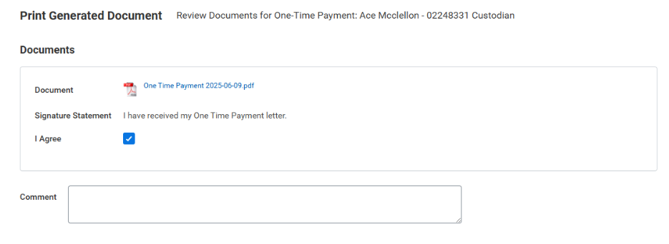
Accepting a letter
3. Once you have reviewed the notification letter, click the checkbox next to I Agree.
4. Click Submit.
Notes:
Once you have reviewed the letter, Click the “I Agree” box to acknowledge the letter. Be sure you click the Submit button to finish.
Note that this letter is not time sensitive. You will still receive the payment on the effective date, but you should try to click the checkbox as soon as possible.

Slide 35
Accepting a letter
You will see a notification: You have submitted.
Notes:
Once you have submitted, you will receive a You have submitted popup notification to confirm your submission.

Slide 36
Questions?

Slide 37
Break Time
Notes:
Provide a break of no more than 10 minutes

Slide 38
How to apply for a UW job as an employee
Notes:
Our first topic for today is how to apply for a UW job as a UW employee, or what is called an internal position. An internal job is a type of job that only people who are already employed by the University can apply for. People outside of the University cannot apply for those jobs.

Slide 39
Applying for Jobs
Do not:
Apply for jobs on the external UW jobs website (jobs.wisc.edu).
Do:
Apply for UW jobs in Workday (regardless of campus).
If you need language assistance, contact Cultural Linguistic Services (CLS).
Notes:
Previously employees applied for a job at the university on the UW jobs website, jobs.wisc.edu. Employees are no longer going to be using that site to apply for jobs.
Instead, you should apply for any new jobs using the Workday website. Workday connects the hiring and onboarding processes. Workday ensures current employee information transfers to new roles, including roles at other campuses. This includes transferrable vacation, personal hours, sick leave; personal information such as your address; and much more.
We will look at the steps to get to the Applying for Jobs space in Workday, and then give you time to practice using the system to review open jobs. If you need language assistance when applying for jobs, you can contact Cultural Linguistic Services.
One thing to note before we look at how to find job postings - All job postings for all Universities of Wisconsin will show up on the Workday Jobs Hub, not just internal positions at UW-Madison. This means you will see jobs that are available at UW-Milwaukee or UW-La Crosse. We are going to look at how you can filter down positions to find the ones that are right for you.

Slide 40
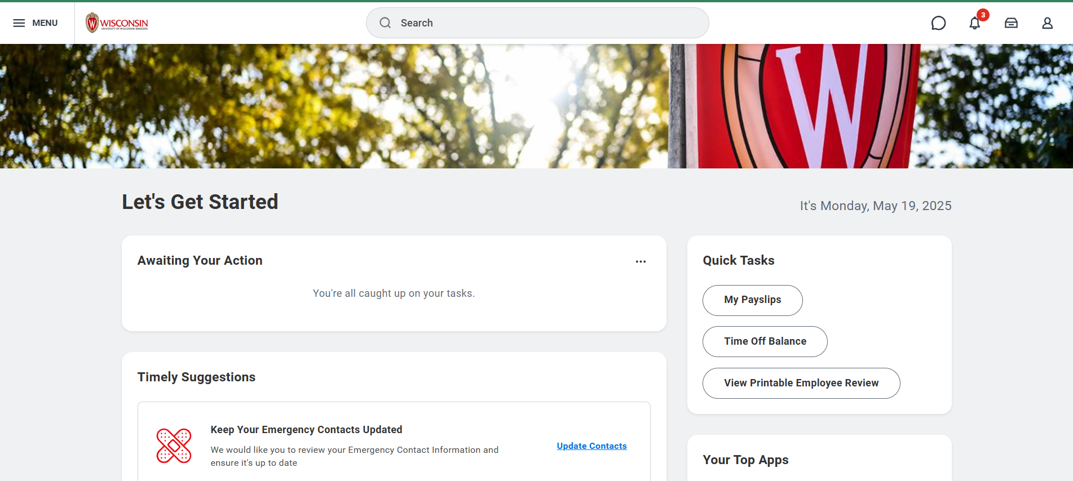
Applying for UW Jobs
From the Workday home page, click on the Menu.
Notes:
First, we will go through the process of applying using a computer.
1. From the Workday home page, click on the Menu.

Slide 41
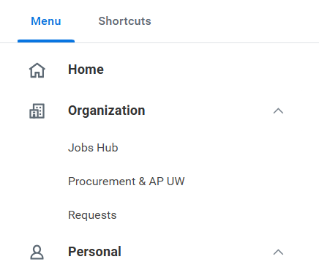
Applying for UW Jobs
2. Click on Jobs Hub under the Organization tab.
Notes:
2. Next, click on Jobs Hub under the Organization tab.

Slide 42
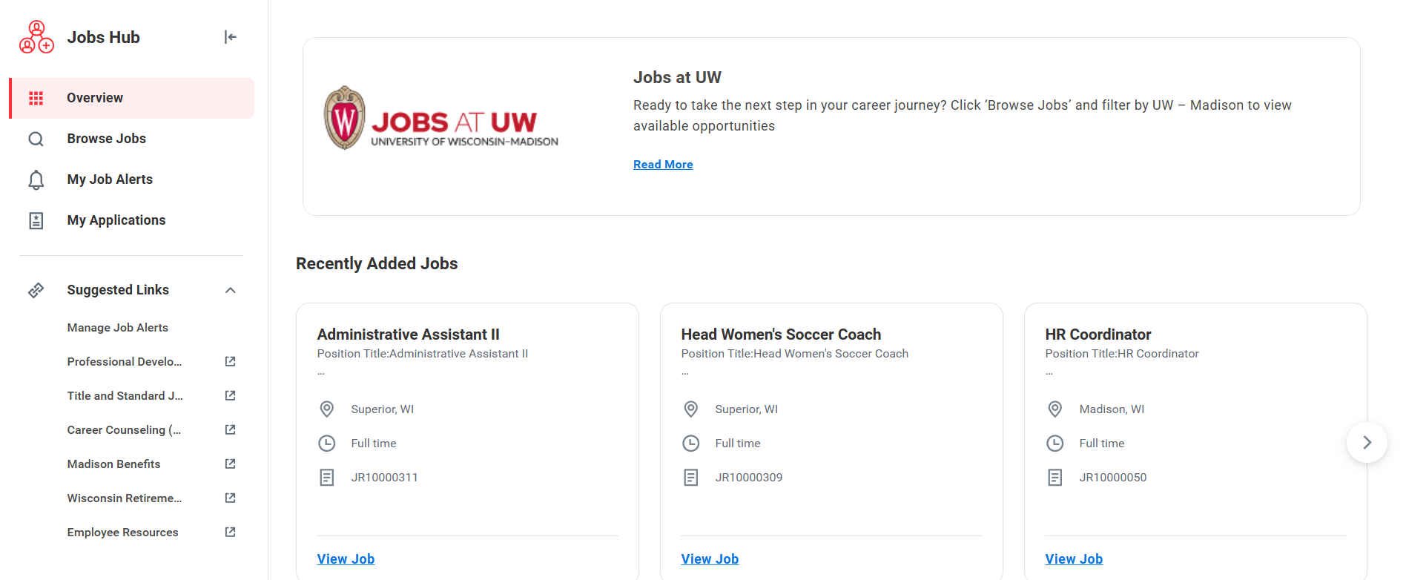
Applying for UW Jobs
Notes:
Here is an overview of the Jobs Hub webpage. There are a couple of key pieces we want to make you aware of on this page.

Slide 43
Applying for UW Jobs
1. The most recently posted jobs will appear first.
2. Use the right or left arrow icons to scroll through recently added jobs.
Notes:
1. The most recently posted jobs will show up first. It is important to note that this site will list job postings at all Universities of Wisconsin, meaning you may see job postings from outside of UW-Madsion. We will look at how to filter searches in a bit.
2. To see more jobs, you can click the arrow on the right side of the page to scroll through more recently added jobs.

Slide 44
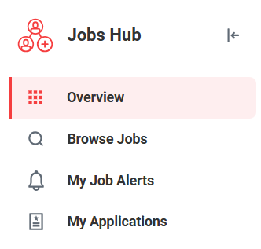
Applying for UW Jobs
3. Click the magnifying glass icon (Browse Jobs) to browse all open positions
Notes:
3. If you want to view even more jobs, click on the magnifying glass icon to see all open positions.

Slide 45
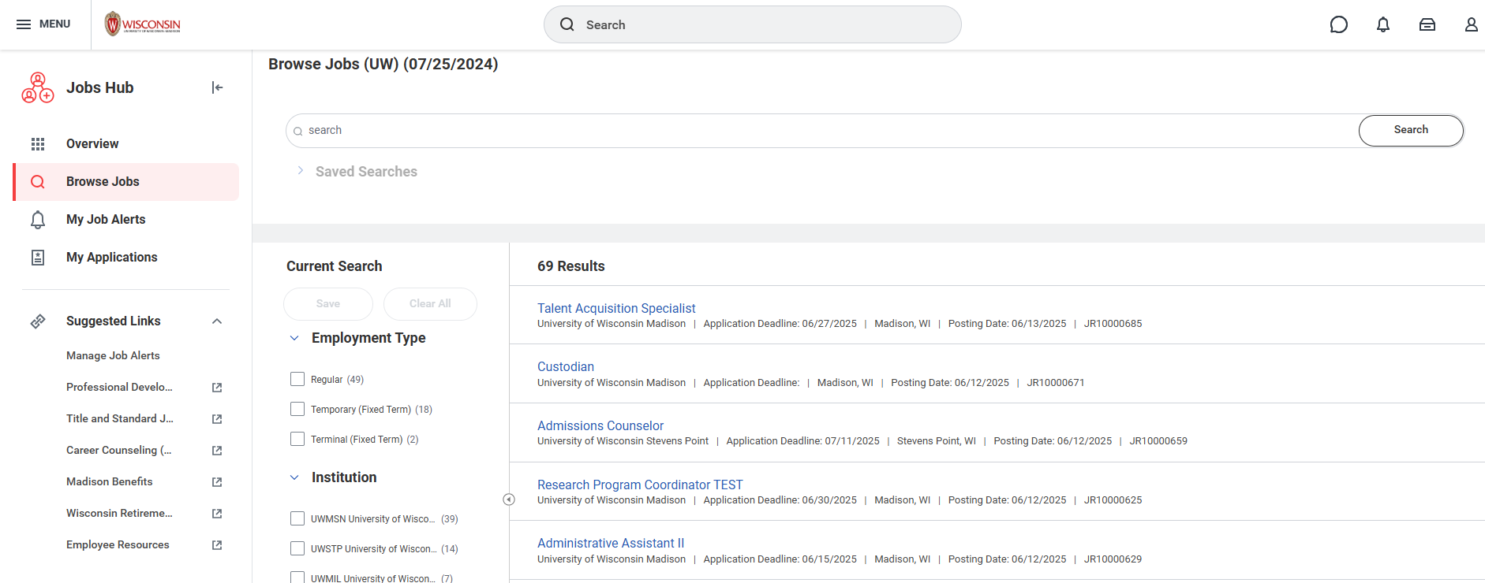
Browse all jobs
Notes:
Once you click on the magnifying glass to browse all jobs, it will bring you to a new screen that has a lot of information on it.
One way to look for jobs is by using the Search Bar if you know the job title or details about the job.
The other way to look for jobs is by filtering them to view only the jobs that are relevant to you.

Slide 46
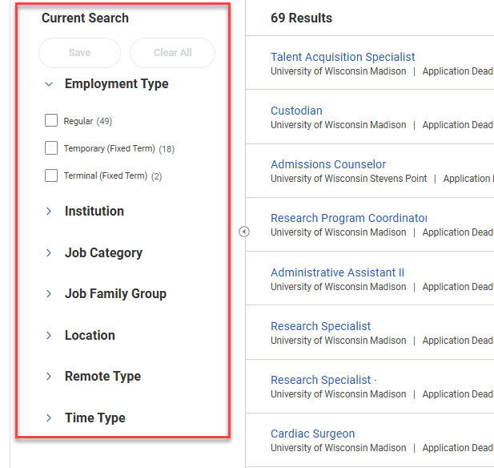
Sort the list of jobs
The list of jobs can be sorted by:
Employment Type
Institution
Job Category
Job Family Group
Location
Remote Type
Time Type
Click the check box next to the job types you want to see.
Notes:
Sorting jobs will be important to help you find the jobs that best suit you and your skills. You can do a lot of filtering, but the ones that are bold on the screen are some key filters to use – Institution, Location and Time Type.
Employment Type – These are the employee’s contract types. This includes Regular Employment, Temporary Employment, Terminal or Fixes appointments
Institution – This means which University the job is at.
Job Category – This means the employee class, including Faculty, Academic Staff, Limited appointment, or University Staff.
Job Family Group - This is the type of work the job falls under. Such as working in HR, IT, Finance, Facilities, and other types.
Location – This will be a big filter to consider, especially if you want to look for jobs only in Madison.
Remote Type – This will filter jobs that are only onsite or if they can be partially remote, or fully remote.
Time Type – This helps filter the jobs between full time and part time.
To help you filter and sort jobs, click the check box to see jobs that fall under that category.

Slide 47
Finding a job to apply for
4. To view the full job posting, click the Job Title.
Notes:
4. Once you find a job, click the Job Title to learn more about it.

Slide 48
Applying for Jobs
5. Once you find a job you want to apply for, click Apply to start the application process.
6. Upload your application materials and fill out the application questions. You may indicate to maintain confidentiality.
Notes:
5. Once you find a job that you want to apply for, click the Apply button to start the application process.
6. This will prompt you to upload your application materials that are outlined in the “How to Apply section of the job posting.. There may be some application questions that you also need to respond to. It is important that you look at the “How to Apply” section of the job posting to make sure you are adding the requested documents. Some common examples would be a resume and a cover letter.
You may also indicate to maintain confidentiality if the university is required to disclose your identity or application materials in the event of an open records request.

Slide 49
Submitting the application
7. Before you submit, review the information you entered. When you are ready, click submit.
A message will pop up: You have submitted.
Notes:
7. Before you submit, you are prompted and encouraged to review the information you entered. When you are ready, click the Submit button. You can also save it for later if you’d like. Once you have submitted, you will receive a confirmation message.

Slide 50
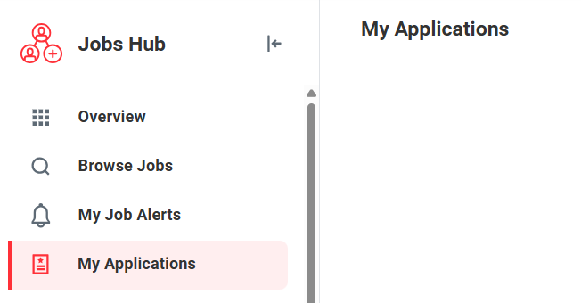
Reviewing your job applications
To view the application, see the application status, or withdraw your application:
Go to the Jobs Hub.
Click on My Applications.
Notes:
If you want to view your applications that you have submitted, see the application status, or withdraw applications within Workday. To do this, you
Go to the Jobs Hub
Click on My Applications on the left side of the screen.
It will then open up a screen that has any jobs you’ve applied for and you can review them.

Slide 51
Applying for Jobs (Mobile app)
From the Workday home page, tap Apps.
Tap the Jobs Hub.
Notes:
If you’d like, you do have the option to apply for jobs on the Workday mobile app. We will walk through the instructions to apply for jobs using the mobile app.
From the Workday home page, tap Apps.
Tap the Jobs Hub.

Slide 52
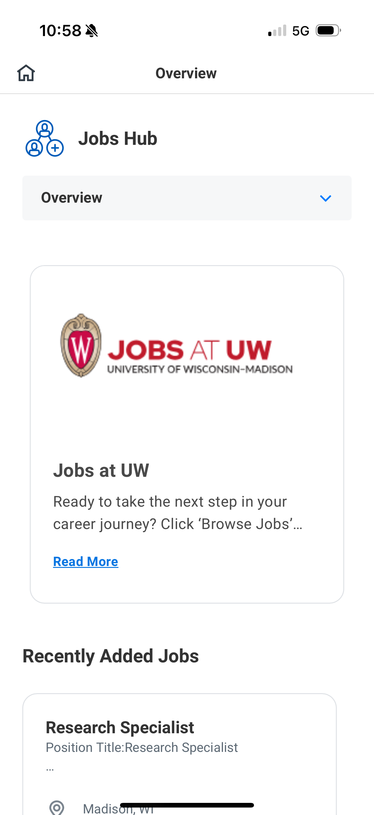
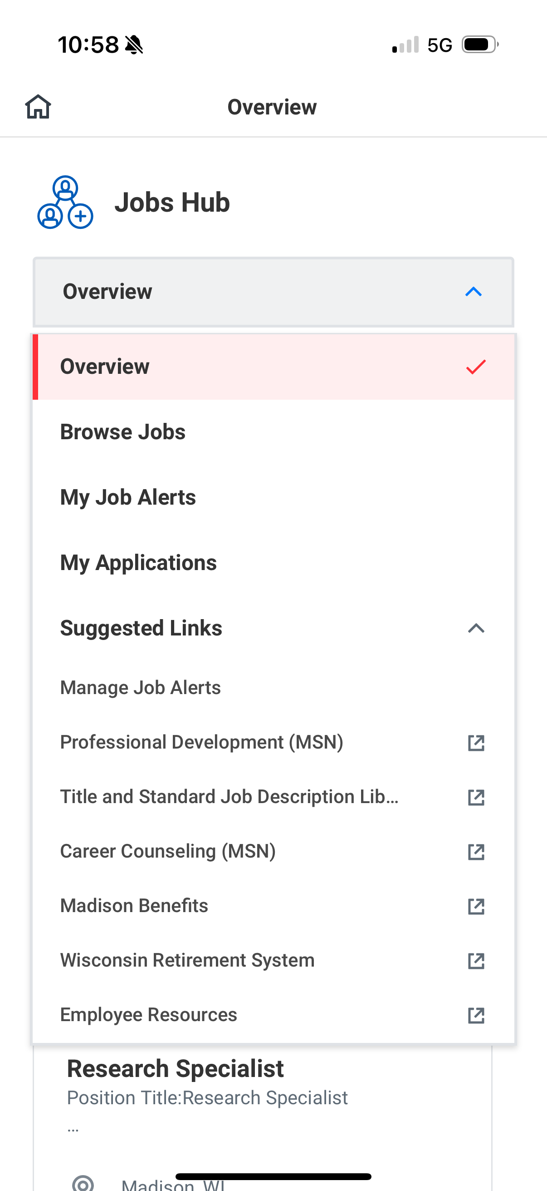
Applying for Jobs (Mobile app)
3. Scroll down to view Recently Added Jobs.
4. Tap Overview and select Browse Jobs.
Notes:
From the Jobs Hub, you will see a similar screen as the web version, but this is more condensed on the phone.
3. Scroll down the page to view Recently Added Jobs.
4. To Browse all jobs, tap Overview at the top, and select Browse Jobs from the drop-down list.

Slide 53
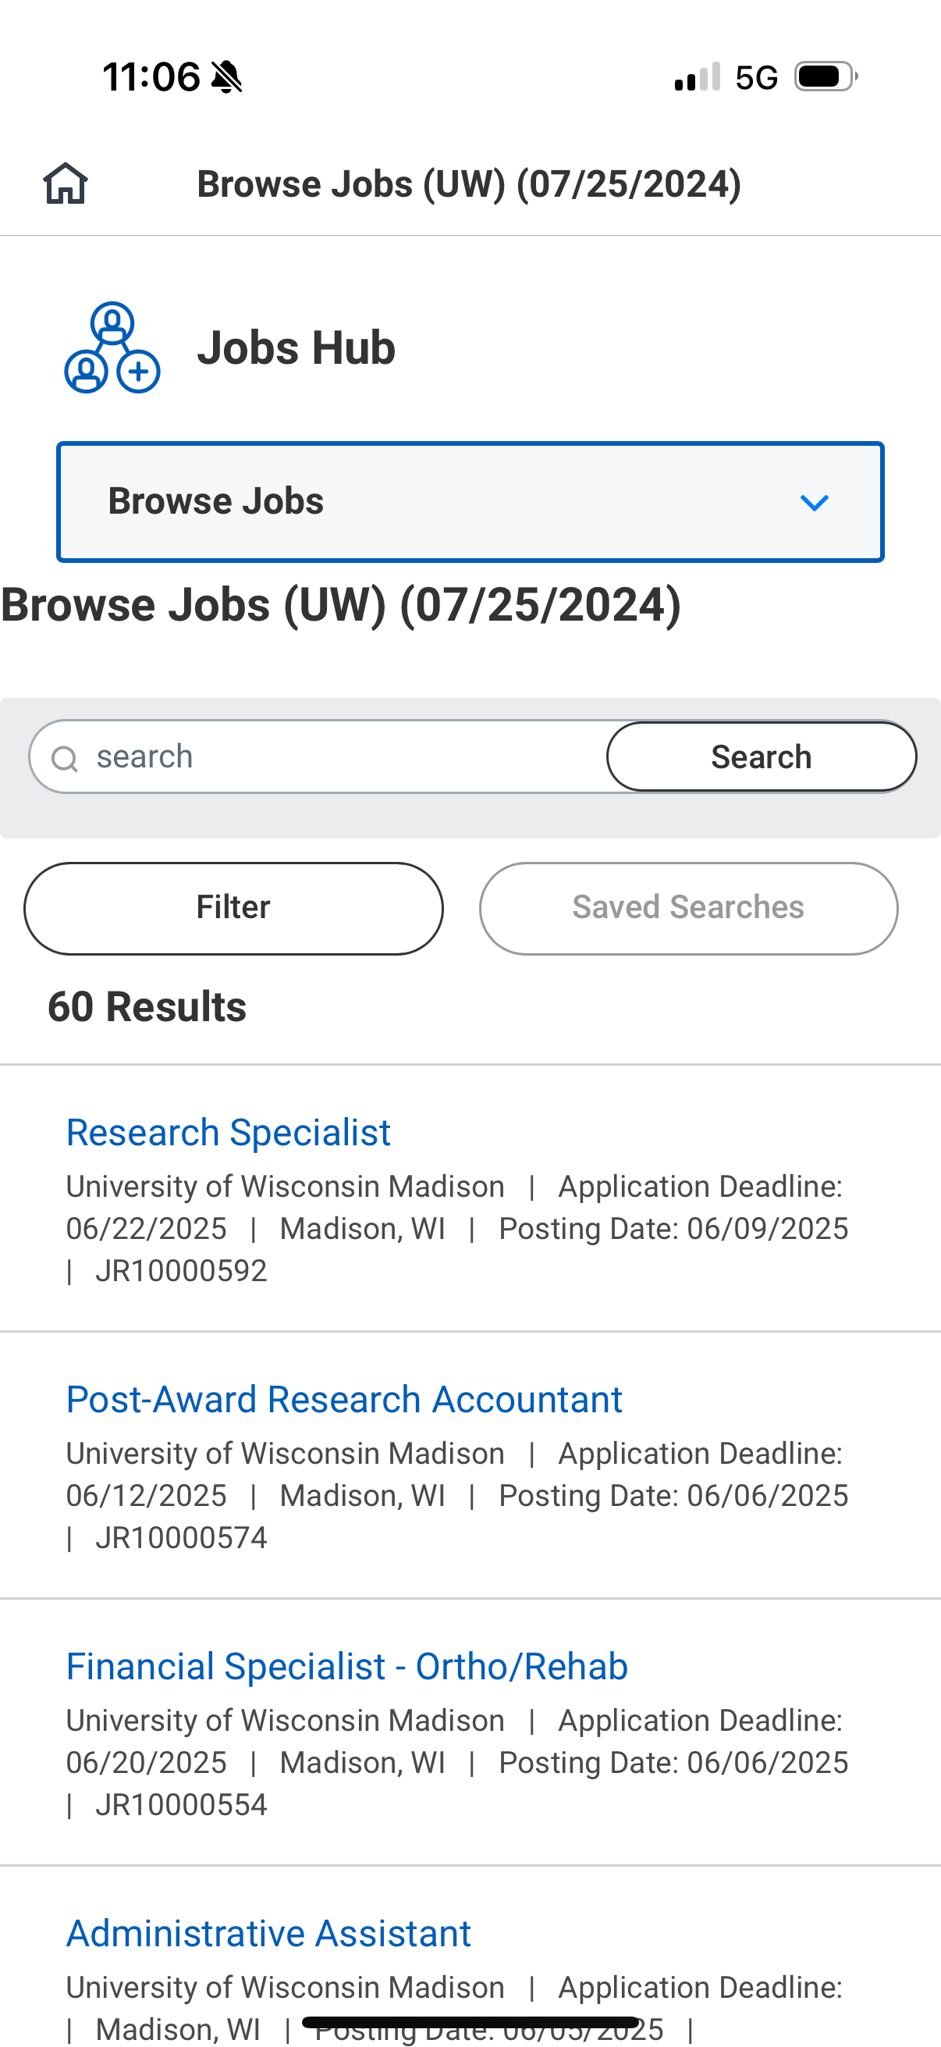
Applying for Jobs (Mobile app)
5. Use the search bar to search for a job.
OR
Use the filter button to narrow your search.
Notes:
5. You can use the search bar to search for a job if you know the title.
You can also use the filter button to narrow your search. The filter categories are the same as the computer version. You can view:
Employment Type
Institution
Job Category
Job Family Group
Location
Remote Type
Time Type

Slide 54
Practice: Review Job Postings
Follow the instructions to view job postings
Identify some jobs that are of interest to you
Remember to use the filters to narrow your search
Raise your hand if you need help
If you finish early, you can help others.
Notes:
Now we’re going to give you some time to explore the Jobs Hub to practice. We aren’t asking you to apply for any jobs, but we want to give you the opportunity to see the Jobs Hub for yourself in case you want to apply for a new position in the future.
Follow the instructions to view job postings
Identify some jobs that are of interest to you
Remember to use the filters to narrow your search

Slide 55
How to apply for Blue Collar Multi-Shift Transfer (BCMS)
Notes:
Next up we are going to talk about how you can apply for a Blue Collar Multi Shift Transfer. Blue Collar Multi-Shift (BCMS) is the UW-Madison process to open up positions in different shifts to current employees first. This process allows employees the opportunity to change to a different shift, like 3rd shift to 1st shift, before the job is opened to candidates.
As with most of the information we’ve shared, the policies for applying for a blue collar multi shift transfer are not changing, but how you would apply for that transfer are changing. We will look at the space in Workday that you could look for job openings and how you would apply for a transfer.

Slide 56
BCMS Transfers
Employees might apply for a BCMS transfer to:
Change shift times
Change departments within a division
Who can apply for a BCMS transfer?
Blue Collar Multi-Shift transfers (BCMS) are only for current, permanent UW-Madison employees.
How can I apply for a BCMS transfer?
You can apply online or in-person.
A completed BCMS transfer form is required for both online or in-person applications.
Notes:
Someone who would apply for this transfer may choose to do so in order to
change shift times
change departments within a division
There are some parameters around who can apply for a BCMS transfer:
You can only apply for this transfer is you are a current, permanent UW-Madison employee.
If you are interested in applying for a Blue Collar Multi Shift transfer,
you will use your Workday account to do so.
You may also use a paper form

Slide 57
BCMS Requirements
You must meet all of the following criteria to be eligible for a Blue-Collar Multi-Shift Transfer:
Currently employed in the same title within your division
No disciplinary letter(s) received within the last 12 months
Have not transferred via the BCMS process within the last six months
Not currently on probation
Meet all required qualifications for the BCMS transfer position
The BCMS form must be submitted with your online application or in person to be considered for a blue-collar multi-shift transfer within your division.
The deadline to apply is 7 days after the position is posted.
Notes:
Even if you are a UW-Madison employee, there are additional criteria that an employee must meet to be eligible for a BCMS transfer.
Currently employed in the same title within your division
No disciplinary letter(s) received within the last 12 months
Have not transferred via the BCMS process within the last six months
Not currently on probation
Meet all required qualifications for the BCMS transfer position
The BCMS form must be submitted with your online application or in person to be considered for a blue collar multi-shift transfer within your division.
The deadline to apply is 7 days after the position is posted.

Slide 58
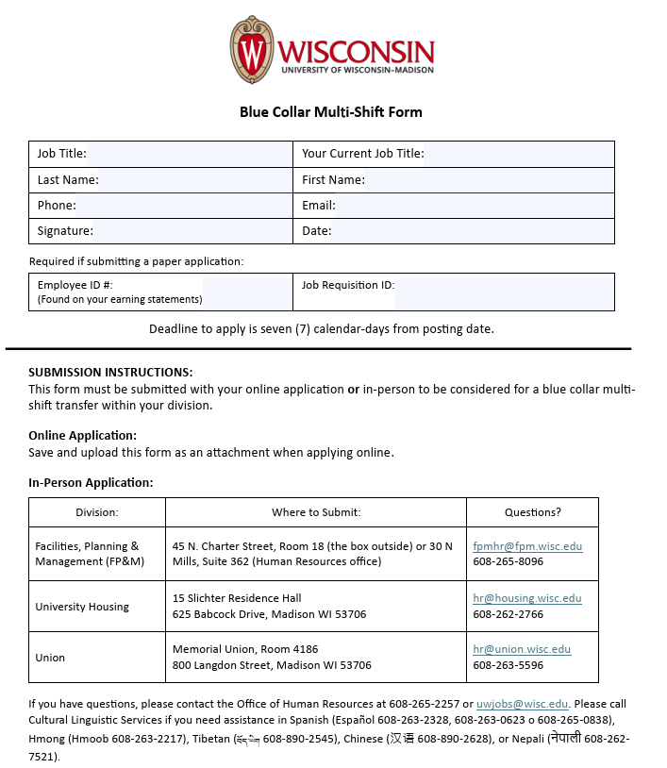
BCMS Transfer Form
Find the BCMS Transfer form here: https://jobs.wisc.edu/bcms
Available in all languages
Paper forms available
Notes:
The blue collar multi shift transfer form is available at the website listed here. The form gives you instructions for what you need to fill out, and how to submit the form online, or in-person.
This form is also available in all languages, so once you get to the website, you can select whichever language you use. The languages are:
English
Español / Spanish
Hmoob / Hmong
བོད་ཡིག / Tibetan
中文 / Chinese
Bनेपाली / Nepali

Slide 59
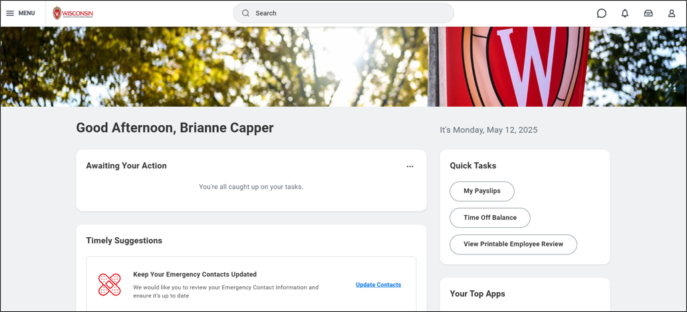
How to apply for a BCMS Transfer
From the Workday home page, click on the Menu.
Notes:
Let’s look at how you would apply for a blue collar multi shift transfer using Workday.
1. First, in the homepage, open the Menu.

Slide 60
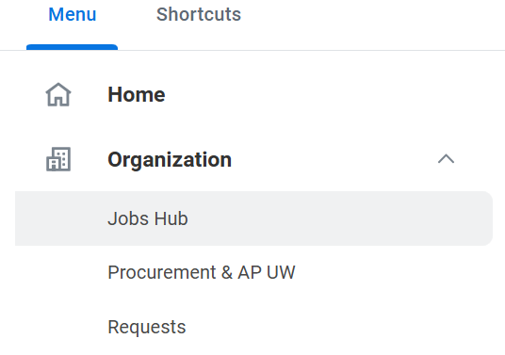
Apply for a BCMS Transfer
2. Click on Jobs Hub under the Organization tab.
Notes:
2. Then open the Jobs Hub under the Organization tab.
This is the space that we were just looking at to browse available jobs.

Slide 61
Apply for a BCMS Transfer
3. Click Browse Jobs.
4. In the search bar, type BCMS. Hit the enter button on your keyboard.
Notes:
3. From the Jobs Hub, click Browse Jobs.
4. Then, in the search bar, type BCMS and hit enter to see a list of blue collar multi shift jobs available.

Slide 62
Apply for a BCMS Transfer
A list of open BCMS positions will appear.
In the position title, it will identify the following details about the job:
Title
Unit
Shift
To learn more about the position, click on the Job Posting Title.
Notes:
If there are any openings, a list will appear.
Each position title will have this information in it:
Job title,
Unit
Shift
In the screenshot here, we can see that the job title is a Food Service Assistant Advanced. The unit is with Godon Avenue Market, and the shift time is Midshift.
If you want to continue to learn more about the position, click on the Job Posting Title.

Slide 63
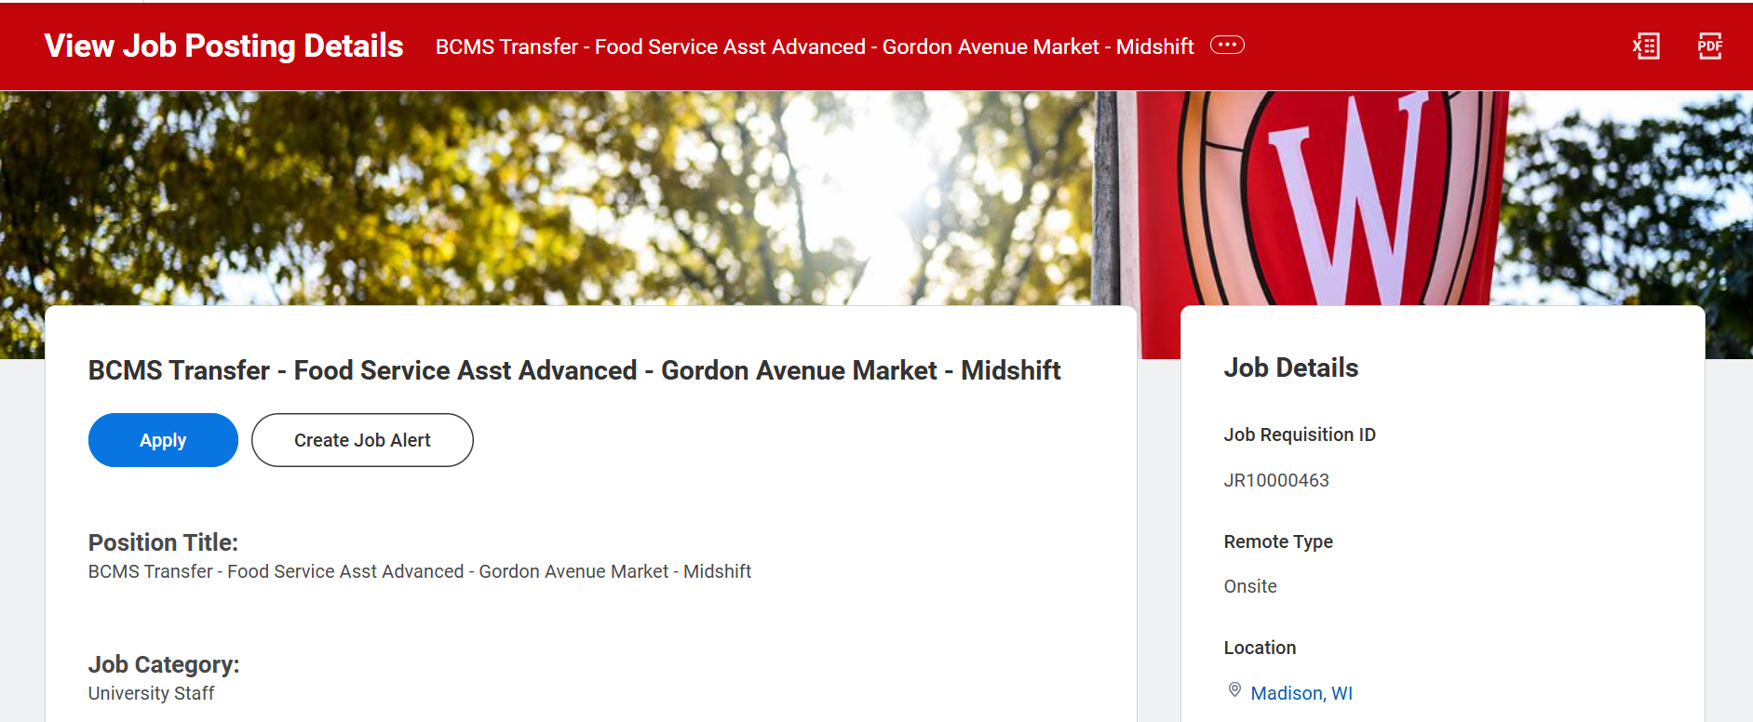
Apply for a BCMS Transfer
5. Click Apply.
6. Upload a completed BCMS Transfer form in place of a resume.
Notes:
If you are interested in the position and meet all of the job requirements, you can follow the same steps to apply as you would for any other jobs.
5. Click apply
6. The only difference from applying for any other job is that instead of uploading a resume, you will be asked to upload a completed BCMS Transfer form.

Slide 64
Apply for a BCMS Transfer
6. Before submitting your application, review the information.
7. Click Submit.
You will receive an email confirming your application.
Notes:
6. As with the internal position, review your information before submitting your application.
7. Once you are certain your information is correct, you’ll click Submit.
You will receive an email that confirms your application.

Slide 65
Apply for a BCMS Transfer
Paper applications are available
Request a paper BCMS Transfer form from your division's HR office or print the form from the BCMS website: https://jobs.wisc.edu/bcms
Submit the completed transfer form to your HR office.
Notes:
Now, there is an option for you to apply for a BCMS transfer using a paper application. The preferred method is using the online application through Workday, but if you do not have access to a computer, don't feel comfortable completing the online application, you can use the paper BCMS Transfer form instead.
You can request that through your division's Human Resources office, and then work with them to submit the form.

Slide 66
Questions?

Slide 67
How to get help
Notes:
Before we take a break, we want to remind you of some of the ways you can get help if you need it after today’s training is over.

Slide 68
How to get help
Contact your supervisor or local HR
Attend Cultural Linguistic Services (CLS) Open Computer Labs
3rd Wednesday of the month
3:30 p.m. – 5 p.m.
21 North Park Street Room 5041 (5th floor)
You do not need to register or make an appointment to attend
Notes:
1. The first suggestion we have is for you to contact your supervisor. Some of your questions may be related to your actual role, but some of them may be about using Workday. We suggest you start with your supervisor, and if needed, they can connect you with your local HR for more help.
Another option you have is by attending Cultural Linguistic Serivces's Open computer labs.
These take place on the 3rd Wednesday of every month at 21 North Park Steet, Room 5041. You can show up anytime between 3:30-5pm to ask for help.
You do not need to register or make an appointment. Simply show up and the CLS team will help you with your Workday related questions.

Slide 69
Resources and Next Steps
Notes:
Before we end our session, I wanted to highlight a couple of resources to help you continue your learning, and some next steps.

Slide 70
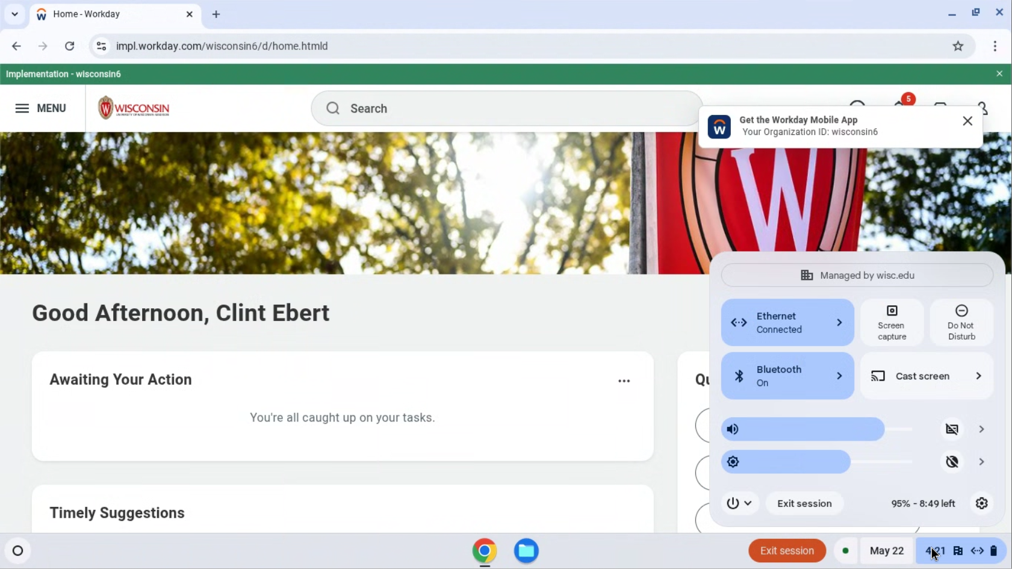
Log off
Before you leave, please restart your computer.
Click on the time at the bottom right corner of your screen.
Notes:
Before you leave, please log off your computer. Click on the time at the bottom right corner of your screen.

Slide 71
Log off
2. Click on the power icon.
3. Select Restart.
The screen will turn white and then turn off.
Notes:
Click on the power icon. Select restart. The screen will turn white and then turn off. You are now logged out of the computer and the device is ready for the next person to use it.

Slide 72
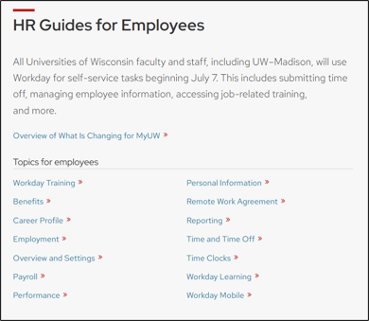
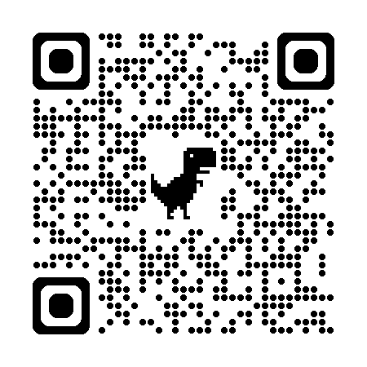
HR Guides for Employees
hr.wisc.edu/hr-guides/#for-employees
Training resources
Answers to common questions
Translations
Notes:
A great place for you to go for help is the HR Guides for Employees. Whether you’re looking for guidance, training, or answers to common questions, this directory can help you navigate HR functions in Workday.

Slide 73
Next Steps
Sign in at the front of the room (if you didn’t already)
Ask your supervisor if you need help
Notes:
Here are some next steps: ​
Make sure you signed in at the front of the room​
Contact your supervisor for help​

Slide 74
Thank you!

